Slide 1

AQA GCSE PHYSICS · PAPER 2 · FOUNDATION & HIGHER
Poles and magnetic fields
Magnetism and electromagnetism
Lesson 1 of 8
openrevise.com

Slide 2

AQA GCSE PHYSICS · PAPER 2 · FOUNDATION & HIGHER
Warm-up
Answer each one, then check.
1
Name a magnetic material.
2
What is a force?
3
What is a non-contact force?
4
What do we call the ends of a magnet?
5
What do we use to find north?
Magnetism and electromagnetism
openrevise.com
Lesson 1 of 8

Slide 3
AQA GCSE PHYSICS · PAPER 2 · FOUNDATION & HIGHER
Warm-up - Answers
Name a magnetic material.
Iron, steel, nickel or cobalt
1
What is a force?
A push or a pull
2
What is a non-contact force?
A force acting without objects touching
3
What do we call the ends of a magnet?
Poles
4
What do we use to find north?
A compass
5
Magnetism and electromagnetism
openrevise.com
Lesson 1 of 8

Slide 4

AQA GCSE PHYSICS · PAPER 2 · FOUNDATION & HIGHER
Learning Objectives
Describe the forces between magnetic poles.
1
Describe permanent and induced magnets.
2
Describe the magnetic field of a bar magnet and draw its field lines.
3
Explain how a compass shows the direction of a magnetic field and why it shows the Earth has a magnetic field.
4
Describe how to plot a magnetic field with a compass.
5
Magnetism and electromagnetism
openrevise.com
Lesson 1 of 8

Slide 5

AQA GCSE PHYSICS · PAPER 2 · FOUNDATION & HIGHER
MAGNETIC POLES
Like poles repel and unlike poles attract. These forces are non-contact forces. A magnetic field is the region around a magnet where a force acts on another magnet or on a magnetic material.
The force is strongest at the poles, where the field lines are closest together. Field lines point from north to south outside the magnet.
Magnetism and electromagnetism
openrevise.com
Lesson 1 of 8

Slide 6
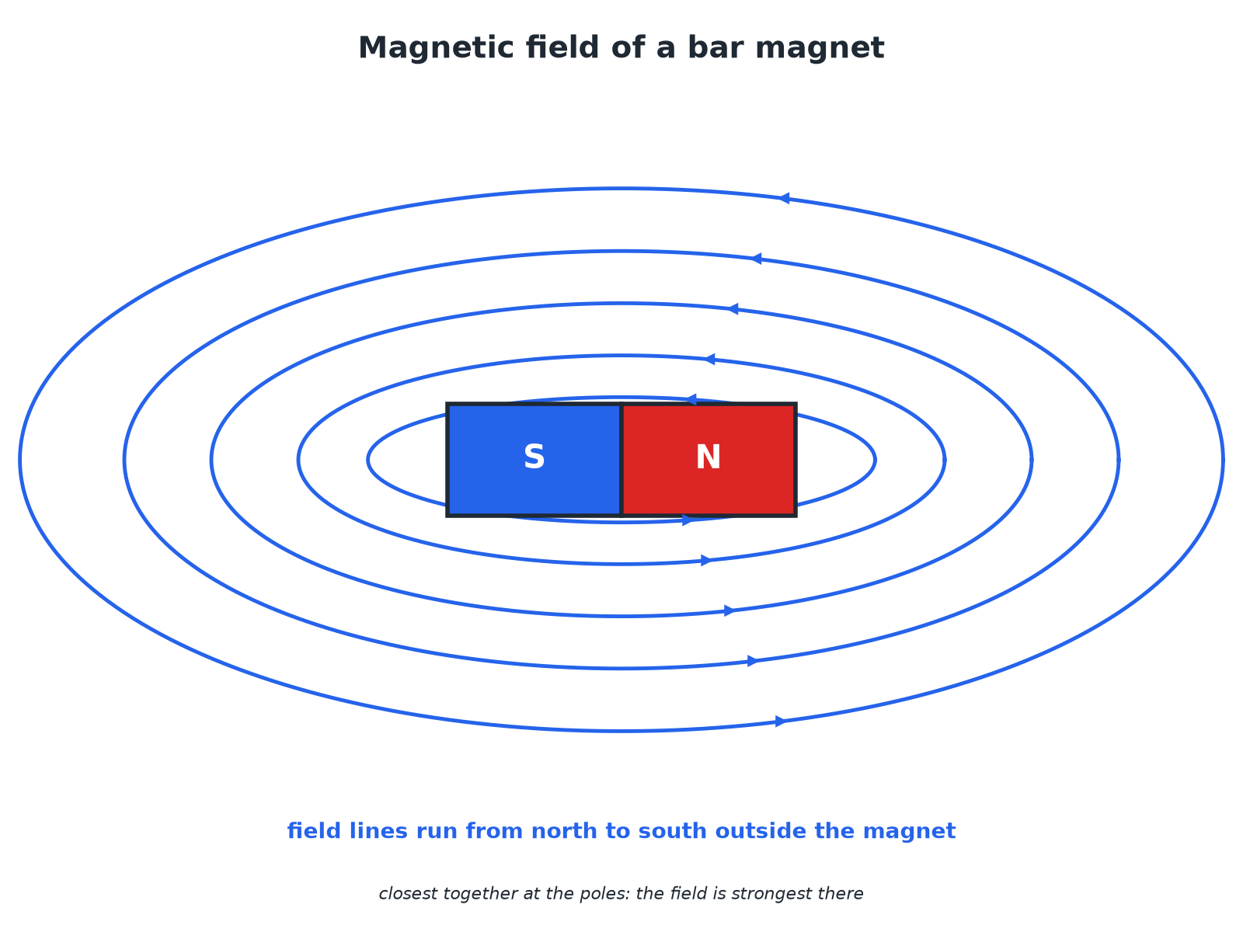

AQA GCSE PHYSICS · PAPER 2 · FOUNDATION & HIGHER
Magnetic Field of a Bar Magnet
Field lines are closest at the poles.
Magnetism and electromagnetism
openrevise.com
Lesson 1 of 8

Slide 7
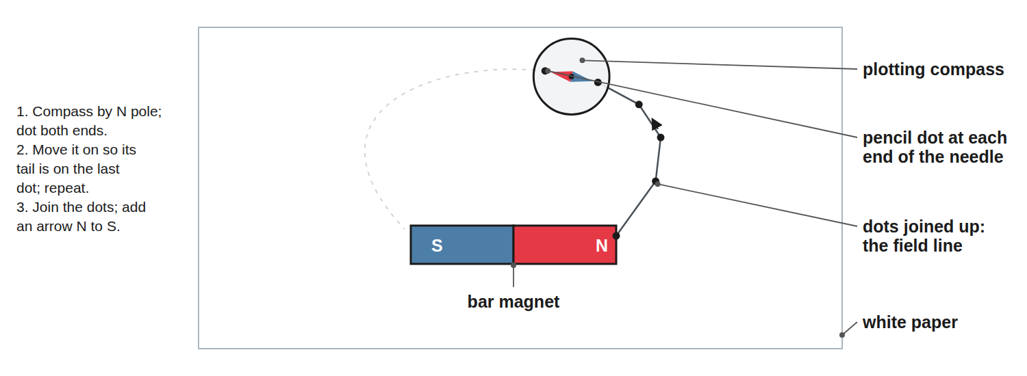
AQA GCSE PHYSICS · PAPER 2 · FOUNDATION & HIGHER
Plotting a Magnetic Field with a Compass
Mark each end of the needle, then move the compass.
Magnetism and electromagnetism
openrevise.com
Lesson 1 of 8

Slide 8

AQA GCSE PHYSICS · PAPER 2 · FOUNDATION & HIGHER
Permanent or Induced?
PERMANENT MAGNET
INDUCED MAGNET
• Always has its own magnetic field.
• Made of hard magnetic material.
• Can attract AND repel another magnet.
• Becomes a magnet only while in another magnetic field.
• Made of a magnetic material such as iron.
• Always ATTRACTED to the magnet; loses most magnetism when removed.
Magnetism and electromagnetism
openrevise.com
Lesson 1 of 8

Slide 9

AQA GCSE PHYSICS · PAPER 2 · FOUNDATION & HIGHER
Magnetic Forces
Learn the rules.
Situation
What happens
North and south poles near each other
Attract
Two north poles (or two south poles)
Repel
A magnet near an unmagnetised iron nail
Nail becomes an induced magnet and is attracted
Compass needle near a magnet
Needle lines up with the field
Magnetism and electromagnetism
openrevise.com
Lesson 1 of 8

Slide 10

AQA GCSE PHYSICS · PAPER 2 · FOUNDATION & HIGHER
Why a Compass Points North
Explain why the needle of a compass points towards the Earth's north.
The compass needle
A small bar magnet free to turn
1
The Earth
Has its own magnetic field, like a giant bar magnet
2
Result
The needle lines up with the Earth's field and points along it
3
ANSWER
The Earth has a magnetic field and the needle aligns with it.
Magnetism and electromagnetism
openrevise.com
Lesson 1 of 8

Slide 11

AQA GCSE PHYSICS · PAPER 2 · FOUNDATION & HIGHER
Key Points
Learn these.
Direction
Field lines run from north to south outside the magnet.
Strength
Stronger where the lines are closer together.
Distance
The field gets weaker as you move away.
Magnetic materials
Iron, steel, cobalt and nickel.
Magnetism and electromagnetism
openrevise.com
Lesson 1 of 8

Slide 12

AQA GCSE PHYSICS · PAPER 2 · FOUNDATION & HIGHER
Key Terms
Magnetic pole
The end of a magnet where the force is strongest.
Magnetic field
The region around a magnet where a force acts on another magnet or a magnetic material.
Permanent magnet
A magnet that always produces its own magnetic field.
Induced magnet
A material that becomes magnetic only when in a magnetic field.
Field line
A line showing the direction of the force on a north pole.
Compass
A small magnet that lines up with a magnetic field.
Magnetism and electromagnetism
openrevise.com
Lesson 1 of 8

Slide 13

AQA GCSE PHYSICS · PAPER 2 · FOUNDATION & HIGHER
YOUR TASK
10 minutes
Field Lines
Sketch the field lines between a north pole and a south pole facing each other, then between two north poles. Add arrows.
Lines leave N, enter S.
1
Lines never cross.
2
WHAT A GOOD ANSWER SHOWS
Between N and S: lines run from N to S across the gap. Between two N poles: lines curve away from each other and never join.
Magnetism and electromagnetism
openrevise.com
Lesson 1 of 8
Notes:
Ask learners to compare where the field is strongest.

Slide 14
AQA GCSE PHYSICS · PAPER 2 · FOUNDATION & HIGHER
Can I...?
State the rules for poles.
Put arrows on field lines.
Describe permanent and induced magnets.
Describe a compass.
Name magnetic materials.
Explain the Earth's field.
Draw a bar magnet field.
Describe plotting a field.
Magnetism and electromagnetism
openrevise.com
Lesson 1 of 8

Slide 15
AQA GCSE PHYSICS · PAPER 2 · FOUNDATION & HIGHER
Summary & Exam Focus
Like poles repel, unlike poles attract.
Field lines run north to south.
Induced magnets are always attracted.
A compass shows the Earth has a magnetic field.
EXAM FOCUS
Explain why an iron nail is attracted to a magnet. (2 marks)
The nail becomes an induced magnet.
openrevise.com

Slide 16
AQA GCSE PHYSICS · PAPER 2 · FOUNDATION & HIGHER
Exam Practice: Poles and magnetic fields
Answer all questions. Use the mark allocation as a guide to how much to write. · 14 minutes
Question 1 · 2 marks · State
State what happens when (a) two north poles are brought together and (b) a north pole and a south pole are brought together.
Question 2 · 2 marks · Describe
What is the difference between a permanent magnet and an induced magnet?
Question 3 · 3 marks · Explain
A student brings one end of a bar of iron near a magnet. The iron is attracted. Explain why the iron is always attracted and never repelled.
Magnetism and electromagnetism
openrevise.com
Lesson 1 of 8

Slide 17
AQA GCSE PHYSICS · PAPER 2 · FOUNDATION & HIGHER
Exam Practice: Poles and magnetic fields (cont.)
Question 4 · 4 marks · Describe
Describe how you would use a plotting compass to plot the magnetic field of a bar magnet.
Question 5 · 2 marks · Explain
A compass needle points north. Explain what this tells you about the Earth.
Magnetism and electromagnetism
openrevise.com
Lesson 1 of 8

Slide 18
AQA GCSE PHYSICS · PAPER 2 · FOUNDATION & HIGHER
Question 1 · 2 marks · State
“
State what happens when (a) two north poles are brought together and (b) a north pole and a south pole are brought together.
HOW TO ANSWER IT
Command word: State. Worth 2 marks, so plan before writing.
Magnetism and electromagnetism
openrevise.com
Lesson 1 of 8

Slide 19
AQA GCSE PHYSICS · PAPER 2 · FOUNDATION & HIGHER
Question 1 · mark scheme
2 marks available. Award a mark for each point made.
Repel
1 mark
Attract
1 mark
Magnetism and electromagnetism
openrevise.com
Lesson 1 of 8

Slide 20
AQA GCSE PHYSICS · PAPER 2 · FOUNDATION & HIGHER
Question 2 · 2 marks · Describe
“
What is the difference between a permanent magnet and an induced magnet?
HOW TO ANSWER IT
Command word: Describe. Worth 2 marks, so plan before writing.
Magnetism and electromagnetism
openrevise.com
Lesson 1 of 8

Slide 21
AQA GCSE PHYSICS · PAPER 2 · FOUNDATION & HIGHER
Question 2 · mark scheme
2 marks available. Award a mark for each point made.
Permanent: always magnetic
1 mark
Induced: only magnetic in a field
1 mark
Magnetism and electromagnetism
openrevise.com
Lesson 1 of 8

Slide 22
AQA GCSE PHYSICS · PAPER 2 · FOUNDATION & HIGHER
Question 3 · 3 marks · Explain
“
A student brings one end of a bar of iron near a magnet. The iron is attracted. Explain why the iron is always attracted and never repelled.
HOW TO ANSWER IT
Command word: Explain. Worth 3 marks, so plan before writing.
Magnetism and electromagnetism
openrevise.com
Lesson 1 of 8

Slide 23
AQA GCSE PHYSICS · PAPER 2 · FOUNDATION & HIGHER
Question 3 · mark scheme
3 marks available. Award a mark for each point made.
Iron becomes an induced magnet
1 mark
Nearest end is the opposite pole
1 mark
Unlike poles attract
1 mark
Magnetism and electromagnetism
openrevise.com
Lesson 1 of 8

Slide 24
AQA GCSE PHYSICS · PAPER 2 · FOUNDATION & HIGHER
Question 4 · 4 marks · Describe
“
Describe how you would use a plotting compass to plot the magnetic field of a bar magnet.
HOW TO ANSWER IT
Command word: Describe. Worth 4 marks, so plan before writing.
Magnetism and electromagnetism
openrevise.com
Lesson 1 of 8

Slide 25
AQA GCSE PHYSICS · PAPER 2 · FOUNDATION & HIGHER
Question 4 · mark scheme
4 marks available. Award a mark for each point made.
Magnet on paper, compass near a pole
1 mark
Mark both ends of the needle
1 mark
Move compass along and repeat; join the dots
1 mark
Repeat from other starting points and add arrows from north to south
1 mark
Magnetism and electromagnetism
openrevise.com
Lesson 1 of 8

Slide 26
AQA GCSE PHYSICS · PAPER 2 · FOUNDATION & HIGHER
Question 5 · 2 marks · Explain
“
A compass needle points north. Explain what this tells you about the Earth.
HOW TO ANSWER IT
Command word: Explain. Worth 2 marks, so plan before writing.
Magnetism and electromagnetism
openrevise.com
Lesson 1 of 8

Slide 27
AQA GCSE PHYSICS · PAPER 2 · FOUNDATION & HIGHER
Question 5 · mark scheme
2 marks available. Award a mark for each point made.
Needle lines up with a magnetic field
1 mark
The Earth has a magnetic field
1 mark
Magnetism and electromagnetism
openrevise.com
Lesson 1 of 8

