Slide 1

EDEXCEL GCSE BUSINESS · PAPER 2
Business growth
Growing the business
Lesson 1 of 4
openrevise.com

Slide 2

EDEXCEL GCSE BUSINESS · PAPER 2
From Topic 1
Answer from memory before the answers appear.
What is limited liability?
1
Who owns a private limited company?
2
Name two long-term sources of finance.
3
What is market share?
4
Growing the business
openrevise.com
Lesson 1 of 4

Slide 3
EDEXCEL GCSE BUSINESS · PAPER 2
From Topic 1 - Answers
What is limited liability?
The owners can only lose the money they invested in the business.
1
Who owns a private limited company?
Shareholders, whose shares cannot be sold to the general public.
2
Name two long-term sources of finance.
Any two of: personal savings, loans, share capital, venture capital, retained profit, crowdfunding.
3
What is market share?
The percentage of total sales in a market made by one business.
4
Growing the business
openrevise.com
Lesson 1 of 4

Slide 4

EDEXCEL GCSE BUSINESS · PAPER 2
Learning Objectives
Explain organic growth through new products and new markets.
1
Explain external growth through mergers and takeovers.
2
Explain the features, advantages and disadvantages of a public limited company.
3
Explain the internal and external sources of finance for a growing business.
4
Growing the business
openrevise.com
Lesson 1 of 4

Slide 5

EDEXCEL GCSE BUSINESS · PAPER 2
Why Do Businesses Grow?
Most business owners want their business to get bigger.
More profit
Selling more usually means more profit for the owners.
Economies of scale
Bigger businesses can buy in bulk and spread their costs, so the cost of making each product falls.
Market share and power
A larger business has more influence over prices and suppliers, and is harder for competitors to push out.
Survival
A bigger business with several products or markets is less likely to fail if one of them struggles.
Growing the business
openrevise.com
Lesson 1 of 4

Slide 6

EDEXCEL GCSE BUSINESS · PAPER 2
PART ONE
Organic Growth
Growing from within, using the business's own resources.
openrevise.com

Slide 7

EDEXCEL GCSE BUSINESS · PAPER 2
Organic (Internal) Growth
Organic growth is when a business grows by expanding its own activities.
New products
Developing new products through innovation and research and development (R&D).
New markets: changing place
Selling in new locations - opening new branches, selling online or selling abroad.
New markets: changing target market
Selling existing products to new customers, such as a different age group.
The pace
Organic growth is usually slow, but the business keeps control and grows at a speed it can manage.
Growing the business
openrevise.com
Lesson 1 of 4

Slide 8

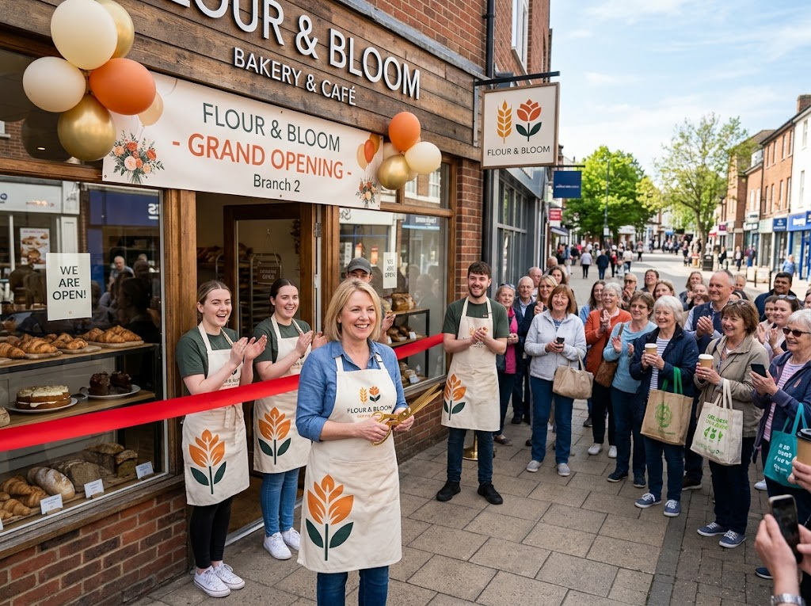
EDEXCEL GCSE BUSINESS · PAPER 2
Growing Branch by Branch
Opening a second branch is one of the commonest ways to grow organically. The business uses what it already knows works - its products, brand and methods - and takes them to new customers in a new place.
Opening a new branch: organic growth into a new location.
Growing the business
openrevise.com
Lesson 1 of 4

Slide 9

EDEXCEL GCSE BUSINESS · PAPER 2
Organic Growth: For and Against
ADVANTAGES
DISADVANTAGES
• Lower risk: the business grows using what it already knows.
• The owners keep control.
• Can be paid for from retained profit, so less borrowing.
• The business culture and quality stay the same.
• Slow: it can take years to grow significantly.
• Competitors may grow faster by taking over other businesses.
• Limited by how much profit the business makes.
• New products and markets still carry risk.
Growing the business
openrevise.com
Lesson 1 of 4

Slide 10
EDEXCEL GCSE BUSINESS · PAPER 2
PART TWO
External Growth
Growing by joining with other businesses.
openrevise.com

Slide 11

EDEXCEL GCSE BUSINESS · PAPER 2
Mergers and Takeovers
External (inorganic) growth is when a business grows by joining with another business.
Merger
Two businesses agree to join together to form one new, larger business.
Takeover
One business buys enough shares in another to gain control of it. A takeover can be friendly or hostile.
Why grow this way
It is fast: the business instantly gains new customers, products, staff, skills and market share.
Removing competition
Taking over a rival reduces competition in the market.
Growing the business
openrevise.com
Lesson 1 of 4

Slide 12
EDEXCEL GCSE BUSINESS · PAPER 2
External Growth: For and Against
ADVANTAGES
DISADVANTAGES
• Fast: growth happens almost overnight.
• Instantly gains market share and customers.
• Removes or reduces competition.
• Gains new products, skills and technology.
• Bigger economies of scale.
• Expensive: buying another business costs a lot.
• The two businesses' cultures may clash.
• Staff may lose their jobs, lowering morale.
• Customers may dislike the change.
• Harder to manage a much bigger business.
Growing the business
openrevise.com
Lesson 1 of 4

Slide 13
EDEXCEL GCSE BUSINESS · PAPER 2
PART THREE
Public Limited Companies
A common next step for a growing business.
openrevise.com

Slide 14

EDEXCEL GCSE BUSINESS · PAPER 2
Public Limited Company (PLC)
A public limited company can sell its shares to the general public, usually on the stock market.
Stock market flotation
When a company first sells its shares to the public on the stock market, it "floats".
Limited liability
Like a private limited company, shareholders can only lose what they invested.
Advantages
Can raise very large sums by selling shares; higher profile; easier to borrow from banks.
Disadvantages
Expensive to set up; the original owners lose control, as anyone can buy shares; accounts are published in detail; risk of being taken over.
Growing the business
openrevise.com
Lesson 1 of 4

Slide 15

EDEXCEL GCSE BUSINESS · PAPER 2
Private or Public Limited Company?
Feature
Private limited (Ltd)
Public limited (PLC)
Shares sold to
Chosen people, often family and friends
The general public, on the stock market
Size of finance
Limited to what owners and investors can put in
Very large sums can be raised
Control
Owners keep control
Owners can lose control to new shareholders
Takeover risk
Low
Higher: anyone can buy shares
Liability
Limited
Limited
Growing the business
openrevise.com
Lesson 1 of 4

Slide 16
EDEXCEL GCSE BUSINESS · PAPER 2
PART FOUR
Finance for Growth
Where a growing business finds the money.
openrevise.com

Slide 17
EDEXCEL GCSE BUSINESS · PAPER 2
Sources of Finance for Growth
Retained profit (internal)
Profit kept in the business. No interest or loss of control, but may not be enough for major growth.
Selling assets (internal)
Selling property, machinery or vehicles the business no longer needs. Quick, but the assets are gone for good.
Loan capital (external)
Large loans from banks, repaid with interest. Owners keep control, but interest adds to costs.
Share capital (external)
Selling new shares, including a stock market flotation. Can raise huge sums, but owners share control and profit.
Growing the business
openrevise.com
Lesson 1 of 4

Slide 18
EDEXCEL GCSE BUSINESS · PAPER 2
CASE STUDY
Dr. Martens: Floating on the Stock Market
Dr. Martens, the boot maker, began making its famous boots in Northamptonshire in 1960. As the brand grew worldwide, it became a public limited company, floating on the London Stock Exchange in January 2021. Selling shares to the public let its private owners sell part of their stake and made the business one of the best-known companies on the stock market - but it also meant its performance was now watched, and judged, by thousands of shareholders.
1960
2021
The first Dr. Martens boots made in the UK
Dr. Martens floats on the London Stock Exchange
Growing the business
openrevise.com
Lesson 1 of 4

Slide 19

EDEXCEL GCSE BUSINESS · PAPER 2
Key Terms
Organic growth
Growth from within, by expanding the business's own activities.
External growth
Growth by joining with another business, through a merger or takeover.
Merger
When two businesses agree to join together to form one business.
Takeover
When one business buys control of another.
Innovation
Turning new ideas into new products or processes.
Research and development (R&D)
Investigating and developing new products and processes.
Growing the business
openrevise.com
Lesson 1 of 4

Slide 20
EDEXCEL GCSE BUSINESS · PAPER 2
Key Terms (cont.)
Public limited company (PLC)
A company whose shares can be sold to the general public.
Stock market flotation
When a company first sells its shares to the public on the stock market.
Economies of scale
The fall in cost per unit as a business grows.
Growing the business
openrevise.com
Lesson 1 of 4

Slide 21

EDEXCEL GCSE BUSINESS · PAPER 2
YOUR TASK
12 minutes
Grow or Buy?
A successful chain of three gyms wants to double in size. Option A: open three new gyms over the next four years. Option B: take over a rival chain of three gyms now. For each option, give two advantages and two disadvantages, then recommend one.
1
Two advantages and two disadvantages of Option A.
2
Two advantages and two disadvantages of Option B.
3
Recommend one, and explain why.
WHAT A GOOD ANSWER SHOWS
Two advantages and two disadvantages for organic and external growth, applied to gyms, with a justified recommendation.
Growing the business
openrevise.com
Lesson 1 of 4
Notes:
Push for context: staff at a taken-over gym might leave, and members may not like a new brand.

Slide 22

EDEXCEL GCSE BUSINESS · PAPER 2
Can I...?
Explain why businesses grow.
Compare organic and external growth.
Explain organic growth through new products.
Explain the features of a PLC.
Explain organic growth through new markets.
Explain internal sources of finance for growth.
Explain mergers and takeovers.
Explain external sources of finance for growth.
Growing the business
openrevise.com
Lesson 1 of 4

Slide 23
EDEXCEL GCSE BUSINESS · PAPER 2
Summary & Exam Focus
Organic growth: new products (innovation, R&D) and new markets (new places or target markets).
External growth: mergers and takeovers - fast but expensive and risky.
A PLC can raise large sums by selling shares to the public, but the owners may lose control.
Growth can be financed internally (retained profit, selling assets) or externally (loans, share capital).
EXAM FOCUS
Explain one disadvantage to a business of growing through a takeover. (3 marks)
Use the business in the question - a takeover of a local rival means different risks from buying a supplier abroad.
openrevise.com

Slide 24
EDEXCEL GCSE BUSINESS · PAPER 2
Exam Practice: Business Growth
Answer all questions. Use the context of the business in the question where one is given. · 20 minutes
Question 1 · 1 mark · Define
Define the term 'organic growth'.
Question 2 · 2 marks · Outline
Outline one benefit to a business of becoming a public limited company.
Question 3 · 3 marks · Explain
Explain one disadvantage to a business of growing through a takeover.
Question 4 · 9 marks · Justify
Justify which one of these two options GreenLeaf Ltd should choose.
Growing the business
openrevise.com
Lesson 1 of 4

Slide 25
EDEXCEL GCSE BUSINESS · PAPER 2
Question 1 · 1 mark · Define
“
Define the term 'organic growth'.
HOW TO ANSWER IT
Command word: Define. Worth 1 mark, so plan before writing.
Growing the business
openrevise.com
Lesson 1 of 4

Slide 26
EDEXCEL GCSE BUSINESS · PAPER 2
Question 1 · mark scheme
1 mark available. Award a mark for each point made.
Growth from within / using the business's own resources
1 mark
Growing the business
openrevise.com
Lesson 1 of 4

Slide 27
EDEXCEL GCSE BUSINESS · PAPER 2
Question 2 · 2 marks · Outline
“
Outline one benefit to a business of becoming a public limited company.
HOW TO ANSWER IT
Command word: Outline. Worth 2 marks, so plan before writing.
Growing the business
openrevise.com
Lesson 1 of 4

Slide 28
EDEXCEL GCSE BUSINESS · PAPER 2
Question 2 · mark scheme
2 marks available. Award a mark for each point made.
A benefit identified, e.g. raise large sums / higher profile / easier to borrow
1 mark
Developed: how this helps the business
1 mark
Growing the business
openrevise.com
Lesson 1 of 4

Slide 29
EDEXCEL GCSE BUSINESS · PAPER 2
Question 3 · 3 marks · Explain
“
Explain one disadvantage to a business of growing through a takeover.
HOW TO ANSWER IT
Command word: Explain. Worth 3 marks, so plan before writing.
Growing the business
openrevise.com
Lesson 1 of 4

Slide 30
EDEXCEL GCSE BUSINESS · PAPER 2
Question 3 · mark scheme
3 marks available. Award a mark for each point made.
A disadvantage identified, e.g. cost / culture clash / job losses / harder to manage
1 mark
First linked point of explanation
1 mark
Second linked point of explanation
1 mark
Growing the business
openrevise.com
Lesson 1 of 4

Slide 31
EDEXCEL GCSE BUSINESS · PAPER 2
Question 4 · 9 marks · Justify
“
Justify which one of these two options GreenLeaf Ltd should choose.
— GreenLeaf Ltd makes plant-based ready meals sold in UK supermarkets. Its sales have grown by 20% a year for five years. It wants to grow faster. Option 1: Develop a new range of…
HOW TO ANSWER IT
Command word: Justify. Worth 9 marks, so plan before writing.
Growing the business
openrevise.com
Lesson 1 of 4

Slide 32
EDEXCEL GCSE BUSINESS · PAPER 2
Question 4 · mark scheme
9 marks available. Award a mark for each point made.
AO2 (Application, 3 marks): uses the context - plant-based meals, 20% growth, R&D team, the rival's supermarket contracts
Level 1-3
AO3a (Analysis, 3 marks): chains of reasoning about each option
Level 1-3
AO3b (Evaluation, 3 marks): a justified choice with a supported judgement
Level 1-3
Growing the business
openrevise.com
Lesson 1 of 4

