Slide 1

EDEXCEL GCSE BUSINESS · PAPER 2
Business and globalisation
Growing the business
Lesson 3 of 4
openrevise.com

Slide 2

EDEXCEL GCSE BUSINESS · PAPER 2
Last Lesson
Answer from memory before the answers appear.
Give two reasons why business objectives change.
1
What does exiting a market mean?
2
What is profit maximisation?
3
From Topic 1: what does SPICED mean?
4
Growing the business
openrevise.com
Lesson 3 of 4

Slide 3
EDEXCEL GCSE BUSINESS · PAPER 2
Last Lesson - Answers
Give two reasons why business objectives change.
Any two of: market conditions, technology, performance, legislation, internal reasons.
1
What does exiting a market mean?
Stopping selling in a location or segment.
2
What is profit maximisation?
Aiming to make as much profit as possible.
3
From Topic 1: what does SPICED mean?
Strong Pound, Imports Cheap, Exports Dear.
4
Growing the business
openrevise.com
Lesson 3 of 4

Slide 4

EDEXCEL GCSE BUSINESS · PAPER 2
Learning Objectives
Explain what globalisation is.
1
Explain imports and exports and their impact on businesses.
2
Explain why businesses change location and what multinationals are.
3
Explain barriers to international trade: tariffs and trade blocs.
4
Explain how businesses compete internationally.
5
Growing the business
openrevise.com
Lesson 3 of 4

Slide 5

EDEXCEL GCSE BUSINESS · PAPER 2
What Is Globalisation?
Globalisation is the process by which the world's economies are becoming increasingly connected.
Trade
Goods and services are bought and sold between countries more than ever before.
Communication
The internet lets businesses sell and communicate worldwide instantly.
Transport
Container ships and air freight move goods around the world cheaply.
For businesses
Globalisation means new markets and cheaper supplies - but also new competition from around the world.
Growing the business
openrevise.com
Lesson 3 of 4

Slide 6

EDEXCEL GCSE BUSINESS · PAPER 2
PART ONE
Imports and Exports
Buying from abroad and selling abroad.
openrevise.com

Slide 7

EDEXCEL GCSE BUSINESS · PAPER 2
Imports and Exports
IMPORTS
EXPORTS
• Goods and services bought from other countries.
• Give businesses access to cheaper or better materials and products.
• Give customers more choice.
• But: UK businesses face competition from foreign imports.
• Goods and services sold to other countries.
• Give businesses access to much bigger markets.
• Can increase sales and allow growth.
• But: harder to understand foreign customers, and exchange rates add risk.
Growing the business
openrevise.com
Lesson 3 of 4

Slide 8

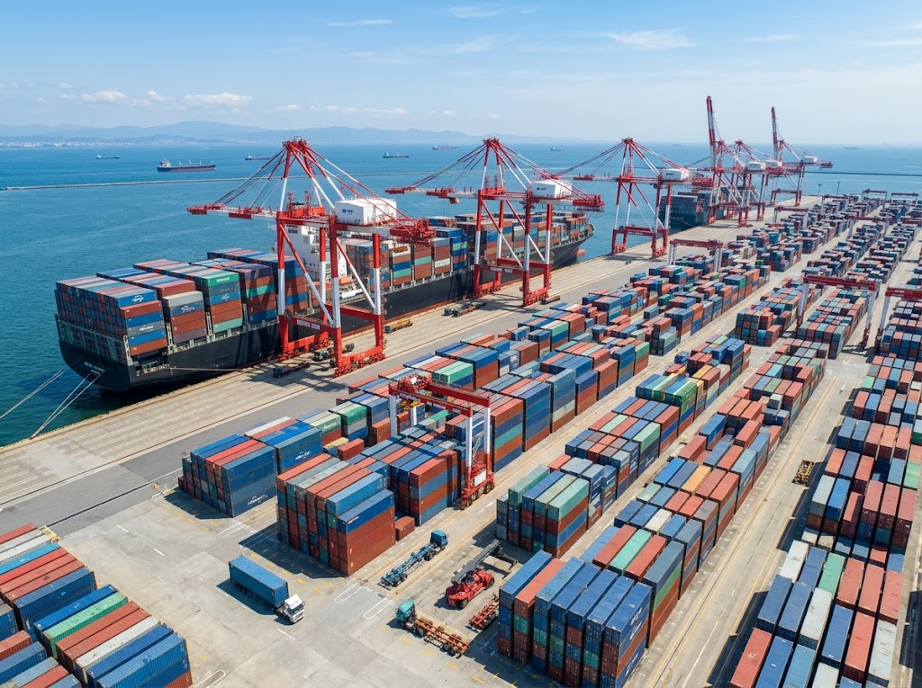
EDEXCEL GCSE BUSINESS · PAPER 2
The World's Goods on the Move
Most of the goods traded between countries travel in shipping containers. Cheap, reliable shipping means a UK shop can sell products made on the other side of the world - and a UK manufacturer can sell to customers on every continent.
Container ships carry most of the world's traded goods.
Growing the business
openrevise.com
Lesson 3 of 4

Slide 9
EDEXCEL GCSE BUSINESS · PAPER 2
PART TWO
Multinationals and Location
Businesses that operate in more than one country.
openrevise.com

Slide 10

EDEXCEL GCSE BUSINESS · PAPER 2
Changing Business Location
Globalisation lets businesses locate parts of their operations abroad.
Lower costs
Wages, rent and taxes may be much lower in other countries.
Closer to customers
Producing near a big overseas market cuts transport costs and time.
Access to materials and skills
Some countries have raw materials or skilled workers the business needs.
The downsides
Jobs lost in the home country, longer supply chains, language and cultural differences, and damage to reputation if working conditions are poor.
Growing the business
openrevise.com
Lesson 3 of 4

Slide 11
EDEXCEL GCSE BUSINESS · PAPER 2
Multinational Companies (MNCs)
A multinational company has its headquarters in one country and operates in several others.
Examples
Coca-Cola, Toyota, Unilever and McDonald's all make or sell products in many countries.
Benefits to MNCs
Huge markets, economies of scale, and the chance to locate each activity where it is cheapest.
Benefits to host countries
Jobs, investment, taxes and new skills and technology.
Drawbacks for host countries
Local businesses may struggle to compete, and profits may leave the country.
Growing the business
openrevise.com
Lesson 3 of 4

Slide 12
EDEXCEL GCSE BUSINESS · PAPER 2
PART THREE
Barriers to International Trade
Not all trade is free.
openrevise.com

Slide 13

EDEXCEL GCSE BUSINESS · PAPER 2
Tariffs and Trade Blocs
Governments can make international trade easier or harder.
Tariff
A tax on imported goods. It makes imports more expensive, protecting home businesses from foreign competition.
Impact of tariffs
A business importing materials pays more, raising its costs; a business exporting may sell less if other countries put tariffs on its goods.
Trade bloc
A group of countries that agree to trade freely with each other, with few or no tariffs between them, such as the European Union (EU).
Impact of trade blocs
Businesses inside the bloc trade easily with each other, but businesses outside may face tariffs and extra rules when selling into it.
Growing the business
openrevise.com
Lesson 3 of 4

Slide 14

EDEXCEL GCSE BUSINESS · PAPER 2
Competing Internationally
How businesses win customers in other countries.
Using the internet
E-commerce lets even a small business sell worldwide from its own website or online marketplaces.
Changing the marketing mix
Adapting the product, price, promotion and place for each country - different flavours, sizes, languages and prices.
Understanding local culture
Names, colours and adverts that work in one country may offend or confuse in another.
Keeping costs down
Competing with businesses in low-cost countries means being efficient or offering something they cannot.
Growing the business
openrevise.com
Lesson 3 of 4

Slide 15

EDEXCEL GCSE BUSINESS · PAPER 2
CASE STUDY
Dyson: Moving Production Abroad
James Dyson first made his vacuum cleaners in Malmesbury, Wiltshire. In 2002 Dyson moved most of its manufacturing to Malaysia, where costs were lower and it was closer to its suppliers and to fast-growing markets in Asia. Around 800 production jobs were lost in the UK, although Dyson kept its research and design in Britain. The move shows the trade-off of globalisation: lower costs and access to new markets, against job losses at home and criticism in the UK press.
2002
800
Dyson moves manufacturing to Malaysia
UK production jobs lost
Growing the business
openrevise.com
Lesson 3 of 4

Slide 16

EDEXCEL GCSE BUSINESS · PAPER 2
Key Terms
Globalisation
The process by which the world's economies are becoming increasingly connected.
Import
A good or service bought from another country.
Export
A good or service sold to another country.
Multinational company (MNC)
A business with its headquarters in one country that operates in several countries.
Tariff
A tax on imported goods.
Trade bloc
A group of countries that trade freely with each other, with few or no tariffs between them.
Free trade
Trade between countries without barriers such as tariffs.
Growing the business
openrevise.com
Lesson 3 of 4

Slide 17

EDEXCEL GCSE BUSINESS · PAPER 2
YOUR TASK
12 minutes
Going Global
A UK company makes premium dog food and wants to start selling in Japan and the USA. Suggest how it should adapt each part of its marketing mix for these markets, and identify one barrier to trade it might face.
1
Product changes.
2
Price changes.
3
Promotion changes.
Place changes.
4
WHAT A GOOD ANSWER SHOWS
A specific change to each of the 4Ps for an overseas market, plus a trade barrier such as a tariff or product rules.
5
One barrier to trade.
Growing the business
openrevise.com
Lesson 3 of 4
Notes:
Look for cultural awareness - pack sizes, languages on the label, local pet-food regulations.

Slide 18

EDEXCEL GCSE BUSINESS · PAPER 2
Can I...?
Explain what globalisation is.
Explain what a multinational is.
Explain imports and their impact.
Explain the impact of tariffs.
Explain exports and their impact.
Explain the impact of trade blocs.
Explain why businesses change location.
Explain how businesses compete internationally.
Growing the business
openrevise.com
Lesson 3 of 4

Slide 19
EDEXCEL GCSE BUSINESS · PAPER 2
Summary & Exam Focus
Globalisation connects the world's economies through trade, communication and transport.
Imports give cheaper supplies but more competition; exports give bigger markets but more risk.
Businesses move production abroad for lower costs and to be closer to markets; MNCs operate in many countries.
Tariffs and trade blocs affect the cost of trade; businesses compete internationally online and by adapting the marketing mix.
EXAM FOCUS
Explain one impact on a UK business of a tariff being placed on the materials it imports. (3 marks)
Tariffs raise the price of imports. Take the chain through to costs, prices, sales and profit.
openrevise.com

Slide 20
EDEXCEL GCSE BUSINESS · PAPER 2
Exam Practice: Business and Globalisation
Answer all questions. Use the context of the business in the question where one is given. · 20 minutes
Question 1 · 1 mark · Define
Define the term 'tariff'.
Question 2 · 2 marks · Outline
Outline one benefit to a business of exporting its products.
Question 3 · 3 marks · Explain
Explain one impact on a UK business of a tariff being placed on the materials it imports.
Question 4 · 9 marks · Justify
Justify which one of these two options Highland Knitwear Ltd should choose.
Growing the business
openrevise.com
Lesson 3 of 4

Slide 21
EDEXCEL GCSE BUSINESS · PAPER 2
Question 1 · 1 mark · Define
“
Define the term 'tariff'.
HOW TO ANSWER IT
Command word: Define. Worth 1 mark, so plan before writing.
Growing the business
openrevise.com
Lesson 3 of 4

Slide 22
EDEXCEL GCSE BUSINESS · PAPER 2
Question 1 · mark scheme
1 mark available. Award a mark for each point made.
A tax on imports
1 mark
Growing the business
openrevise.com
Lesson 3 of 4

Slide 23
EDEXCEL GCSE BUSINESS · PAPER 2
Question 2 · 2 marks · Outline
“
Outline one benefit to a business of exporting its products.
HOW TO ANSWER IT
Command word: Outline. Worth 2 marks, so plan before writing.
Growing the business
openrevise.com
Lesson 3 of 4

Slide 24
EDEXCEL GCSE BUSINESS · PAPER 2
Question 2 · mark scheme
2 marks available. Award a mark for each point made.
A benefit identified, e.g. bigger market / more sales / spread risk
1 mark
Developed
1 mark
Growing the business
openrevise.com
Lesson 3 of 4

Slide 25
EDEXCEL GCSE BUSINESS · PAPER 2
Question 3 · 3 marks · Explain
“
Explain one impact on a UK business of a tariff being placed on the materials it imports.
HOW TO ANSWER IT
Command word: Explain. Worth 3 marks, so plan before writing.
Growing the business
openrevise.com
Lesson 3 of 4

Slide 26
EDEXCEL GCSE BUSINESS · PAPER 2
Question 3 · mark scheme
3 marks available. Award a mark for each point made.
An impact identified, e.g. higher costs / higher prices / lower profit / switch suppliers
1 mark
First linked point of explanation
1 mark
Second linked point of explanation
1 mark
Growing the business
openrevise.com
Lesson 3 of 4

Slide 27
EDEXCEL GCSE BUSINESS · PAPER 2
Question 4 · 9 marks · Justify
“
Justify which one of these two options Highland Knitwear Ltd should choose.
— Highland Knitwear Ltd makes wool jumpers in Scotland. Its UK sales are falling. Option 1: Start exporting to Japan, where there is strong demand for Scottish wool, selling through…
HOW TO ANSWER IT
Command word: Justify. Worth 9 marks, so plan before writing.
Growing the business
openrevise.com
Lesson 3 of 4

Slide 28
EDEXCEL GCSE BUSINESS · PAPER 2
Question 4 · mark scheme
9 marks available. Award a mark for each point made.
AO2 (Application, 3 marks): uses the context - Scottish wool, Japan, the department store, Asian production
Level 1-3
AO3a (Analysis, 3 marks): chains of reasoning about each option
Level 1-3
AO3b (Evaluation, 3 marks): a justified choice with a supported judgement
Level 1-3
Growing the business
openrevise.com
Lesson 3 of 4

