Slide 1

EDEXCEL GCSE BUSINESS · PAPER 2
Product
Making marketing decisions
Lesson 1 of 5
openrevise.com

Slide 2

EDEXCEL GCSE BUSINESS · PAPER 2
From Topic 1
Answer from memory before the answers appear.
Name the four Ps of the marketing mix.
1
What is a unique selling point?
2
What is an integrated marketing mix?
3
Name two ways to add value.
4
Making marketing decisions
openrevise.com
Lesson 1 of 5

Slide 3
EDEXCEL GCSE BUSINESS · PAPER 2
From Topic 1 - Answers
Name the four Ps of the marketing mix.
Product, price, promotion and place.
1
What is a unique selling point?
A feature that makes a product different from all its competitors.
2
What is an integrated marketing mix?
One where the four Ps fit together for the target market.
3
Name two ways to add value.
Any two of: convenience, branding, quality, design, USP.
4
Making marketing decisions
openrevise.com
Lesson 1 of 5

Slide 4

EDEXCEL GCSE BUSINESS · PAPER 2
Learning Objectives
Explain the design mix: function, aesthetics and cost.
1
Explain the stages of the product life cycle.
2
Explain extension strategies.
3
Explain the importance of differentiating a product.
4
Making marketing decisions
openrevise.com
Lesson 1 of 5

Slide 5

EDEXCEL GCSE BUSINESS · PAPER 2
PART ONE
The Design Mix
Three things every product must balance.
openrevise.com

Slide 6

EDEXCEL GCSE BUSINESS · PAPER 2
The Design Mix
Function
How well the product works and does its job - its features, reliability and ease of use.
Aesthetics
How the product looks, feels, smells, sounds or tastes - its appeal to the senses.
Cost
How cheaply it can be made, so it can be sold at a price customers will pay and still make a profit.
Making marketing decisions
openrevise.com
Lesson 1 of 5

Slide 7

EDEXCEL GCSE BUSINESS · PAPER 2
Balancing the Design Mix
No product can be the best at everything, so businesses decide which element matters most.
Function first
Safety equipment and medical products must work perfectly, whatever they look like.
Aesthetics first
Fashion, jewellery and luxury goods sell mainly on how they look.
Cost first
Supermarket own-brand basics are designed to be as cheap as possible to make.
Target market
The balance depends on what the target customers value and are willing to pay for.
Making marketing decisions
openrevise.com
Lesson 1 of 5

Slide 8



EDEXCEL GCSE BUSINESS · PAPER 2
From Idea to Shelf
Design decides the balance of function, aesthetics and cost before a product is made.
Design: balancing how it works, looks and costs.
The finished product, ready to sell.
Making marketing decisions
openrevise.com
Lesson 1 of 5

Slide 9
EDEXCEL GCSE BUSINESS · PAPER 2
PART TWO
The Product Life Cycle
Every product's story, from launch to decline.
openrevise.com

Slide 10
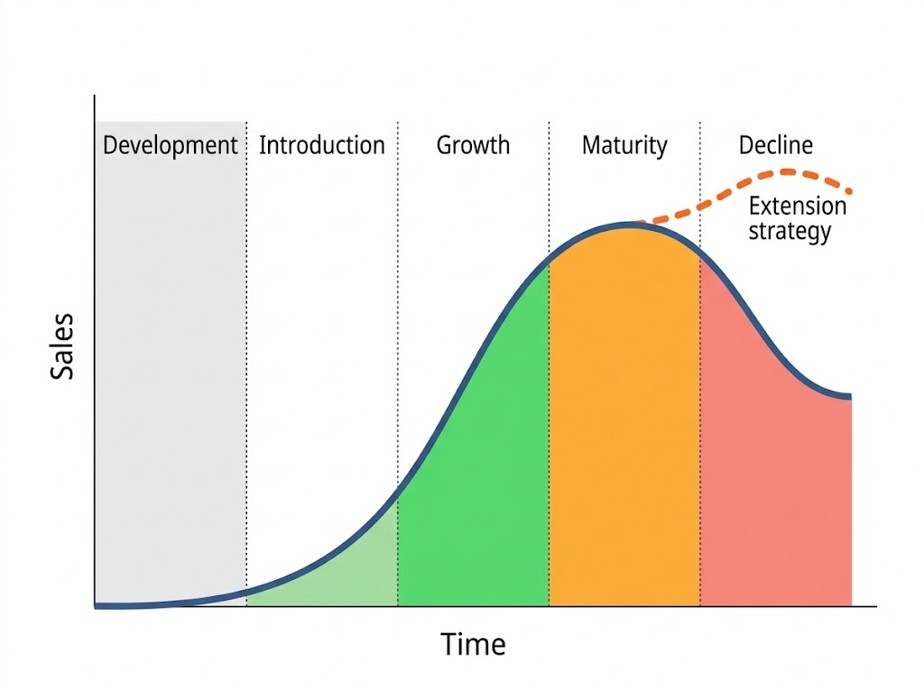
EDEXCEL GCSE BUSINESS · PAPER 2
The Product Life Cycle
The product life cycle shows how a product's sales change over time. Knowing which stage a product is in helps a business decide how to price and promote it - and when to try to extend its life.
Sales rise, peak and fall - unless an extension strategy lifts them again.
Making marketing decisions
openrevise.com
Lesson 1 of 5

Slide 11
EDEXCEL GCSE BUSINESS · PAPER 2
The Five Stages
Stage
Sales
Profit
What the business does
Development
None
Negative: R&D costs
Researches, designs and tests the product
Introduction
Low, rising slowly
Usually a loss
Heavy promotion to make customers aware
Growth
Rising fast
Profit begins
Increases distribution; competitors may appear
Maturity
At their peak, levelling off
Highest
Defends market share; considers extension strategies
Decline
Falling
Falling
Uses extension strategies or withdraws the product
Making marketing decisions
openrevise.com
Lesson 1 of 5

Slide 12

EDEXCEL GCSE BUSINESS · PAPER 2
Extension Strategies
An extension strategy is an action taken to make a product last longer before it declines.
New features
Adding improvements or new versions - new flavours, sizes or technology.
New markets
Selling to a new target market or in new countries.
Repackaging and rebranding
Giving the product a fresh look or a new image.
Advertising and price cuts
A new promotional campaign or a lower price to win back customers.
Making marketing decisions
openrevise.com
Lesson 1 of 5

Slide 13
EDEXCEL GCSE BUSINESS · PAPER 2
PART THREE
Differentiation
Standing out from the competition.
openrevise.com

Slide 14

EDEXCEL GCSE BUSINESS · PAPER 2
The Importance of Differentiation
Product differentiation means making a product different from competitors' products.
How
Through design, features, quality, branding, packaging or a unique selling point.
Why it matters
A differentiated product gives customers a reason to choose it over rivals.
Higher prices
Customers will often pay more for a product they see as better or unique.
Loyalty
A distinctive product and brand builds customer loyalty and repeat sales.
Making marketing decisions
openrevise.com
Lesson 1 of 5

Slide 15

EDEXCEL GCSE BUSINESS · PAPER 2
CASE STUDY
Lucozade: A Second Life
Lucozade was created in 1927 by a Newcastle chemist as a drink to give energy to people recovering from illness, and for decades it was sold in chemists wrapped in orange cellophane. By the late 1970s sales were falling, as the product had reached decline. In the 1980s its owners used an extension strategy: they repositioned Lucozade as an energy drink for sport, with new packaging and adverts featuring Olympic athlete Daley Thompson. The new target market - active young people - gave the product a whole new life.
1927
1980s
Lucozade created as a drink for the sick
Relaunched as a sports and energy drink
Making marketing decisions
openrevise.com
Lesson 1 of 5

Slide 16

EDEXCEL GCSE BUSINESS · PAPER 2
Key Terms
Design mix
The balance of function, aesthetics and cost in a product's design.
Function
How well a product works.
Aesthetics
How a product appeals to the senses.
Product life cycle
The stages a product goes through: development, introduction, growth, maturity and decline.
Extension strategy
An action taken to extend the life of a product before it declines.
Product differentiation
Making a product different from competitors' products.
Making marketing decisions
openrevise.com
Lesson 1 of 5

Slide 17

EDEXCEL GCSE BUSINESS · PAPER 2
YOUR TASK
12 minutes
Save the Product
A brand of fizzy orange drink has been sold for 30 years, and sales have been falling for three years. Identify which stage of the life cycle it is in, then suggest three different extension strategies and say which you would choose and why.
1
Identify the stage.
2
Suggest three extension strategies.
3
Choose one and justify it.
WHAT A GOOD ANSWER SHOWS
Decline identified, three distinct extension strategies (e.g. sugar-free version, new packaging, new market), and a justified choice.
Making marketing decisions
openrevise.com
Lesson 1 of 5

Slide 18

EDEXCEL GCSE BUSINESS · PAPER 2
Can I...?
Explain the design mix.
Describe sales and profit at each stage.
Explain how the design mix is balanced.
Explain extension strategies.
Name the five stages of the product life cycle.
Explain the importance of differentiation.
Making marketing decisions
openrevise.com
Lesson 1 of 5

Slide 19
EDEXCEL GCSE BUSINESS · PAPER 2
Summary & Exam Focus
The design mix balances function, aesthetics and cost.
The product life cycle: development, introduction, growth, maturity and decline.
Extension strategies: new features, new markets, repackaging, advertising and price cuts.
Differentiation gives customers a reason to choose the product over rivals.
EXAM FOCUS
Explain one extension strategy a business could use for a product in decline. (3 marks)
Name the strategy, explain how it attracts customers again, and link it to sales rising and the product lasting longer.
openrevise.com

