Slide 1

EDEXCEL GCSE BUSINESS · PAPER 2
Price
Making marketing decisions
Lesson 2 of 5
openrevise.com

Slide 2

EDEXCEL GCSE BUSINESS · PAPER 2
Last Lesson
Answer from memory before the answers appear.
Name the three parts of the design mix.
1
Name the five stages of the product life cycle.
2
Give one extension strategy.
3
What is product differentiation?
4
Making marketing decisions
openrevise.com
Lesson 2 of 5

Slide 3
EDEXCEL GCSE BUSINESS · PAPER 2
Last Lesson - Answers
Name the three parts of the design mix.
Function, aesthetics and cost.
1
Name the five stages of the product life cycle.
Development, introduction, growth, maturity and decline.
2
Give one extension strategy.
New features, new markets, repackaging, advertising or price cuts.
3
What is product differentiation?
Making a product different from competitors' products.
4
Making marketing decisions
openrevise.com
Lesson 2 of 5

Slide 4

EDEXCEL GCSE BUSINESS · PAPER 2
Learning Objectives
Explain the pricing strategies: penetration, skimming, cost-plus, competitive and promotional.
1
Calculate a price using cost-plus pricing.
2
Explain the factors that influence pricing: technology, competition, market segments and the product life cycle.
3
Making marketing decisions
openrevise.com
Lesson 2 of 5

Slide 5

EDEXCEL GCSE BUSINESS · PAPER 2
PART ONE
Pricing Strategies
Five ways to set a price.
openrevise.com

Slide 6

EDEXCEL GCSE BUSINESS · PAPER 2
Penetration Pricing
Setting a low price when a product is launched, to attract customers and gain market share quickly.
How it works
A low price persuades customers to try the product and switch from rivals. Once the product is established, the price rises.
Advantages
Quickly builds sales and market share; discourages competitors from entering.
Disadvantages
Low profit at first; customers may leave when the price rises.
Used for
New products entering competitive markets, such as streaming services and new snacks.
Making marketing decisions
openrevise.com
Lesson 2 of 5

Slide 7

EDEXCEL GCSE BUSINESS · PAPER 2
Price Skimming
Setting a high price when a product is launched, then lowering it over time.
How it works
Early adopters who want the product first will pay a high price. As demand from them falls, the price is cut to attract more customers.
Advantages
High profit on each early sale, helping recover development costs; creates a premium image.
Disadvantages
Low sales at first; high profits attract competitors.
Used for
New technology with a strong brand or a unique feature, such as new phones and games consoles.
Making marketing decisions
openrevise.com
Lesson 2 of 5

Slide 8

EDEXCEL GCSE BUSINESS · PAPER 2
Cost-plus Pricing
Adding a percentage mark-up to the cost of making the product.
How it works
Price = cost per unit + a percentage of that cost as profit.
Advantages
Simple, and ensures every sale covers its costs.
Disadvantages
Ignores what competitors charge and what customers will pay.
Used for
Businesses such as builders and manufacturers who need every job to cover its costs.
Making marketing decisions
openrevise.com
Lesson 2 of 5

Slide 9
EDEXCEL GCSE BUSINESS · PAPER 2
Calculating a Cost-plus Price
Find the mark-up, then add it to the cost.
A candle costs £8 to make. The business adds a 50% mark-up. Calculate the selling price.
Find the mark-up
50% of £8 = £8 × 0.5 = £4
1
Add it to the cost
£8 + £4 = £12
2
ANSWER
Selling price = £12
Making marketing decisions
openrevise.com
Lesson 2 of 5

Slide 10

EDEXCEL GCSE BUSINESS · PAPER 2
Competitive Pricing
Setting a price similar to competitors' prices.
How it works
The business looks at what rivals charge and sets a similar price, or just below.
Advantages
Avoids losing customers to cheaper rivals.
Disadvantages
Profit depends on costs being as low as competitors'; can lead to a price war.
Used for
Products that are very similar to rivals', such as petrol, bread and basic groceries.
Making marketing decisions
openrevise.com
Lesson 2 of 5

Slide 11

EDEXCEL GCSE BUSINESS · PAPER 2
Promotional Pricing
Temporarily reducing prices to boost sales.
How it works
Discounts, sales, "buy one get one free" and special offers for a limited time.
Advantages
Quickly boosts sales, clears old stock and attracts new customers.
Disadvantages
Lower profit per item; customers may wait for the next offer rather than pay full price.
Used for
Seasonal stock, new products and slow-selling lines.
Making marketing decisions
openrevise.com
Lesson 2 of 5

Slide 12

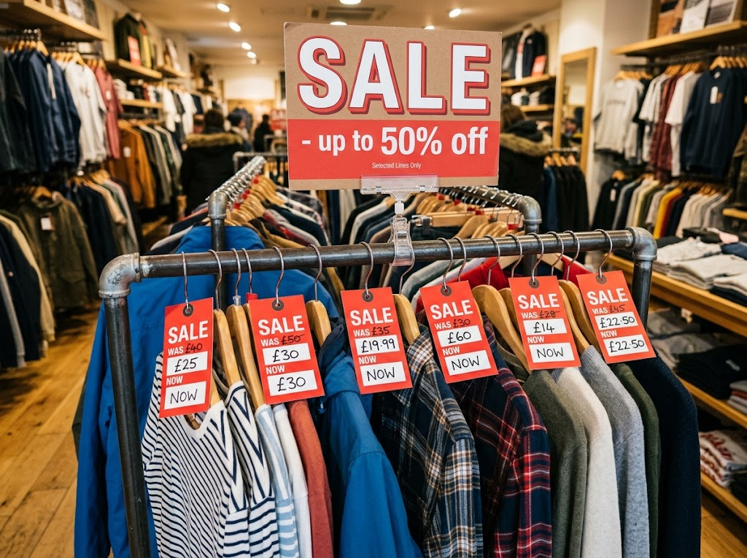
EDEXCEL GCSE BUSINESS · PAPER 2
Price as a Promotion
A sale is promotional pricing at its simplest: a temporary cut in price to bring customers in. It works - but a business that runs sales too often trains its customers never to pay full price.
Promotional pricing: a temporary price cut to boost sales and clear stock.
Making marketing decisions
openrevise.com
Lesson 2 of 5

Slide 13
EDEXCEL GCSE BUSINESS · PAPER 2
PART TWO
What Influences Pricing?
The factors behind the choice.
openrevise.com

Slide 14

EDEXCEL GCSE BUSINESS · PAPER 2
Influences on Pricing Strategies
Technology
Price comparison websites make customers more price-sensitive; new technology can cut costs, allowing lower prices.
Competition
In a competitive market prices must stay close to rivals'; with few competitors, prices can be higher.
Market segments
Different segments will pay different prices - students want low prices; luxury buyers accept high ones.
Product life cycle
Launch may use penetration or skimming; maturity uses competitive pricing; decline may use promotional pricing.
Making marketing decisions
openrevise.com
Lesson 2 of 5

Slide 15
EDEXCEL GCSE BUSINESS · PAPER 2
Which Strategy When?
Situation
Likely strategy
A new snack entering a crowded market
Penetration
A new, unique games console
Skimming
A builder quoting for a new kitchen
Cost-plus
A petrol station with rivals on the same road
Competitive
A shop clearing summer stock in September
Promotional
Making marketing decisions
openrevise.com
Lesson 2 of 5

Slide 16

EDEXCEL GCSE BUSINESS · PAPER 2
CASE STUDY
Apple: Skimming the New iPhone
Each year Apple launches new iPhone models at high prices. Loyal customers who want the latest technology are willing to pay, giving Apple a high profit on each early sale. When the next models arrive, Apple cuts the price of the older ones or keeps them on sale at a lower price, reaching customers who would not pay the launch price. Apple's strong brand and loyal customers make price skimming possible - a new business with an unknown brand could not do the same.
High
Lower
Launch prices for the newest models
Prices for older models once new ones arrive
Making marketing decisions
openrevise.com
Lesson 2 of 5

Slide 17

EDEXCEL GCSE BUSINESS · PAPER 2
Key Terms
Pricing strategy
The method a business uses to set the price of a product.
Penetration pricing
A low launch price to gain market share quickly.
Price skimming
A high launch price that is lowered over time.
Cost-plus pricing
Adding a percentage mark-up to the cost of a product.
Competitive pricing
Setting a price similar to competitors'.
Promotional pricing
Temporarily reducing prices to boost sales.
Mark-up
The percentage added to cost to set the price.
Making marketing decisions
openrevise.com
Lesson 2 of 5

Slide 18

EDEXCEL GCSE BUSINESS · PAPER 2
YOUR TASK
12 minutes
Price It
Recommend a pricing strategy for each product and justify it: a new energy drink from an unknown brand; the first ever folding smartphone from a famous brand; a local plumber's call-out charge; a supermarket's own-brand milk; last season's football shirts. Then calculate the price of a product costing £15 with a 40% mark-up.
1
Choose a strategy for each product.
2
Justify each choice.
3
Calculate the cost-plus price.
WHAT A GOOD ANSWER SHOWS
A suitable strategy for each with a reason linked to competition, brand, costs or life cycle stage; cost-plus price £21.
Making marketing decisions
openrevise.com
Lesson 2 of 5
Notes:
Skimming only works with a strong brand or a unique product - check they spot that for the folding phone.

Slide 19

EDEXCEL GCSE BUSINESS · PAPER 2
Can I...?
Explain penetration pricing.
Explain competitive pricing.
Explain price skimming.
Explain promotional pricing.
Explain cost-plus pricing.
Explain the influences on pricing.
Calculate a cost-plus price.
Making marketing decisions
openrevise.com
Lesson 2 of 5

Slide 20
EDEXCEL GCSE BUSINESS · PAPER 2
Summary & Exam Focus
Penetration: low launch price for market share. Skimming: high launch price, lowered later.
Cost-plus: cost + mark-up. Competitive: match rivals. Promotional: temporary discounts.
Influences: technology, competition, market segments and the product life cycle.
EXAM FOCUS
Explain one disadvantage of price skimming for a business launching a new product. (3 marks)
Strategy questions need context: say why the strategy suits (or does not suit) this product and this market.
openrevise.com

Slide 21
EDEXCEL GCSE BUSINESS · PAPER 2
Exam Practice: Price
Answer all questions. Show your working in calculations. · 20 minutes
Question 1 · 1 mark · Define
Define the term 'penetration pricing'.
Question 2 · 2 marks · Calculate
A business makes garden benches for £60 each and uses cost-plus pricing with a 35% mark-up. Calculate the selling price of a bench. You are…
Question 3 · 3 marks · Explain
Explain one disadvantage of price skimming for a business launching a new product.
Question 4 · 9 marks · Justify
Justify which one of these two options SnapFit Ltd should choose.
Making marketing decisions
openrevise.com
Lesson 2 of 5

Slide 22
EDEXCEL GCSE BUSINESS · PAPER 2
Question 1 · 1 mark · Define
“
Define the term 'penetration pricing'.
HOW TO ANSWER IT
Command word: Define. Worth 1 mark, so plan before writing.
Making marketing decisions
openrevise.com
Lesson 2 of 5

Slide 23
EDEXCEL GCSE BUSINESS · PAPER 2
Question 1 · mark scheme
1 mark available. Award a mark for each point made.
Low launch price / to gain market share
1 mark
Making marketing decisions
openrevise.com
Lesson 2 of 5

Slide 24
EDEXCEL GCSE BUSINESS · PAPER 2
Question 2 · 2 marks · Calculate
“
A business makes garden benches for £60 each and uses cost-plus pricing with a 35% mark-up. Calculate the selling price of a bench. You are advised to show your working.
HOW TO ANSWER IT
Command word: Calculate. Worth 2 marks, so plan before writing.
Making marketing decisions
openrevise.com
Lesson 2 of 5

Slide 25
EDEXCEL GCSE BUSINESS · PAPER 2
Question 2 · mark scheme
2 marks available. Award a mark for each point made.
Correct method: cost + (cost × 35%)
1 mark
Correct answer: £81
1 mark (award 2 marks for the correct answer with no working)
Making marketing decisions
openrevise.com
Lesson 2 of 5

Slide 26
EDEXCEL GCSE BUSINESS · PAPER 2
Question 3 · 3 marks · Explain
“
Explain one disadvantage of price skimming for a business launching a new product.
HOW TO ANSWER IT
Command word: Explain. Worth 3 marks, so plan before writing.
Making marketing decisions
openrevise.com
Lesson 2 of 5

Slide 27
EDEXCEL GCSE BUSINESS · PAPER 2
Question 3 · mark scheme
3 marks available. Award a mark for each point made.
A disadvantage identified, e.g. low sales / attracts competitors / needs strong brand
1 mark
First linked point of explanation
1 mark
Second linked point of explanation
1 mark
Making marketing decisions
openrevise.com
Lesson 2 of 5

Slide 28
EDEXCEL GCSE BUSINESS · PAPER 2
Question 4 · 9 marks · Justify
“
Justify which one of these two options SnapFit Ltd should choose.
— SnapFit Ltd has developed a new fitness tracker watch. It has a unique feature: it measures hydration levels, which no competitor can do. The market for fitness trackers is large…
HOW TO ANSWER IT
Command word: Justify. Worth 9 marks, so plan before writing.
Making marketing decisions
openrevise.com
Lesson 2 of 5

Slide 29
EDEXCEL GCSE BUSINESS · PAPER 2
Question 4 · mark scheme
9 marks available. Award a mark for each point made.
AO2 (Application, 3 marks): uses the context - the hydration feature, unknown brand, competitive market, £249 and £99
Level 1-3
AO3a (Analysis, 3 marks): chains of reasoning about each strategy
Level 1-3
AO3b (Evaluation, 3 marks): a justified choice with a supported judgement
Level 1-3
Making marketing decisions
openrevise.com
Lesson 2 of 5

