Slide 1

EDEXCEL GCSE BUSINESS · PAPER 2
Promotion
Making marketing decisions
Lesson 3 of 5
openrevise.com

Slide 2

EDEXCEL GCSE BUSINESS · PAPER 2
Last Lesson
Answer from memory before the answers appear.
What is penetration pricing?
1
What is price skimming?
2
How do you calculate a cost-plus price?
3
Give one influence on pricing.
4
Making marketing decisions
openrevise.com
Lesson 3 of 5

Slide 3
EDEXCEL GCSE BUSINESS · PAPER 2
Last Lesson - Answers
What is penetration pricing?
A low launch price to gain market share.
1
What is price skimming?
A high launch price, lowered over time.
2
How do you calculate a cost-plus price?
Cost + (cost × mark-up %).
3
Give one influence on pricing.
Technology, competition, market segments or the product life cycle.
4
Making marketing decisions
openrevise.com
Lesson 3 of 5

Slide 4

EDEXCEL GCSE BUSINESS · PAPER 2
Learning Objectives
Explain the main promotional methods: advertising, sponsorship, product trials, sales promotions, public relations and branding.
1
Explain how promotion is chosen to suit different market segments.
2
Explain how technology is used in promotion: targeted adverts, viral advertising, social media and e-newsletters.
3
Making marketing decisions
openrevise.com
Lesson 3 of 5

Slide 5

EDEXCEL GCSE BUSINESS · PAPER 2
PART ONE
Promotional Methods
The tools a business uses to tell customers about its products.
openrevise.com

Slide 6

EDEXCEL GCSE BUSINESS · PAPER 2
Promotional Methods
Advertising
Paid messages on TV, radio, cinema, billboards, in print or online. Reaches many people, but can be expensive.
Sponsorship
Paying to have the brand linked to an event, team or programme. Builds awareness and a positive image.
Product trials
Free samples or free trials, so customers can try before they buy.
Sales promotions
Short-term offers: discounts, "buy one get one free", competitions, vouchers and loyalty points.
Public relations (PR)
Getting positive coverage in the media without paying for it directly - press releases, events and launches.
Branding
Creating a recognisable name, logo and image that customers trust and remember.
Making marketing decisions
openrevise.com
Lesson 3 of 5

Slide 7

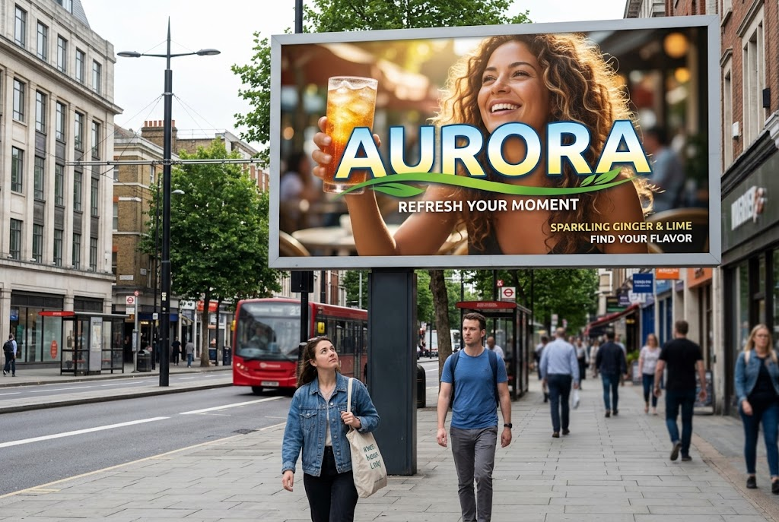
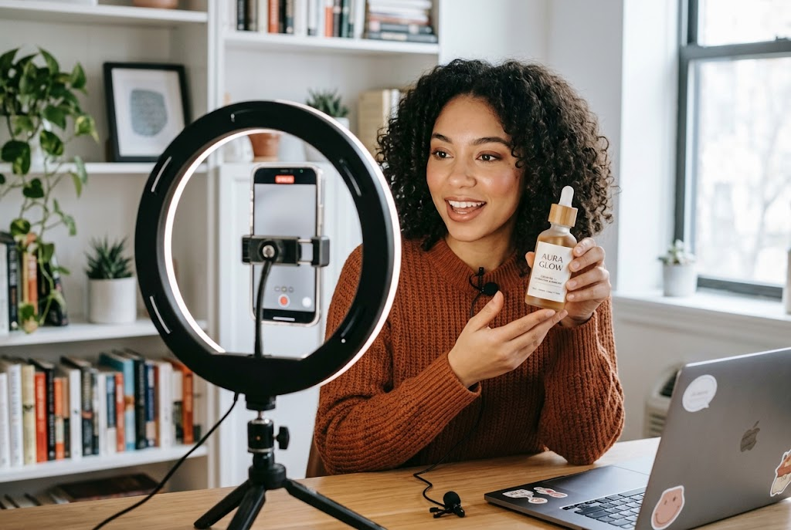
EDEXCEL GCSE BUSINESS · PAPER 2
Old Media and New
A billboard reaches everyone who passes; an influencer reaches exactly the right followers.
Traditional advertising: seen by everyone who passes.
Social media: aimed at exactly the right followers.
Making marketing decisions
openrevise.com
Lesson 3 of 5

Slide 8
EDEXCEL GCSE BUSINESS · PAPER 2
Promotion for Different Market Segments
The best promotion reaches the target customers where they are.
Teenagers and young adults
Social media, influencers and online video.
Older customers
TV, radio, newspapers and direct mail.
Local customers
Leaflets, local radio, local newspapers and community sponsorship.
Making marketing decisions
openrevise.com
Lesson 3 of 5

Slide 9
EDEXCEL GCSE BUSINESS · PAPER 2
Promotion for Different Market Segments (cont.)
Business customers
Trade magazines, exhibitions and email.
Budget
Large businesses can afford TV and national sponsorship; small ones rely on cheaper methods.
Making marketing decisions
openrevise.com
Lesson 3 of 5

Slide 10
EDEXCEL GCSE BUSINESS · PAPER 2
PART TWO
Technology and Promotion
How digital media has changed promotion.
openrevise.com

Slide 11

EDEXCEL GCSE BUSINESS · PAPER 2
Promotion Using Technology
Technology lets businesses target customers precisely and cheaply.
Targeted online advertising
Adverts shown only to people whose searches, location, age and interests match the target market.
Viral advertising
Content that customers share with each other on social media, spreading the message for free.
Social media
Posts, stories and videos that build a following and let customers engage with the brand.
E-newsletters
Emails sent to customers who have signed up, with news, offers and new products.
Making marketing decisions
openrevise.com
Lesson 3 of 5

Slide 12

EDEXCEL GCSE BUSINESS · PAPER 2
Traditional or Digital Promotion?
TRADITIONAL (TV, PRINT, BILLBOARDS)
DIGITAL (ONLINE, SOCIAL MEDIA, EMAIL)
• Reaches a very large audience.
• Builds trust and brand image.
• Very expensive, especially TV.
• Hard to measure exactly who saw it.
• Cannot be targeted precisely.
• Cheap, and suits small budgets.
• Targeted at exactly the right customers.
• Results can be measured - clicks, views and sales.
• Customers can share it, spreading it further.
• But: easy to ignore, and bad feedback spreads fast too.
Making marketing decisions
openrevise.com
Lesson 3 of 5

Slide 13

EDEXCEL GCSE BUSINESS · PAPER 2
CASE STUDY
John Lewis: The Christmas Advert
Since 2007 the department store John Lewis has launched a big-budget Christmas TV advert every November. The adverts - such as "The Long Wait" in 2011 and "The Man on the Moon" in 2015 - tell emotional stories and have become an event in their own right. They are shown on TV, but are also watched and shared millions of times online, reported in newspapers and discussed on social media. John Lewis combines traditional advertising, viral sharing and public relations in one campaign.
2007
Millions
John Lewis's first big Christmas advert
Online views and shares each year
Making marketing decisions
openrevise.com
Lesson 3 of 5

Slide 14

EDEXCEL GCSE BUSINESS · PAPER 2
Key Terms
Promotion
Communicating with customers to persuade them to buy.
Advertising
Paid-for communication through media such as TV, print, billboards and online.
Sponsorship
Paying to link a brand with an event, team or programme.
Sales promotion
A short-term offer to boost sales, such as a discount or free gift.
Public relations (PR)
Gaining positive media coverage without paying for it directly.
Branding
Giving a product a recognisable name, logo and image.
Making marketing decisions
openrevise.com
Lesson 3 of 5

Slide 15
EDEXCEL GCSE BUSINESS · PAPER 2
Key Terms (cont.)
Viral advertising
Promotion that spreads as customers share it online.
Targeted advertising
Online adverts shown only to people who match the target market.
Making marketing decisions
openrevise.com
Lesson 3 of 5

Slide 16

EDEXCEL GCSE BUSINESS · PAPER 2
YOUR TASK
15 minutes
Plan a Campaign
A new brand of protein bar aimed at 18-30-year-olds who go to the gym is launching with a £20,000 budget. Plan a promotional campaign using at least three methods, including one use of technology. Explain why each suits the target market and budget.
1
Choose three methods.
2
Include one digital method.
3
Explain why each suits the target market.
Keep within the budget.
4
WHAT A GOOD ANSWER SHOWS
Three or more methods matched to young gym-goers, with at least one digital method, and a sensible use of the budget - no £1 million TV campaign.
Making marketing decisions
openrevise.com
Lesson 3 of 5
Notes:
Push them to explain why each method reaches this segment specifically.

Slide 17

EDEXCEL GCSE BUSINESS · PAPER 2
Can I...?
Explain advertising.
Explain public relations.
Explain sponsorship.
Explain branding.
Explain product trials.
Match promotion to market segments.
Explain sales promotions.
Explain how technology is used in promotion.
Making marketing decisions
openrevise.com
Lesson 3 of 5

Slide 18
EDEXCEL GCSE BUSINESS · PAPER 2
Summary & Exam Focus
Methods: advertising, sponsorship, product trials, sales promotions, PR and branding.
The right method depends on the market segment and the budget.
Technology: targeted adverts, viral advertising, social media and e-newsletters.
Digital promotion is cheap, targeted and measurable.
EXAM FOCUS
Explain one benefit to a business of using social media to promote its products. (3 marks)
Always link the method to the target market: a promotion is only good if it reaches the right customers at a cost the business can afford.
openrevise.com

Slide 19
EDEXCEL GCSE BUSINESS · PAPER 2
Exam Practice: Promotion
Answer all questions. Use the context of the business in the question where one is given. · 20 minutes
Question 1 · 1 mark · Define
Define the term 'sponsorship'.
Question 2 · 2 marks · Outline
Outline one benefit to a business of using product trials.
Question 3 · 3 marks · Explain
Explain one benefit to a business of using social media to promote its products.
Question 4 · 9 marks · Justify
Justify which one of these two options Riverside Garden Centres Ltd should choose.
Making marketing decisions
openrevise.com
Lesson 3 of 5

Slide 20
EDEXCEL GCSE BUSINESS · PAPER 2
Question 1 · 1 mark · Define
“
Define the term 'sponsorship'.
HOW TO ANSWER IT
Command word: Define. Worth 1 mark, so plan before writing.
Making marketing decisions
openrevise.com
Lesson 3 of 5

Slide 21
EDEXCEL GCSE BUSINESS · PAPER 2
Question 1 · mark scheme
1 mark available. Award a mark for each point made.
Paying to be associated with an event / team / programme
1 mark
Making marketing decisions
openrevise.com
Lesson 3 of 5

Slide 22
EDEXCEL GCSE BUSINESS · PAPER 2
Question 2 · 2 marks · Outline
“
Outline one benefit to a business of using product trials.
HOW TO ANSWER IT
Command word: Outline. Worth 2 marks, so plan before writing.
Making marketing decisions
openrevise.com
Lesson 3 of 5

Slide 23
EDEXCEL GCSE BUSINESS · PAPER 2
Question 2 · mark scheme
2 marks available. Award a mark for each point made.
A benefit identified
1 mark
Developed
1 mark
Making marketing decisions
openrevise.com
Lesson 3 of 5

Slide 24
EDEXCEL GCSE BUSINESS · PAPER 2
Question 3 · 3 marks · Explain
“
Explain one benefit to a business of using social media to promote its products.
HOW TO ANSWER IT
Command word: Explain. Worth 3 marks, so plan before writing.
Making marketing decisions
openrevise.com
Lesson 3 of 5

Slide 25
EDEXCEL GCSE BUSINESS · PAPER 2
Question 3 · mark scheme
3 marks available. Award a mark for each point made.
A benefit identified, e.g. targeted / cheap / viral sharing / measurable
1 mark
First linked point of explanation
1 mark
Second linked point of explanation
1 mark
Making marketing decisions
openrevise.com
Lesson 3 of 5

Slide 26
EDEXCEL GCSE BUSINESS · PAPER 2
Question 4 · 9 marks · Justify
“
Justify which one of these two options Riverside Garden Centres Ltd should choose.
— Riverside Garden Centres Ltd has five garden centres in the south of England. Most of its customers are aged over 50. It has £50,000 to spend on promotion. Option 1: Sponsor a…
HOW TO ANSWER IT
Command word: Justify. Worth 9 marks, so plan before writing.
Making marketing decisions
openrevise.com
Lesson 3 of 5

Slide 27
EDEXCEL GCSE BUSINESS · PAPER 2
Question 4 · mark scheme
9 marks available. Award a mark for each point made.
AO2 (Application, 3 marks): uses the context - five centres, customers over 50, £50,000, the two options
Level 1-3
AO3a (Analysis, 3 marks): chains of reasoning about each option
Level 1-3
AO3b (Evaluation, 3 marks): a justified choice with a supported judgement
Level 1-3
Making marketing decisions
openrevise.com
Lesson 3 of 5

