Slide 1

EDEXCEL GCSE BUSINESS · PAPER 2
Place
Making marketing decisions
Lesson 4 of 5
openrevise.com

Slide 2

EDEXCEL GCSE BUSINESS · PAPER 2
Last Lesson
Answer from memory before the answers appear.
Name three promotional methods.
1
What is targeted advertising?
2
What is public relations?
3
How should promotion match a market segment?
4
Making marketing decisions
openrevise.com
Lesson 4 of 5

Slide 3
EDEXCEL GCSE BUSINESS · PAPER 2
Last Lesson - Answers
Name three promotional methods.
Any three of: advertising, sponsorship, product trials, sales promotions, PR, branding.
1
What is targeted advertising?
Online adverts shown only to people who match the target market.
2
What is public relations?
Gaining positive media coverage without paying for it directly.
3
How should promotion match a market segment?
Use methods and media the target customers actually see.
4
Making marketing decisions
openrevise.com
Lesson 4 of 5

Slide 4

EDEXCEL GCSE BUSINESS · PAPER 2
Learning Objectives
Explain distribution channels and the role of intermediaries.
1
Explain the role of retailers and e-tailers (e-commerce).
2
Explain multi-channel distribution.
3
Explain the advantages and disadvantages of each method of distribution.
4
Making marketing decisions
openrevise.com
Lesson 4 of 5

Slide 5

EDEXCEL GCSE BUSINESS · PAPER 2
What Is Place?
Place is about how and where customers can buy a product.
Distribution
The process of getting products from the producer to the customer.
Distribution channel
The route a product takes from producer to customer.
Intermediary
A business in the middle of the channel, such as a wholesaler or retailer.
Why it matters
Customers can only buy a product if it is available where and when they want it.
Making marketing decisions
openrevise.com
Lesson 4 of 5

Slide 6

EDEXCEL GCSE BUSINESS · PAPER 2
Distribution Channels
Channel
Route
Example
Direct
Producer to consumer
A farm shop, or a brand's own website
One intermediary
Producer to retailer to consumer
A clothing brand sold in department stores
Two intermediaries
Producer to wholesaler to retailer to consumer
Sweets sold to a wholesaler, then to corner shops
Making marketing decisions
openrevise.com
Lesson 4 of 5

Slide 7

EDEXCEL GCSE BUSINESS · PAPER 2
Intermediaries
Intermediaries sit between the producer and the customer.
Wholesaler
Buys large quantities from producers and sells smaller quantities to retailers. Breaks bulk, stores stock and delivers.
Retailer
Sells to the final customer, in shops or online.
Advantages
Producers reach many more customers and do not need their own shops.
Disadvantages
Each intermediary adds its own profit, raising the final price, and the producer has less control over how its product is sold.
Making marketing decisions
openrevise.com
Lesson 4 of 5

Slide 8

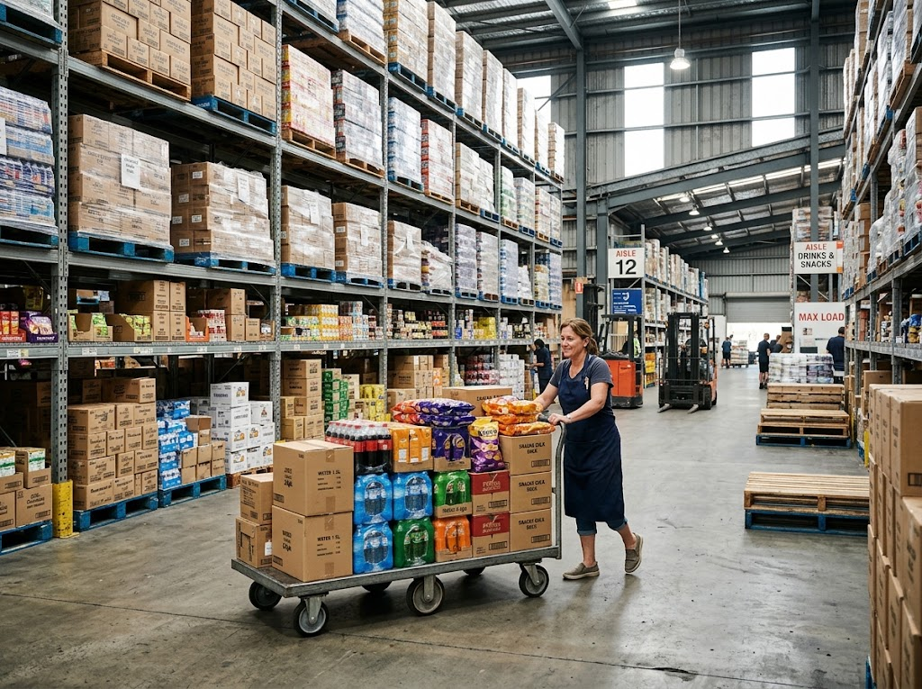
EDEXCEL GCSE BUSINESS · PAPER 2
Breaking Bulk
A corner shop could never order a lorry-load of crisps straight from the factory. A wholesaler buys in bulk from many producers and sells to small shops in the quantities they need - adding a margin for the service.
A wholesaler buys in bulk from producers and sells smaller amounts to shops.
Making marketing decisions
openrevise.com
Lesson 4 of 5

Slide 9

EDEXCEL GCSE BUSINESS · PAPER 2
PART ONE
Retailers and E-tailers
Shops, websites, or both.
openrevise.com

Slide 10

EDEXCEL GCSE BUSINESS · PAPER 2
Retailers or E-tailers?
RETAILERS (PHYSICAL SHOPS)
E-TAILERS (E-COMMERCE)
• Customers can see, touch and try products.
• Face-to-face service and advice.
• Customers take products home immediately.
• But: high costs of rent and staff.
• Limited to customers who can visit.
• Lower costs: no shop rent.
• Reach customers anywhere, 24 hours a day.
• Can offer a huge range.
• But: delivery costs and returns.
• Customers cannot try before buying.
Making marketing decisions
openrevise.com
Lesson 4 of 5

Slide 11
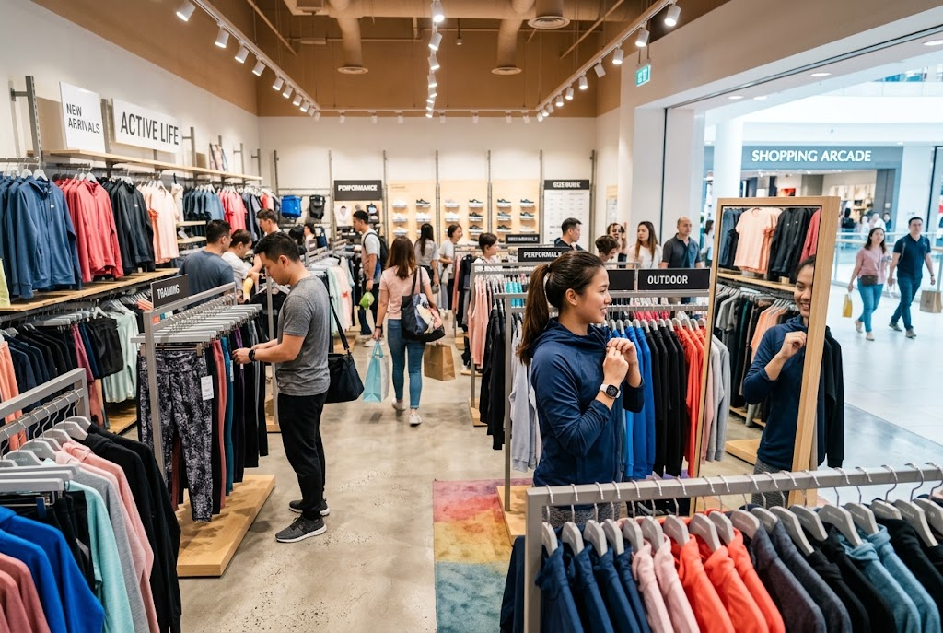
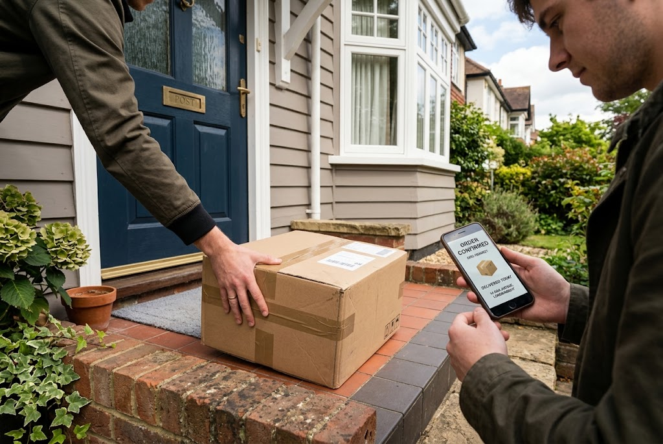
EDEXCEL GCSE BUSINESS · PAPER 2
Two Ways to Buy
The same product, bought in a shop or delivered to the door.
Retail: try it on, take it home today.
E-commerce: ordered online, delivered to the door.
Making marketing decisions
openrevise.com
Lesson 4 of 5

Slide 12

EDEXCEL GCSE BUSINESS · PAPER 2
Multi-channel Distribution
Multi-channel distribution means selling through more than one channel at once.
How it works
A business sells in its own shops, on its own website, through an app, on online marketplaces and through other retailers.
Click-and-collect
Customers order online and collect from a shop - combining the convenience of both.
Advantages
Reaches more customers, in the way each prefers to shop, so sales rise.
Disadvantages
More complex and expensive to manage; prices and stock must be consistent across every channel.
Making marketing decisions
openrevise.com
Lesson 4 of 5

Slide 13

EDEXCEL GCSE BUSINESS · PAPER 2
CASE STUDY
Gymshark: From Online to the High Street
Gymshark began in 2012 as a purely online business, selling gym clothing through its own website and promoting it on social media. For ten years it had no shops. In 2022 it opened its first permanent flagship store, on Regent Street in London, where customers could try on clothes, join workouts and meet the brand in person. By adding a physical store to its website, Gymshark moved to multi-channel distribution - reaching customers who want to try before they buy.
2012
2022
Gymshark starts as an online-only business
Its first flagship store opens on Regent Street
Making marketing decisions
openrevise.com
Lesson 4 of 5

Slide 14

EDEXCEL GCSE BUSINESS · PAPER 2
Key Terms
Place
How and where customers can buy a product.
Distribution channel
The route a product takes from producer to customer.
Intermediary
A business between the producer and the customer, such as a wholesaler or retailer.
Wholesaler
A business that buys in bulk from producers and sells smaller quantities to retailers.
Retailer
A business that sells to the final customer.
E-tailer
A retailer that sells online.
Multi-channel distribution
Selling through several channels at once.
Making marketing decisions
openrevise.com
Lesson 4 of 5

Slide 15

EDEXCEL GCSE BUSINESS · PAPER 2
YOUR TASK
12 minutes
Choose the Channel
Recommend a distribution channel for each product and explain why: handmade wedding cakes; a new brand of crisps; luxury watches; a mobile phone game; fresh flowers from a local grower. Then choose one and explain how it could use multi-channel distribution.
1
Choose a channel for each product.
2
Explain why.
3
Plan multi-channel distribution for one.
WHAT A GOOD ANSWER SHOWS
A suitable channel for each, linked to the product and customer, and a realistic multi-channel plan.
Making marketing decisions
openrevise.com
Lesson 4 of 5
Notes:
Look for reasons: perishability for flowers and cakes, wide availability for crisps, an exclusive image for watches.

Slide 16

EDEXCEL GCSE BUSINESS · PAPER 2
Can I...?
Explain what a distribution channel is.
Explain e-tailers and e-commerce.
Describe the three main channels.
Compare retailers and e-tailers.
Explain the role of wholesalers.
Explain multi-channel distribution.
Explain the role of retailers.
Making marketing decisions
openrevise.com
Lesson 4 of 5

Slide 17
EDEXCEL GCSE BUSINESS · PAPER 2
Summary & Exam Focus
Place is how products get from producer to customer.
Channels can be direct, or use intermediaries such as wholesalers and retailers.
Retailers offer a physical experience; e-tailers offer low costs and wide reach.
Multi-channel distribution reaches more customers but is harder to manage.
EXAM FOCUS
Explain one benefit to a business of using multi-channel distribution. (3 marks)
Link the channel to the product and the customer - fresh food needs a short channel; a mass-market snack needs as many channels as possible.
openrevise.com

Slide 18
EDEXCEL GCSE BUSINESS · PAPER 2
Exam Practice: Place
Answer all questions. Use the context of the business in the question where one is given. · 20 minutes
Question 1 · 1 mark · Define
Define the term 'e-tailer'.
Question 2 · 2 marks · Outline
Outline one disadvantage to a producer of selling through a wholesaler.
Question 3 · 3 marks · Explain
Explain one benefit to a business of using multi-channel distribution.
Question 4 · 6 marks · Analyse
Analyse the impact on Tidal Beauty Ltd of selling its products through the chain of chemists.
Making marketing decisions
openrevise.com
Lesson 4 of 5

Slide 19
EDEXCEL GCSE BUSINESS · PAPER 2
Question 1 · 1 mark · Define
“
Define the term 'e-tailer'.
HOW TO ANSWER IT
Command word: Define. Worth 1 mark, so plan before writing.
Making marketing decisions
openrevise.com
Lesson 4 of 5

Slide 20
EDEXCEL GCSE BUSINESS · PAPER 2
Question 1 · mark scheme
1 mark available. Award a mark for each point made.
A business selling online / online retailer
1 mark
Making marketing decisions
openrevise.com
Lesson 4 of 5

Slide 21
EDEXCEL GCSE BUSINESS · PAPER 2
Question 2 · 2 marks · Outline
“
Outline one disadvantage to a producer of selling through a wholesaler.
HOW TO ANSWER IT
Command word: Outline. Worth 2 marks, so plan before writing.
Making marketing decisions
openrevise.com
Lesson 4 of 5

Slide 22
EDEXCEL GCSE BUSINESS · PAPER 2
Question 2 · mark scheme
2 marks available. Award a mark for each point made.
A disadvantage identified, e.g. lower profit / higher price / less control
1 mark
Developed
1 mark
Making marketing decisions
openrevise.com
Lesson 4 of 5

Slide 23
EDEXCEL GCSE BUSINESS · PAPER 2
Question 3 · 3 marks · Explain
“
Explain one benefit to a business of using multi-channel distribution.
HOW TO ANSWER IT
Command word: Explain. Worth 3 marks, so plan before writing.
Making marketing decisions
openrevise.com
Lesson 4 of 5

Slide 24
EDEXCEL GCSE BUSINESS · PAPER 2
Question 3 · mark scheme
3 marks available. Award a mark for each point made.
A benefit identified
1 mark
First linked point of explanation
1 mark
Second linked point of explanation
1 mark
Making marketing decisions
openrevise.com
Lesson 4 of 5

Slide 25
EDEXCEL GCSE BUSINESS · PAPER 2
Question 4 · 6 marks · Analyse
“
Analyse the impact on Tidal Beauty Ltd of selling its products through the chain of chemists.
— Tidal Beauty Ltd makes natural skincare products. It currently sells only through its own website. A national chain of chemists has offered to stock its products in 300 stores…
HOW TO ANSWER IT
Command word: Analyse. Worth 6 marks, so plan before writing.
Making marketing decisions
openrevise.com
Lesson 4 of 5

Slide 26
EDEXCEL GCSE BUSINESS · PAPER 2
Question 4 · mark scheme
6 marks available. Award a mark for each point made.
AO2 (Application, 3 marks): uses the context - skincare, website only, 300 stores, 40% of the price
Level 1-3
AO3a (Analysis, 3 marks): chains of reasoning about sales, profit and control
Level 1-3
Making marketing decisions
openrevise.com
Lesson 4 of 5

