Slide 1

EDEXCEL GCSE BUSINESS · PAPER 2
Business operations
Making operational decisions
Lesson 1 of 4
openrevise.com

Slide 2

EDEXCEL GCSE BUSINESS · PAPER 2
From Making Marketing Decisions
Answer from memory before the answers appear.
Name the three parts of the design mix.
1
What is an extension strategy?
2
What is cost-plus pricing?
3
What is competitive advantage?
4
Making operational decisions
openrevise.com
Lesson 1 of 4

Slide 3
EDEXCEL GCSE BUSINESS · PAPER 2
From Making Marketing Decisions - Answers
Name the three parts of the design mix.
Function, aesthetics and cost.
1
What is an extension strategy?
An action taken to extend a product's life.
2
What is cost-plus pricing?
Adding a percentage mark-up to the cost of a product.
3
What is competitive advantage?
Anything that makes a business more attractive to customers than its rivals.
4
Making operational decisions
openrevise.com
Lesson 1 of 4

Slide 4

EDEXCEL GCSE BUSINESS · PAPER 2
Learning Objectives
Explain the purpose of business operations.
1
Explain job, batch and flow production, with their advantages and disadvantages.
2
Explain what productivity is.
3
Explain the impact of technology on production: costs, productivity, quality and flexibility.
4
Making operational decisions
openrevise.com
Lesson 1 of 4

Slide 5

EDEXCEL GCSE BUSINESS · PAPER 2
What Are Business Operations?
Operations are the activities that turn inputs into the goods and services a business sells.
Inputs
Raw materials, components, labour, machinery and energy.
The process
Making, assembling, preparing or delivering the product or service.
Outputs
Finished goods or services, sold to customers.
The aim
To produce products of the right quality, at the right cost, in the right quantity, at the right time.
Making operational decisions
openrevise.com
Lesson 1 of 4

Slide 6

EDEXCEL GCSE BUSINESS · PAPER 2
PART ONE
Production Processes
Job, batch and flow.
openrevise.com

Slide 7

EDEXCEL GCSE BUSINESS · PAPER 2
Three Production Processes
Job production
One product made at a time, usually to a customer's individual order. Every product is unique - a wedding dress, a bespoke kitchen, a building.
Batch production
A group of identical products made together, then the process switches to a different batch - loaves of bread, then rolls; a batch of red paint, then blue.
Flow production
Identical products made continuously on a production line, often by machines - cars, cans of drink, chocolate bars.
Making operational decisions
openrevise.com
Lesson 1 of 4

Slide 8


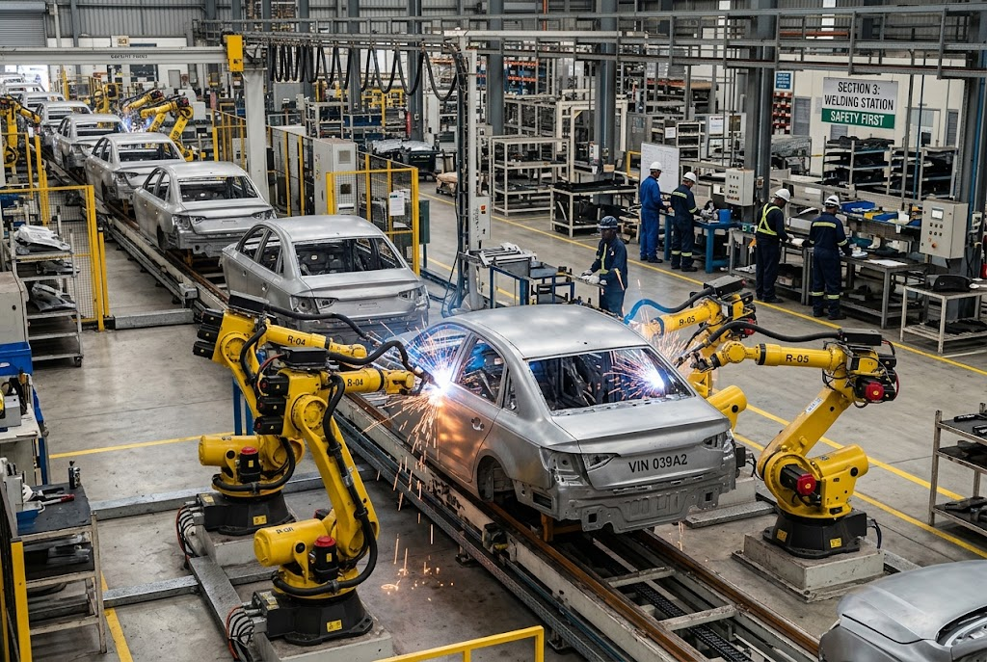
EDEXCEL GCSE BUSINESS · PAPER 2
One at a Time, or Thousands a Day?
The two extremes of production.
Job production: every suit is unique.
Flow production: identical cars, non-stop.
Making operational decisions
openrevise.com
Lesson 1 of 4

Slide 9
EDEXCEL GCSE BUSINESS · PAPER 2
Comparing Production Processes
Feature
Job
Batch
Flow
Number made
One at a time
Groups of identical items
Huge numbers, continuously
Product
Unique, made to order
Same within a batch
Identical
Cost per unit
High
Medium
Low
Workers
Highly skilled
Semi-skilled
Mostly machines, less skilled
Flexibility
Very high
Some
Very low
Example
Wedding dress
Bread
Cars
Making operational decisions
openrevise.com
Lesson 1 of 4

Slide 10
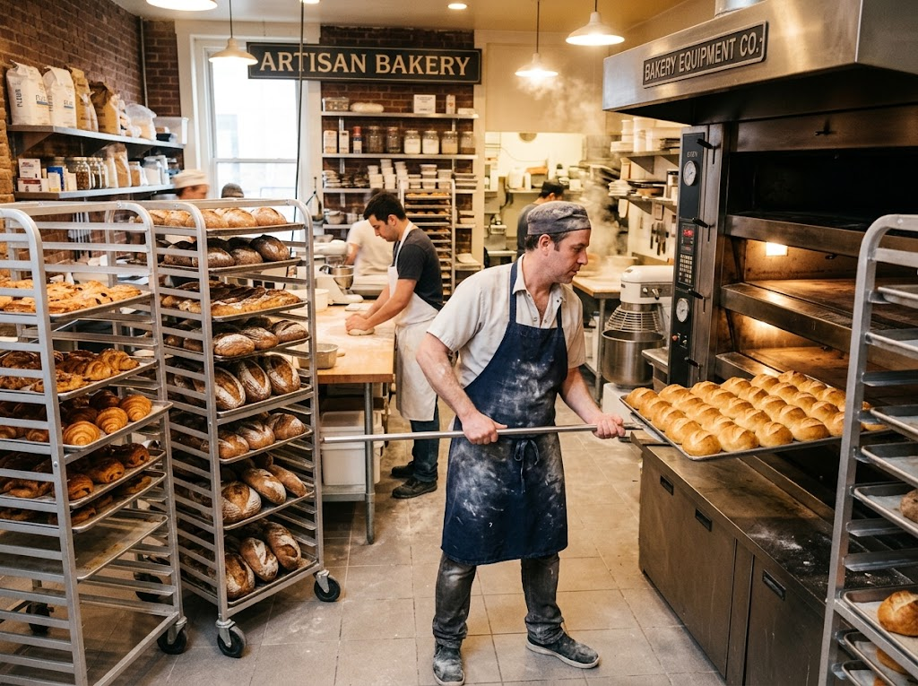
EDEXCEL GCSE BUSINESS · PAPER 2
Batch by Batch
A bakery is the classic example of batch production. It makes a batch of rolls, then switches to croissants, then to loaves. Each batch is identical, but the business can still offer variety - at the cost of time lost changing over between batches.
Batch production: one batch of rolls, then a batch of croissants.
Making operational decisions
openrevise.com
Lesson 1 of 4

Slide 11

EDEXCEL GCSE BUSINESS · PAPER 2
Flexibility or Low Cost?
JOB AND BATCH PRODUCTION
FLOW PRODUCTION
• Flexible: products can be changed or customised.
• Suits small orders and variety.
• Customers get what they want.
• But: higher cost per unit.
• Skilled staff are expensive.
• Very low cost per unit through economies of scale.
• Consistent quality from machines.
• Huge output.
• But: expensive to set up.
• Inflexible: hard to change the product, and boring, repetitive work.
Making operational decisions
openrevise.com
Lesson 1 of 4

Slide 12
EDEXCEL GCSE BUSINESS · PAPER 2
PART TWO
Technology and Production
How machines and computers change operations.
openrevise.com

Slide 13

EDEXCEL GCSE BUSINESS · PAPER 2
Productivity
Productivity is the output produced per worker, or per machine, in a period of time.
Example
A bakery worker who makes 400 loaves a day is more productive than one who makes 300.
Why it matters
Higher productivity means more output for the same cost, so the cost of each unit falls.
How to raise it
Better technology, training, and motivated staff.
Making operational decisions
openrevise.com
Lesson 1 of 4

Slide 14
EDEXCEL GCSE BUSINESS · PAPER 2
The Impact of Technology on Production
Costs
Machines are expensive to buy, but reduce labour costs and waste, so cost per unit falls over time.
Productivity
Robots and automated machines work faster and non-stop, producing far more output.
Quality
Computer-controlled machines make every product to exactly the same standard, with fewer mistakes.
Flexibility
Modern computer-aided machines can be reprogrammed quickly, so even flow production can offer some variety.
Making operational decisions
openrevise.com
Lesson 1 of 4

Slide 15

EDEXCEL GCSE BUSINESS · PAPER 2
CASE STUDY
Morgan: Still Built by Hand
The Morgan Motor Company has made cars in Malvern, Worcestershire, since 1910. While most car makers use flow production with thousands of robots, Morgan still builds its cars largely by hand, using skilled craftspeople and, on many models, a frame made partly of ash wood. Customers can choose colours, leather and details for their own car. Output is tiny compared with a mass-market factory and each car costs far more - but customers pay for a hand-built, personalised car that flow production could never offer.
1910
By hand
Morgan founded in Malvern
How most of each car is built
Making operational decisions
openrevise.com
Lesson 1 of 4

Slide 16

EDEXCEL GCSE BUSINESS · PAPER 2
Key Terms
Operations
The activities that turn inputs into goods and services.
Job production
Making one unique product at a time, usually to order.
Batch production
Making a group of identical products together before switching to another batch.
Flow production
Making identical products continuously on a production line.
Productivity
Output per worker or per machine in a period of time.
Automation
Using machines and computers to carry out tasks with little human input.
Making operational decisions
openrevise.com
Lesson 1 of 4

Slide 17

EDEXCEL GCSE BUSINESS · PAPER 2
YOUR TASK
10 minutes
Which Process?
Choose the best production process for each and explain why: a custom-built garden shed; 50,000 identical cans of cola a day; 200 birthday cards in each of 20 designs; a portrait painting; frozen pizzas in six flavours.
Choose job, batch or flow.
1
Explain your choice.
2
WHAT A GOOD ANSWER SHOWS
Job for the shed and the portrait, flow for the cola, batch for the cards and the pizzas, each with a reason about quantity, variety and cost.
Making operational decisions
openrevise.com
Lesson 1 of 4

Slide 18

EDEXCEL GCSE BUSINESS · PAPER 2
Can I...?
Explain what operations are.
Compare the three processes.
Explain job production.
Explain productivity.
Explain batch production.
Explain how technology affects costs and productivity.
Explain flow production.
Explain how technology affects quality and flexibility.
Making operational decisions
openrevise.com
Lesson 1 of 4

Slide 19
EDEXCEL GCSE BUSINESS · PAPER 2
Summary & Exam Focus
Job production: unique products, high cost, very flexible.
Batch production: groups of identical products, some flexibility.
Flow production: identical products continuously, low unit cost, inflexible.
Technology affects costs, productivity, quality and flexibility.
EXAM FOCUS
Explain one impact on a business of introducing automated machinery into its production. (3 marks)
Technology questions have two sides: high set-up costs now, lower unit costs and better quality later. Use the business's context to decide which matters more.
openrevise.com

