Slide 1

EDEXCEL GCSE BUSINESS · PAPER 2
Working with suppliers
Making operational decisions
Lesson 2 of 4
openrevise.com

Slide 2

EDEXCEL GCSE BUSINESS · PAPER 2
Last Lesson
Answer from memory before the answers appear.
Name the three production processes.
1
Which process has the lowest cost per unit?
2
What is productivity?
3
Give one impact of technology on production.
4
Making operational decisions
openrevise.com
Lesson 2 of 4

Slide 3
EDEXCEL GCSE BUSINESS · PAPER 2
Last Lesson - Answers
Name the three production processes.
Job, batch and flow.
1
Which process has the lowest cost per unit?
Flow production.
2
What is productivity?
Output per worker in a period of time.
3
Give one impact of technology on production.
Lower unit costs, higher productivity, better quality or more flexibility.
4
Making operational decisions
openrevise.com
Lesson 2 of 4

Slide 4

EDEXCEL GCSE BUSINESS · PAPER 2
Learning Objectives
Interpret a bar gate stock graph.
1
Explain just-in-time (JIT) stock control.
2
Explain the factors in choosing a supplier: quality, delivery, availability, cost and trust.
3
Explain the effect of logistics and supply decisions on costs, reputation and customer satisfaction.
4
Making operational decisions
openrevise.com
Lesson 2 of 4

Slide 5

EDEXCEL GCSE BUSINESS · PAPER 2
Why Manage Stock?
Stock is the raw materials, components and finished goods a business holds.
Too much stock
Ties up cash, costs money to store and insure, and may go out of date, be damaged or stolen.
Too little stock
Production stops and customers are let down, so sales and reputation suffer.
The balance
Enough stock to keep running and meet demand, without wasting money holding too much.
Making operational decisions
openrevise.com
Lesson 2 of 4

Slide 6

EDEXCEL GCSE BUSINESS · PAPER 2
PART ONE
Bar Gate Stock Graphs
A picture of stock rising and falling.
openrevise.com

Slide 7

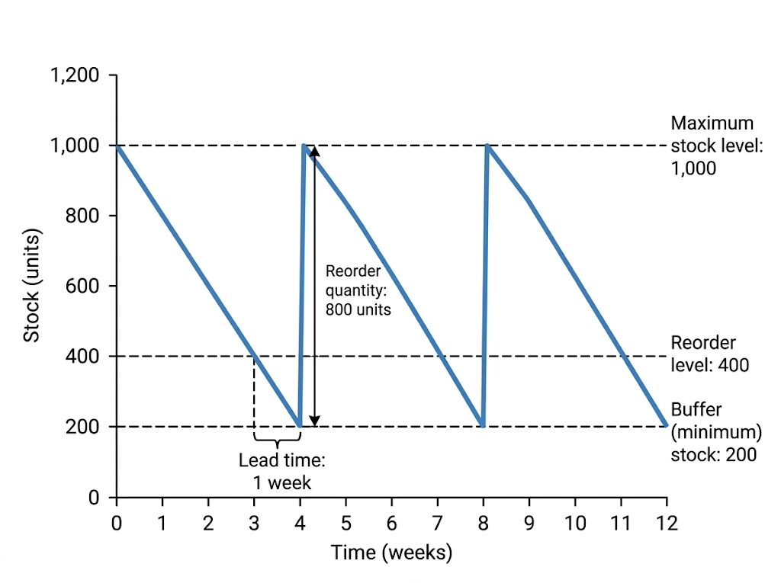
EDEXCEL GCSE BUSINESS · PAPER 2
Reading a Bar Gate Stock Graph
A bar gate stock graph shows stock falling as it is used, then jumping back up when a delivery arrives. Here the business uses 200 units a week. When stock falls to 400 it reorders; one week later 800 units arrive, just as stock reaches the 200-unit buffer.
Stock falls as it is used, is reordered at 400 units, and is topped back up to 1,000 when the delivery arrives.
Making operational decisions
openrevise.com
Lesson 2 of 4

Slide 8
EDEXCEL GCSE BUSINESS · PAPER 2
The Parts of a Bar Gate Stock Graph
Term
Meaning
On the graph
Maximum stock level
The most stock the business wants to hold
1,000 units
Reorder level
The stock level at which a new order is placed
400 units
Buffer (minimum) stock
The lowest level stock should fall to, kept for emergencies
200 units
Reorder quantity
The amount ordered each time
800 units
Lead time
The time between placing an order and it arriving
1 week
Making operational decisions
openrevise.com
Lesson 2 of 4

Slide 9

EDEXCEL GCSE BUSINESS · PAPER 2
Using the Graph
Work out what is used during the lead time.
The business uses 200 units a week and reorders when stock falls to 400 units. The lead time is 1 week. How much stock will be left when the delivery arrives, and what will stock be after the 800-unit delivery?
Stock used during the lead time
200 units a week × 1 week = 200 units
1
Stock left when the delivery arrives
400 - 200 = 200 units (the buffer stock)
2
Stock after the delivery
200 + 800 = 1,000 units (the maximum)
3
ANSWER
200 units left; 1,000 units after the delivery.
Making operational decisions
openrevise.com
Lesson 2 of 4

Slide 10
EDEXCEL GCSE BUSINESS · PAPER 2
PART TWO
Just-in-Time
Holding almost no stock at all.
openrevise.com

Slide 11

EDEXCEL GCSE BUSINESS · PAPER 2
Just-in-Time (JIT) Stock Control
ADVANTAGES
DISADVANTAGES
• Very little money tied up in stock.
• Low storage, insurance and waste costs.
• Less space needed, so smaller premises.
• Stock is always fresh and up to date.
• Production stops if a delivery is late.
• Relies on very reliable suppliers.
• Frequent small deliveries can cost more.
• Cannot meet a sudden rise in demand.
• Loses bulk-buying discounts.
Making operational decisions
openrevise.com
Lesson 2 of 4

Slide 12

EDEXCEL GCSE BUSINESS · PAPER 2
How JIT Works
Just-in-time means ordering materials to arrive exactly when they are needed, and holding little or no stock.
Frequent deliveries
Suppliers deliver small amounts often, sometimes several times a day.
Close relationships
The business and its suppliers share production plans so deliveries arrive on time.
Suits
Businesses with reliable suppliers nearby and predictable demand, such as car makers and supermarkets.
Making operational decisions
openrevise.com
Lesson 2 of 4

Slide 13
EDEXCEL GCSE BUSINESS · PAPER 2
PART THREE
Choosing Suppliers
Procurement: finding and buying from the right suppliers.
openrevise.com

Slide 14
EDEXCEL GCSE BUSINESS · PAPER 2
Factors in Choosing a Supplier
Quality
Materials must be good enough to make a quality product; poor materials mean faults and complaints.
Delivery
The cost, speed and reliability of delivery - late deliveries stop production.
Availability
The supplier must be able to supply the quantities needed, when they are needed.
Cost
A lower price reduces the business's costs, but the cheapest is not always the best.
Trust
A reliable supplier with a good track record, who communicates honestly when problems arise.
Making operational decisions
openrevise.com
Lesson 2 of 4

Slide 15
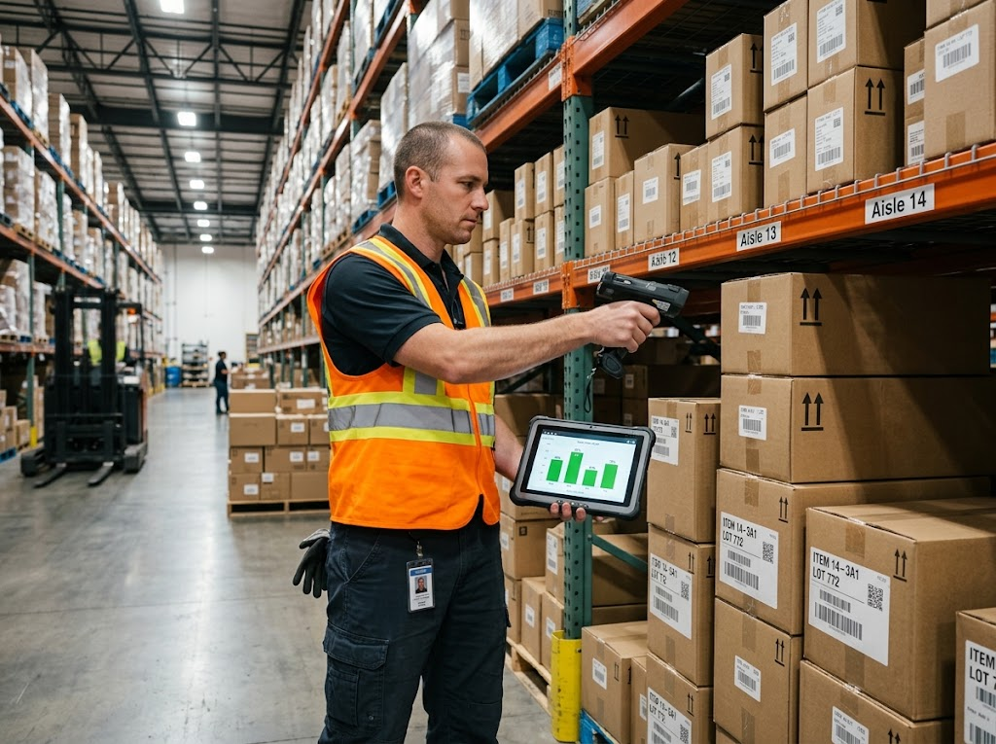
EDEXCEL GCSE BUSINESS · PAPER 2
Stock on the Shelves
Modern businesses track every item of stock with barcodes and software. The system can warn managers - or even order automatically - when stock reaches the reorder level.
Barcode scanning keeps an exact, up-to-date record of stock.
Making operational decisions
openrevise.com
Lesson 2 of 4

Slide 16

EDEXCEL GCSE BUSINESS · PAPER 2
The Effect of Supply Decisions
Logistics is the management of getting materials in and products out on time. Supply decisions affect the whole business.
Costs
Cheaper suppliers and efficient deliveries reduce costs; unreliable ones cause expensive delays.
Reputation
Poor-quality materials or unethical suppliers can damage the business's reputation.
Customer satisfaction
Products in stock, of good quality and delivered on time keep customers happy and loyal.
Making operational decisions
openrevise.com
Lesson 2 of 4

Slide 17

EDEXCEL GCSE BUSINESS · PAPER 2
CASE STUDY
Toyota and the Chip Shortage
Toyota developed just-in-time production in Japan, and car makers around the world copied it. JIT kept their stock costs extremely low. But in 2021 a worldwide shortage of computer chips showed the risk. Modern cars need hundreds of chips, and car makers holding little stock could not get enough. Factories around the world, including in the UK, had to cut or stop production, and customers waited months for new cars. Many businesses began holding more buffer stock of key parts.
JIT
2021
Developed by Toyota in Japan
A global chip shortage stops car production
Making operational decisions
openrevise.com
Lesson 2 of 4

Slide 18

EDEXCEL GCSE BUSINESS · PAPER 2
Key Terms
Stock
Raw materials, components and finished goods held by a business.
Bar gate stock graph
A graph showing how stock levels rise and fall over time.
Reorder level
The stock level at which a new order is placed.
Buffer stock
The minimum stock kept for emergencies.
Lead time
The time between ordering stock and it arriving.
Just-in-time (JIT)
Ordering stock to arrive exactly when it is needed, holding little or none.
Making operational decisions
openrevise.com
Lesson 2 of 4

Slide 19
EDEXCEL GCSE BUSINESS · PAPER 2
Key Terms (cont.)
Procurement
Finding and buying the materials and services a business needs.
Logistics
Managing the movement of materials and products into and out of a business.
Making operational decisions
openrevise.com
Lesson 2 of 4

Slide 20

EDEXCEL GCSE BUSINESS · PAPER 2
YOUR TASK
12 minutes
Stock Detective
A café uses 50 bags of coffee beans a week. Its maximum stock is 300 bags, its reorder level is 150 bags, its buffer stock is 50 bags and the lead time is 2 weeks. Sketch the bar gate stock graph for 12 weeks. Then explain one risk if the supplier's lead time increased to 3 weeks.
1
Draw the graph with the levels labelled.
2
Mark the reorder point and delivery each time.
3
Explain the risk of a longer lead time.
WHAT A GOOD ANSWER SHOWS
A correct saw-tooth graph with all levels labelled, and the risk that the café runs out - stock would fall to 0 before delivery.
Making operational decisions
openrevise.com
Lesson 2 of 4
Notes:
With a 3-week lead time the café uses 150 bags while waiting - exactly its reorder level, so it hits zero.

Slide 21

EDEXCEL GCSE BUSINESS · PAPER 2
Can I...?
Explain why businesses manage stock.
Give advantages and disadvantages of JIT.
Read and label a bar gate stock graph.
Explain the five factors in choosing a supplier.
Calculate stock levels from a graph.
Explain how supply decisions affect costs, reputation and customer satisfaction.
Explain just-in-time.
Making operational decisions
openrevise.com
Lesson 2 of 4

Slide 22
EDEXCEL GCSE BUSINESS · PAPER 2
Summary & Exam Focus
A bar gate stock graph shows maximum stock, reorder level, buffer stock, reorder quantity and lead time.
JIT holds little stock, cutting costs, but relies on reliable suppliers.
Suppliers are chosen on quality, delivery, availability, cost and trust.
Supply decisions affect costs, reputation and customer satisfaction.
EXAM FOCUS
Explain one disadvantage to a business of using just-in-time stock control. (3 marks)
For bar gate graphs, read the numbers carefully off the axes and show your working. For JIT, link any answer to the reliability of suppliers.
openrevise.com

Slide 23
EDEXCEL GCSE BUSINESS · PAPER 2
Exam Practice: Working with Suppliers
Answer all questions. Show your working in calculations. · 25 minutes
Question 1 · 1 mark · Define
Define the term 'lead time'.
Question 2 · 2 marks · Calculate
A business uses 150 units of stock a day. It reorders when stock falls to 600 units, and the lead time is 3 days. Calculate how many units…
Question 3 · 2 marks · Outline
Outline one reason why a business holds buffer stock.
Making operational decisions
openrevise.com
Lesson 2 of 4

Slide 24
EDEXCEL GCSE BUSINESS · PAPER 2
Exam Practice: Working with Suppliers (cont.)
Question 4 · 3 marks · Explain
Explain one disadvantage to a business of using just-in-time stock control.
Question 5 · 9 marks · Justify
Justify which supplier Pedal Power Ltd should choose.
Making operational decisions
openrevise.com
Lesson 2 of 4

Slide 25
EDEXCEL GCSE BUSINESS · PAPER 2
Question 1 · 1 mark · Define
“
Define the term 'lead time'.
HOW TO ANSWER IT
Command word: Define. Worth 1 mark, so plan before writing.
Making operational decisions
openrevise.com
Lesson 2 of 4

Slide 26
EDEXCEL GCSE BUSINESS · PAPER 2
Question 1 · mark scheme
1 mark available. Award a mark for each point made.
Time between ordering and delivery
1 mark
Making operational decisions
openrevise.com
Lesson 2 of 4

Slide 27
EDEXCEL GCSE BUSINESS · PAPER 2
Question 2 · 2 marks · Calculate
“
A business uses 150 units of stock a day. It reorders when stock falls to 600 units, and the lead time is 3 days. Calculate how many units will be left when the delivery arrives. You are advised to show your working.
HOW TO ANSWER IT
Command word: Calculate. Worth 2 marks, so plan before writing.
Making operational decisions
openrevise.com
Lesson 2 of 4

Slide 28
EDEXCEL GCSE BUSINESS · PAPER 2
Question 2 · mark scheme
2 marks available. Award a mark for each point made.
Correct method: reorder level - (daily use × lead time)
1 mark
Correct answer: 150 units
1 mark (award 2 marks for the correct answer with no working)
Making operational decisions
openrevise.com
Lesson 2 of 4

Slide 29
EDEXCEL GCSE BUSINESS · PAPER 2
Question 3 · 2 marks · Outline
“
Outline one reason why a business holds buffer stock.
HOW TO ANSWER IT
Command word: Outline. Worth 2 marks, so plan before writing.
Making operational decisions
openrevise.com
Lesson 2 of 4

Slide 30
EDEXCEL GCSE BUSINESS · PAPER 2
Question 3 · mark scheme
2 marks available. Award a mark for each point made.
A reason identified
1 mark
Developed
1 mark
Making operational decisions
openrevise.com
Lesson 2 of 4

Slide 31
EDEXCEL GCSE BUSINESS · PAPER 2
Question 4 · 3 marks · Explain
“
Explain one disadvantage to a business of using just-in-time stock control.
HOW TO ANSWER IT
Command word: Explain. Worth 3 marks, so plan before writing.
Making operational decisions
openrevise.com
Lesson 2 of 4

Slide 32
EDEXCEL GCSE BUSINESS · PAPER 2
Question 4 · mark scheme
3 marks available. Award a mark for each point made.
A disadvantage identified, e.g. relies on suppliers / cannot meet sudden demand / lost bulk discounts
1 mark
First linked point of explanation
1 mark
Second linked point of explanation
1 mark
Making operational decisions
openrevise.com
Lesson 2 of 4

Slide 33
EDEXCEL GCSE BUSINESS · PAPER 2
Question 5 · 9 marks · Justify
“
Justify which supplier Pedal Power Ltd should choose.
— Pedal Power Ltd makes electric bikes. It needs a new supplier of batteries. Supplier A is based in the UK, delivers within 2 days and has a strong reputation for quality, but…
HOW TO ANSWER IT
Command word: Justify. Worth 9 marks, so plan before writing.
Making operational decisions
openrevise.com
Lesson 2 of 4

Slide 34
EDEXCEL GCSE BUSINESS · PAPER 2
Question 5 · mark scheme
9 marks available. Award a mark for each point made.
AO2 (Application, 3 marks): uses the context - electric bikes, £180 vs £120, 2 days vs 6 weeks, quality complaints
Level 1-3
AO3a (Analysis, 3 marks): chains of reasoning about each supplier
Level 1-3
AO3b (Evaluation, 3 marks): a justified choice with a supported judgement
Level 1-3
Making operational decisions
openrevise.com
Lesson 2 of 4

