Slide 1

EDEXCEL GCSE BUSINESS · PAPER 2
Managing quality
Making operational decisions
Lesson 3 of 4
openrevise.com

Slide 2

EDEXCEL GCSE BUSINESS · PAPER 2
Last Lesson
Answer from memory before the answers appear.
What is buffer stock?
1
What is just-in-time?
2
Name three factors in choosing a supplier.
3
What is lead time?
4
Making operational decisions
openrevise.com
Lesson 3 of 4

Slide 3
EDEXCEL GCSE BUSINESS · PAPER 2
Last Lesson - Answers
What is buffer stock?
The minimum stock kept for emergencies.
1
What is just-in-time?
Ordering stock to arrive exactly when needed, holding little or none.
2
Name three factors in choosing a supplier.
Any three of: quality, delivery, availability, cost, trust.
3
What is lead time?
The time between ordering stock and it arriving.
4
Making operational decisions
openrevise.com
Lesson 3 of 4

Slide 4

EDEXCEL GCSE BUSINESS · PAPER 2
Learning Objectives
Explain what quality means.
1
Explain quality control.
2
Explain quality assurance.
3
Explain the importance of quality in controlling costs and gaining competitive advantage.
4
Making operational decisions
openrevise.com
Lesson 3 of 4

Slide 5

EDEXCEL GCSE BUSINESS · PAPER 2
What Is Quality?
A quality product meets or exceeds customers' expectations - and does so every time.
Fit for purpose
It does what customers need it to do.
Consistent
Every product is made to the same standard.
Not the same as luxury
A cheap product can be high quality if it meets the expectations of customers who buy it.
Services too
Quality applies to service - speed, friendliness and reliability.
Making operational decisions
openrevise.com
Lesson 3 of 4

Slide 6

EDEXCEL GCSE BUSINESS · PAPER 2
Quality Control or Quality Assurance?
QUALITY CONTROL
QUALITY ASSURANCE
• Checking finished products for faults, usually at the end of production.
• Done by specialist inspectors.
• Faulty products are thrown away or reworked.
• Finds problems after they have happened.
• Can be wasteful: materials and time are lost on every faulty product.
• Checking quality at every stage of production.
• Every worker is responsible for their own work.
• Aims to prevent faults happening in the first place.
• Less waste, as faults are caught early.
• Needs training, and staff who care about quality.
Making operational decisions
openrevise.com
Lesson 3 of 4

Slide 7

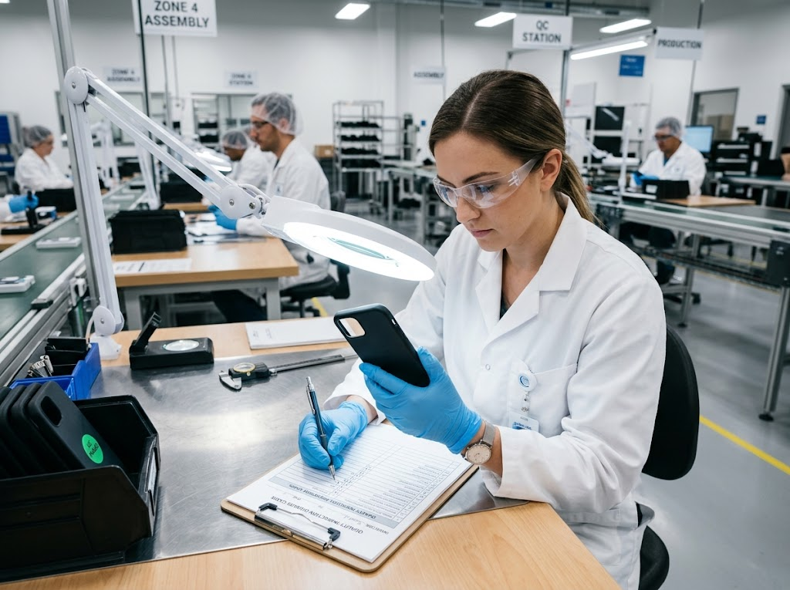
EDEXCEL GCSE BUSINESS · PAPER 2
Checking Every Detail
Quality control inspectors check finished products, or a sample of them, before they are sent to customers. It stops faulty products reaching customers - but by the time a fault is found, the materials and time have already been used.
Quality control: inspecting finished products for faults.
Making operational decisions
openrevise.com
Lesson 3 of 4

Slide 8

EDEXCEL GCSE BUSINESS · PAPER 2
PART ONE
Why Quality Matters
Quality is about costs as well as customers.
openrevise.com

Slide 9

EDEXCEL GCSE BUSINESS · PAPER 2
The Importance of Quality
Controlling costs
Fewer faulty products means less waste, fewer returns and less money spent fixing mistakes.
Competitive advantage
A reputation for quality helps a business stand out from rivals and win customers.
Premium prices
Customers will often pay more for a product they trust to be well made.
Customer loyalty
Customers who get good quality every time come back and recommend the business.
Making operational decisions
openrevise.com
Lesson 3 of 4

Slide 10

EDEXCEL GCSE BUSINESS · PAPER 2
The Cost of Poor Quality
When quality fails, the costs mount up quickly.
Waste
Faulty products must be scrapped or reworked.
Returns and refunds
Customers return faulty goods and demand their money back.
Product recalls
Dangerous faults can force a business to recall every product sold - extremely expensive.
Reputation
Bad reviews and news stories drive customers away for years.
Making operational decisions
openrevise.com
Lesson 3 of 4

Slide 11

EDEXCEL GCSE BUSINESS · PAPER 2
CASE STUDY
The Galaxy Note 7 Recall
In August 2016 Samsung launched the Galaxy Note 7 smartphone. Within weeks, reports emerged of phones overheating and catching fire because of faulty batteries. Airlines banned the phone from flights. Samsung recalled millions of phones, and when replacement phones also caught fire, it stopped making the Note 7 altogether in October 2016. The failure cost Samsung billions of dollars and damaged its reputation - a clear example of how poor quality can cost far more than getting it right would have done.
2016
Billions
Galaxy Note 7 launched and recalled
The cost of the failure, in US dollars
Making operational decisions
openrevise.com
Lesson 3 of 4

Slide 12

EDEXCEL GCSE BUSINESS · PAPER 2
Key Terms
Quality
Meeting or exceeding customers' expectations, consistently.
Quality control
Checking finished products for faults.
Quality assurance
Checking quality at every stage of production to prevent faults.
Product recall
When a business asks customers to return a product because it is faulty or dangerous.
Competitive advantage
Anything that makes a business more attractive to customers than its rivals.
Making operational decisions
openrevise.com
Lesson 3 of 4

Slide 13

EDEXCEL GCSE BUSINESS · PAPER 2
YOUR TASK
12 minutes
Build Quality In
A sandwich factory has had complaints about missing ingredients and wrong labels. Design a quality assurance system for it: list three checks at different stages of production, and explain how each would prevent the problem rather than just finding it.
1
One check when ingredients arrive.
2
One check during assembly.
3
One check at labelling.
How each prevents problems.
4
WHAT A GOOD ANSWER SHOWS
Three checks at different stages (ingredients arriving, assembly, labelling) with each explained as preventing faults.
Making operational decisions
openrevise.com
Lesson 3 of 4

Slide 14
EDEXCEL GCSE BUSINESS · PAPER 2
Can I...?
Explain what quality means.
Explain quality control.
Explain quality assurance.
Compare quality control and quality assurance.
Explain how quality controls costs.
Explain how quality gives a competitive advantage.
Explain the costs of poor quality.
Making operational decisions
openrevise.com
Lesson 3 of 4

Slide 15
EDEXCEL GCSE BUSINESS · PAPER 2
Summary & Exam Focus
Quality means meeting customers' expectations, every time.
Quality control checks finished products; quality assurance builds quality into every stage.
High quality controls costs and gives a competitive advantage.
Poor quality brings waste, returns, recalls and damaged reputation.
EXAM FOCUS
Explain one benefit to a business of using quality assurance rather than quality control. (3 marks)
The difference is when quality is checked: control finds faults at the end, assurance prevents them throughout. Link your answer to costs or reputation.
openrevise.com

