Slide 1

EDEXCEL GCSE BUSINESS · PAPER 2
The sales process
Making operational decisions
Lesson 4 of 4
openrevise.com

Slide 2

EDEXCEL GCSE BUSINESS · PAPER 2
Last Lesson
Answer from memory before the answers appear.
What is quality control?
1
What is quality assurance?
2
Give one cost of poor quality.
3
How does quality give competitive advantage?
4
Making operational decisions
openrevise.com
Lesson 4 of 4

Slide 3
EDEXCEL GCSE BUSINESS · PAPER 2
Last Lesson - Answers
What is quality control?
Checking finished products for faults.
1
What is quality assurance?
Checking quality at every stage to prevent faults.
2
Give one cost of poor quality.
Waste, returns, recalls or damaged reputation.
3
How does quality give competitive advantage?
A reputation for quality makes customers choose the business over rivals.
4
Making operational decisions
openrevise.com
Lesson 4 of 4

Slide 4

EDEXCEL GCSE BUSINESS · PAPER 2
Learning Objectives
Explain the stages of the sales process.
1
Explain product knowledge, speed and efficiency of service, customer engagement and responding to feedback.
2
Explain post-sales service.
3
Explain the importance of good customer service to a business.
4
Making operational decisions
openrevise.com
Lesson 4 of 4

Slide 5

EDEXCEL GCSE BUSINESS · PAPER 2
The Sales Process
Customer service matters at every stage.
1
2
3
4
Before the sale
Answering questions, giving advice and helping the customer choose.
The sale
Taking the order and payment quickly and accurately.
Delivery
Getting the product to the customer on time and in perfect condition.
After the sale
Help with problems, repairs, returns and follow-up.
Making operational decisions
openrevise.com
Lesson 4 of 4

Slide 6

EDEXCEL GCSE BUSINESS · PAPER 2
Good Customer Service
Product knowledge
Staff understand the products well enough to answer questions and recommend the right one.
Speed and efficiency
Short queues, quick answers, fast delivery and accurate orders.
Customer engagement
Friendly, personal contact that makes customers feel valued - in person and online.
Responding to feedback
Listening to reviews and complaints, fixing problems and improving.
Making operational decisions
openrevise.com
Lesson 4 of 4

Slide 7

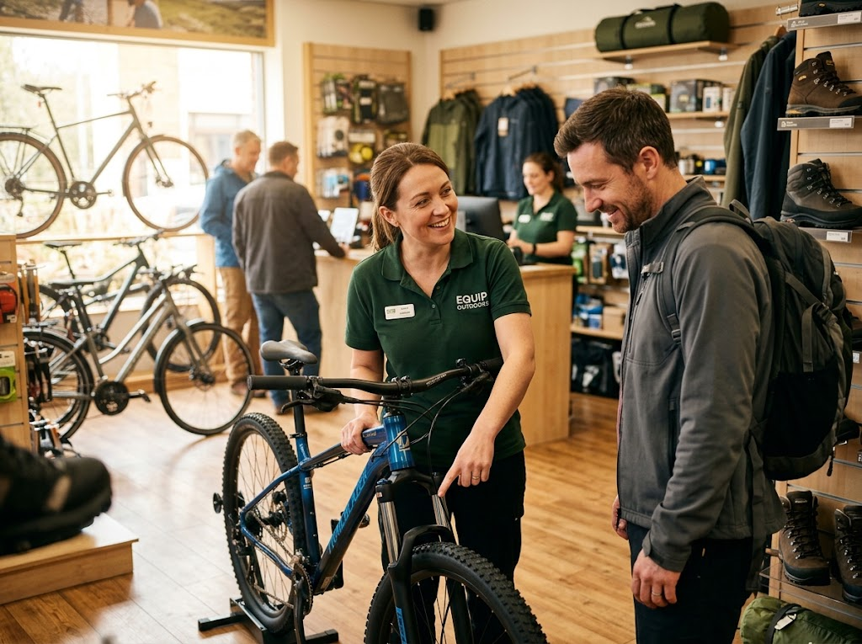
EDEXCEL GCSE BUSINESS · PAPER 2
Knowing the Product
A customer spending hundreds of pounds on a bike wants advice they can trust. A sales assistant who really knows the products helps them choose the right one, so they are happier with it, less likely to return it and more likely to come back.
Product knowledge helps customers choose - and trust the business.
Making operational decisions
openrevise.com
Lesson 4 of 4

Slide 8

EDEXCEL GCSE BUSINESS · PAPER 2
Post-sales Service
Post-sales service is the help a business gives customers after they have bought.
Guarantees and warranties
Promises to repair or replace a faulty product for a set time.
Repairs and servicing
Fixing or maintaining products, such as servicing a car or a boiler.
Returns and refunds
Handling returns quickly and fairly.
Follow-up
Checking the customer is happy, and offering help, tips or future offers.
Making operational decisions
openrevise.com
Lesson 4 of 4

Slide 9
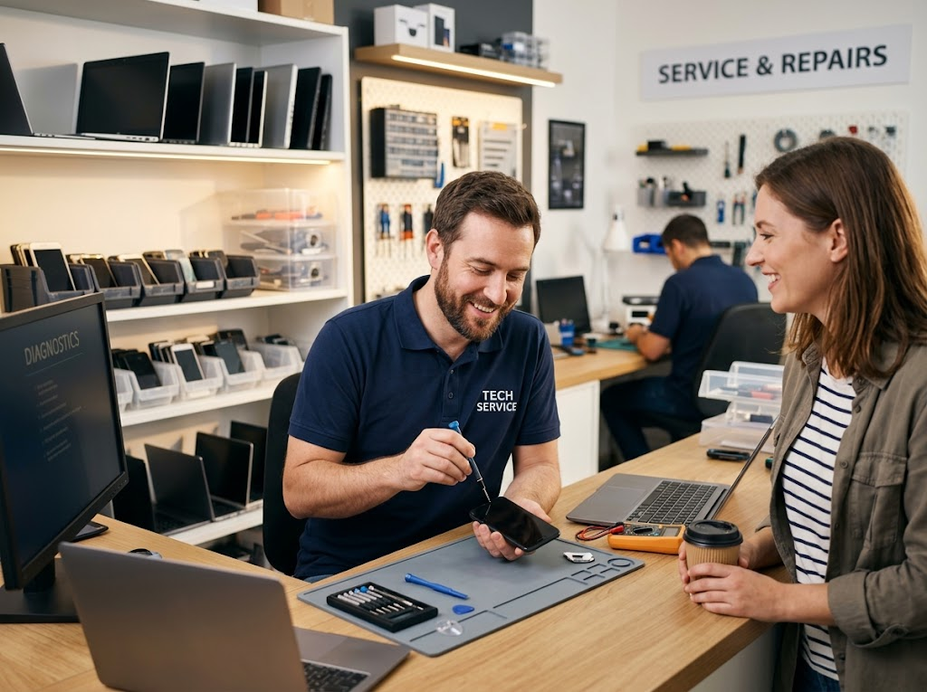
EDEXCEL GCSE BUSINESS · PAPER 2
Help After the Sale
Post-sales service turns a one-off sale into a long-term relationship. A customer whose phone is fixed quickly and politely is far more likely to buy their next phone from the same business.
Post-sales service: the relationship continues after the sale.
Making operational decisions
openrevise.com
Lesson 4 of 4

Slide 10

EDEXCEL GCSE BUSINESS · PAPER 2
Why Customer Service Matters
Good service is one of the few advantages rivals cannot easily copy.
Customer satisfaction
Happy customers are more likely to buy again.
Customer loyalty and repeat purchases
It costs far less to keep a customer than to win a new one.
Reputation and reviews
Good reviews online attract new customers; bad ones drive them away.
Competitive advantage
When products and prices are similar, service decides where customers buy.
Making operational decisions
openrevise.com
Lesson 4 of 4

Slide 11

EDEXCEL GCSE BUSINESS · PAPER 2
CASE STUDY
Apple: The Genius Bar
When Apple opened its first shops in 2001, it included a "Genius Bar" - a counter where customers could get free advice and technical help from trained staff, and book repairs for their devices. It turned the shop into a place customers returned to after buying, not just before. Staff are trained to have deep product knowledge, and customers can book appointments online. By making post-sales service a central part of the shop, Apple built a reputation for looking after its customers that encourages them to stay loyal to the brand.
2001
After the sale
Apple's first shops open with a Genius Bar
Where the Genius Bar focuses its help
Making operational decisions
openrevise.com
Lesson 4 of 4

Slide 12

EDEXCEL GCSE BUSINESS · PAPER 2
Key Terms
Sales process
All the stages of selling, from the first enquiry to after-sales help.
Customer service
How a business looks after its customers before, during and after a sale.
Product knowledge
Staff understanding of the products they sell.
Customer engagement
How a business interacts with and builds relationships with customers.
Post-sales service
Help given to customers after they have bought, such as repairs and warranties.
Customer loyalty
When customers keep buying from the same business.
Making operational decisions
openrevise.com
Lesson 4 of 4

Slide 13

EDEXCEL GCSE BUSINESS · PAPER 2
YOUR TASK
12 minutes
Fix the Service
An online electronics shop has these reviews: "Nobody could tell me which laptop suited me", "Took three weeks to arrive", "Never replied to my email about a faulty charger", "Five weeks to get a refund". For each review, name the part of customer service that failed, and suggest an improvement.
1
Identify the failure.
2
Suggest an improvement.
3
Explain the benefit to the business.
WHAT A GOOD ANSWER SHOWS
Each review linked to product knowledge, speed of service, responding to feedback or post-sales service, with a practical improvement.
Making operational decisions
openrevise.com
Lesson 4 of 4
Notes:
Extend by asking what each failure costs the business - lost sales, returns, bad reviews.

Slide 14
EDEXCEL GCSE BUSINESS · PAPER 2
Can I...?
Describe the stages of the sales process.
Explain product knowledge.
Explain speed and efficiency of service.
Explain customer engagement.
Explain responding to customer feedback.
Explain post-sales service.
Explain why good customer service matters.
Making operational decisions
openrevise.com
Lesson 4 of 4

Slide 15
EDEXCEL GCSE BUSINESS · PAPER 2
Summary & Exam Focus
The sales process runs from the first enquiry to after the sale.
Good service: product knowledge, speed and efficiency, engagement and responding to feedback.
Post-sales service includes warranties, repairs, returns and follow-up.
Good service builds satisfaction, loyalty, reputation and competitive advantage.
EXAM FOCUS
Explain one benefit to a business of providing good post-sales service. (3 marks)
Service answers should always finish with what it means for the business: repeat purchases, loyalty, reviews or competitive advantage.
openrevise.com

Slide 16
EDEXCEL GCSE BUSINESS · PAPER 2
Exam Practice: The Sales Process
Answer all questions. Use the context of the business in the question where one is given. · 20 minutes
Question 1 · 1 mark · Define
Define the term 'post-sales service'.
Question 2 · 1 mark · State
State one feature of good customer service.
Question 3 · 3 marks · Explain
Explain one benefit to a business of providing good post-sales service.
Question 4 · 9 marks · Justify
Justify which one of these two options HomeGlow Ltd should choose.
Making operational decisions
openrevise.com
Lesson 4 of 4

Slide 17
EDEXCEL GCSE BUSINESS · PAPER 2
Question 1 · 1 mark · Define
“
Define the term 'post-sales service'.
HOW TO ANSWER IT
Command word: Define. Worth 1 mark, so plan before writing.
Making operational decisions
openrevise.com
Lesson 4 of 4

Slide 18
EDEXCEL GCSE BUSINESS · PAPER 2
Question 1 · mark scheme
1 mark available. Award a mark for each point made.
Service / support given after the sale
1 mark
Making operational decisions
openrevise.com
Lesson 4 of 4

Slide 19
EDEXCEL GCSE BUSINESS · PAPER 2
Question 2 · 1 mark · State
“
State one feature of good customer service.
HOW TO ANSWER IT
Command word: State. Worth 1 mark, so plan before writing.
Making operational decisions
openrevise.com
Lesson 4 of 4

Slide 20
EDEXCEL GCSE BUSINESS · PAPER 2
Question 2 · mark scheme
1 mark available. Award a mark for each point made.
Any one of: product knowledge; speed / efficiency of service; customer engagement; responding to feedback; post-sales service
1 mark
Making operational decisions
openrevise.com
Lesson 4 of 4

Slide 21
EDEXCEL GCSE BUSINESS · PAPER 2
Question 3 · 3 marks · Explain
“
Explain one benefit to a business of providing good post-sales service.
HOW TO ANSWER IT
Command word: Explain. Worth 3 marks, so plan before writing.
Making operational decisions
openrevise.com
Lesson 4 of 4

Slide 22
EDEXCEL GCSE BUSINESS · PAPER 2
Question 3 · mark scheme
3 marks available. Award a mark for each point made.
A benefit identified, e.g. loyalty / repeat purchase / reputation / competitive advantage
1 mark
First linked point of explanation
1 mark
Second linked point of explanation
1 mark
Making operational decisions
openrevise.com
Lesson 4 of 4

Slide 23
EDEXCEL GCSE BUSINESS · PAPER 2
Question 4 · 9 marks · Justify
“
Justify which one of these two options HomeGlow Ltd should choose.
— HomeGlow Ltd sells kitchen appliances online. Its customer satisfaction scores have fallen, and many reviews complain about slow replies and a lack of help choosing products. It…
HOW TO ANSWER IT
Command word: Justify. Worth 9 marks, so plan before writing.
Making operational decisions
openrevise.com
Lesson 4 of 4

Slide 24
EDEXCEL GCSE BUSINESS · PAPER 2
Question 4 · mark scheme
9 marks available. Award a mark for each point made.
AO2 (Application, 3 marks): uses the context - online sales, slow replies, lack of help choosing, £60,000
Level 1-3
AO3a (Analysis, 3 marks): chains of reasoning about each option
Level 1-3
AO3b (Evaluation, 3 marks): a justified choice with a supported judgement
Level 1-3
Making operational decisions
openrevise.com
Lesson 4 of 4

