Slide 1

EDEXCEL GCSE BUSINESS · PAPER 2
Business calculations
Making financial decisions
Lesson 1 of 2
openrevise.com

Slide 2

EDEXCEL GCSE BUSINESS · PAPER 2
From Topic 1
Answer from memory before the answers appear.
How do you calculate revenue?
1
How do you calculate total costs?
2
How do you calculate profit?
3
How do you calculate interest as a percentage?
4
Making financial decisions
openrevise.com
Lesson 1 of 2

Slide 3
EDEXCEL GCSE BUSINESS · PAPER 2
From Topic 1 - Answers
How do you calculate revenue?
Price × quantity sold.
1
How do you calculate total costs?
Fixed costs + total variable costs.
2
How do you calculate profit?
Total revenue - total costs.
3
How do you calculate interest as a percentage?
(Total repayment - borrowed amount) ÷ borrowed amount × 100.
4
Making financial decisions
openrevise.com
Lesson 1 of 2

Slide 4

EDEXCEL GCSE BUSINESS · PAPER 2
Learning Objectives
Calculate gross profit.
1
Calculate net profit.
2
Calculate the gross profit margin.
3
Calculate the net profit margin.
4
Interpret profit and profit margins to judge performance.
5
Making financial decisions
openrevise.com
Lesson 1 of 2

Slide 5

EDEXCEL GCSE BUSINESS · PAPER 2
PART ONE
Gross and Net Profit
Two measures of profit, telling two different stories.
openrevise.com

Slide 6

EDEXCEL GCSE BUSINESS · PAPER 2
Gross Profit
Gross profit = sales revenue - cost of sales.
Sales revenue
The money received from selling products.
Cost of sales
The direct cost of making or buying the products that were sold - raw materials, stock bought to sell and production wages.
What it shows
How much profit the business makes from its products, before paying for everything else.
Example
Bright Bikes sells £500,000 of bikes. The bikes and parts it sold cost £300,000. Gross profit = £500,000 - £300,000 = £200,000.
Making financial decisions
openrevise.com
Lesson 1 of 2

Slide 7
EDEXCEL GCSE BUSINESS · PAPER 2
Net Profit
Net profit = gross profit - other operating expenses and interest.
Other operating expenses
The costs of running the business that are not part of cost of sales - rent, salaries of office staff, marketing, insurance and utilities.
Interest
The cost of borrowing - interest paid on loans and overdrafts.
What it shows
The true profit left for the owners after every cost has been paid.
Example
Bright Bikes' other operating expenses are £120,000 and it pays £10,000 interest. Net profit = £200,000 - £120,000 - £10,000 = £70,000.
Making financial decisions
openrevise.com
Lesson 1 of 2

Slide 8

EDEXCEL GCSE BUSINESS · PAPER 2
Bright Bikes Ltd: Income Statement
Item
£
Sales revenue
500,000
Cost of sales
(300,000)
Gross profit
200,000
Other operating expenses
(120,000)
Interest
(10,000)
Net profit
70,000
Making financial decisions
openrevise.com
Lesson 1 of 2

Slide 9

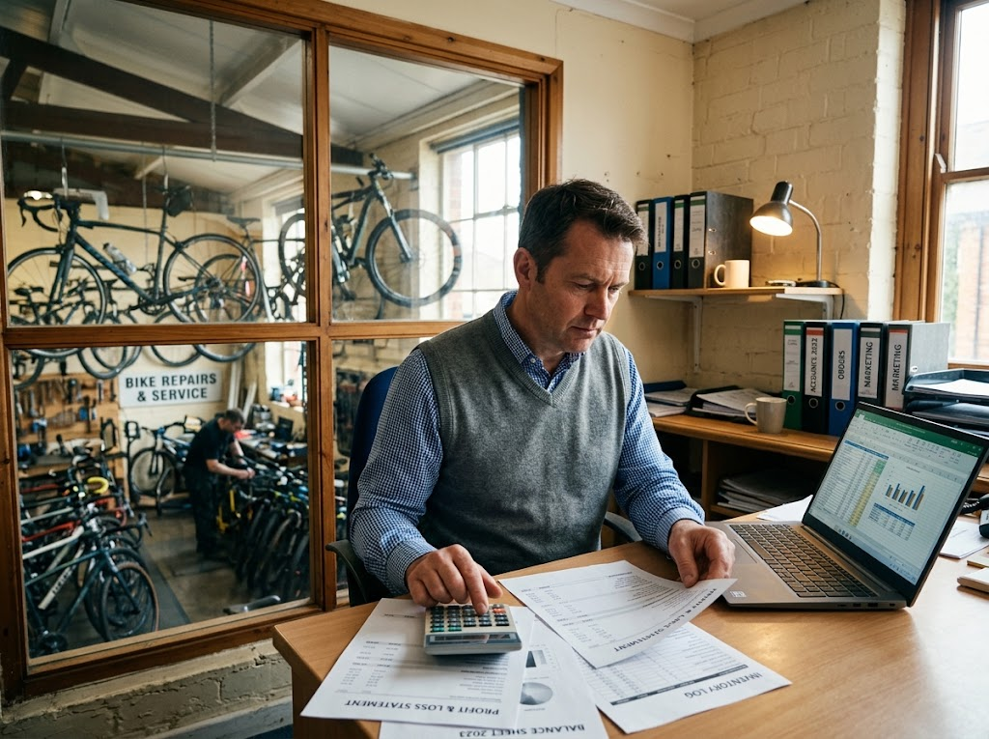
EDEXCEL GCSE BUSINESS · PAPER 2
Reading the Accounts
Revenue alone tells an owner little. Gross profit shows whether the business is buying and making its products at the right cost; net profit shows whether it is controlling everything else. The margins let the owner compare one year with another.
Gross profit, net profit and margins tell an owner how the business is really doing.
Making financial decisions
openrevise.com
Lesson 1 of 2

Slide 10
EDEXCEL GCSE BUSINESS · PAPER 2
PART TWO
Profit Margins
Turning profit into a percentage.
openrevise.com

Slide 11

EDEXCEL GCSE BUSINESS · PAPER 2
Gross Profit Margin
Gross profit margin (%) = (gross profit ÷ sales revenue) × 100.
What it shows
How many pence of gross profit the business makes from every £1 of sales.
A higher margin
Means the business buys or makes its products cheaply compared with its selling price.
How to improve it
Raise prices, or find cheaper suppliers and cut the cost of sales.
Making financial decisions
openrevise.com
Lesson 1 of 2

Slide 12
EDEXCEL GCSE BUSINESS · PAPER 2
Bright Bikes' Gross Profit Margin
Divide, then multiply by 100.
Bright Bikes' gross profit is £200,000 and its sales revenue is £500,000. Calculate its gross profit margin.
Write the formula
GPM = (gross profit ÷ sales revenue) × 100
1
Put in the numbers
= (£200,000 ÷ £500,000) × 100
2
Work it out
= 0.4 × 100 = 40%
3
ANSWER
Gross profit margin = 40%
Making financial decisions
openrevise.com
Lesson 1 of 2

Slide 13
EDEXCEL GCSE BUSINESS · PAPER 2
Net Profit Margin
Net profit margin (%) = (net profit ÷ sales revenue) × 100.
What it shows
How many pence of net profit the business keeps from every £1 of sales, after all costs.
A higher margin
Means the business controls its costs well.
The gap between margins
A big gap between gross and net margin means operating expenses and interest are taking a large share - a sign to control overheads.
Making financial decisions
openrevise.com
Lesson 1 of 2

Slide 14
EDEXCEL GCSE BUSINESS · PAPER 2
Bright Bikes' Net Profit Margin
Same method, using net profit.
Bright Bikes' net profit is £70,000 and its sales revenue is £500,000. Calculate its net profit margin.
Write the formula
NPM = (net profit ÷ sales revenue) × 100
1
Put in the numbers
= (£70,000 ÷ £500,000) × 100
2
Work it out
= 0.14 × 100 = 14%
3
ANSWER
Net profit margin = 14%
Making financial decisions
openrevise.com
Lesson 1 of 2

Slide 15
EDEXCEL GCSE BUSINESS · PAPER 2
Bright Bikes at a Glance
£200,000
40%
£70,000
14%
Gross profit
Gross profit margin
Net profit
Net profit margin
Making financial decisions
openrevise.com
Lesson 1 of 2

Slide 16

EDEXCEL GCSE BUSINESS · PAPER 2
CASE STUDY
Supermarkets: Pennies in the Pound
The UK's big supermarkets sell billions of pounds of food and household goods every year, but their net profit margins are usually very low - often just a few pence of profit for every pound customers spend. Competition on price is fierce, so they keep prices low and make their profit through enormous sales volumes. A luxury brand, by contrast, may sell far less but keep a much larger share of every pound as profit. Comparing margins, not just profit in pounds, shows how differently businesses make their money.
Few pence
Volume
Net profit per £1 of sales at a typical UK supermarket
How supermarkets make their profit
Making financial decisions
openrevise.com
Lesson 1 of 2

Slide 17

EDEXCEL GCSE BUSINESS · PAPER 2
Key Terms
Sales revenue
The money received from selling products.
Cost of sales
The direct cost of making or buying the products sold.
Gross profit
Sales revenue minus cost of sales.
Other operating expenses
Costs of running the business not included in cost of sales, such as rent and salaries.
Net profit
Gross profit minus other operating expenses and interest.
Gross profit margin
Gross profit as a percentage of sales revenue.
Making financial decisions
openrevise.com
Lesson 1 of 2

Slide 18
EDEXCEL GCSE BUSINESS · PAPER 2
Key Terms (cont.)
Net profit margin
Net profit as a percentage of sales revenue.
Income statement
A financial statement showing a business's revenue, costs and profit over a period.
Making financial decisions
openrevise.com
Lesson 1 of 2

Slide 19

EDEXCEL GCSE BUSINESS · PAPER 2
YOUR TASK
15 minutes
Run the Accounts
A sports shop has sales revenue of £250,000, cost of sales of £150,000, other operating expenses of £60,000 and interest of £5,000. Calculate its gross profit, net profit, gross profit margin and net profit margin. Then suggest one way to improve each margin.
1
Calculate gross profit.
2
Calculate net profit.
3
Calculate both margins.
Suggest improvements.
4
WHAT A GOOD ANSWER SHOWS
Gross profit £100,000; net profit £35,000; GPM 40%; NPM 14%; a way to cut cost of sales or raise prices, and a way to cut overheads.
Making financial decisions
openrevise.com
Lesson 1 of 2
Notes:
Common slip: dividing by cost of sales instead of revenue. Margins are always a percentage of revenue.

Slide 20

EDEXCEL GCSE BUSINESS · PAPER 2
Can I...?
Explain cost of sales.
Calculate gross profit margin.
Calculate gross profit.
Calculate net profit margin.
Explain other operating expenses.
Read an income statement.
Calculate net profit.
Suggest how to improve margins.
Making financial decisions
openrevise.com
Lesson 1 of 2

Slide 21
EDEXCEL GCSE BUSINESS · PAPER 2
Summary & Exam Focus
Gross profit = sales revenue - cost of sales.
Net profit = gross profit - other operating expenses and interest.
Gross profit margin = (gross profit ÷ sales revenue) × 100.
Net profit margin = (net profit ÷ sales revenue) × 100.
EXAM FOCUS
Calculate the net profit margin for a business with net profit of £45,000 and sales revenue of £300,000. (2 marks)
Write the formula, show the division, give the answer with a % sign. Margins always divide by sales revenue - never by costs.
openrevise.com

Slide 22
EDEXCEL GCSE BUSINESS · PAPER 2
Exam Practice: Business Calculations
Answer all questions. Show your working in calculations. · 25 minutes
Question 1 · 1 mark · Define
Define the term 'gross profit'.
Question 2 · 2 marks · Calculate
A business has sales revenue of £800,000 and cost of sales of £480,000. Calculate its gross profit margin. You are advised to show your…
Question 3 · 2 marks · Calculate
The same business has other operating expenses of £200,000 and interest of £16,000. Calculate its net profit margin. You are advised to…
Making financial decisions
openrevise.com
Lesson 1 of 2

Slide 23
EDEXCEL GCSE BUSINESS · PAPER 2
Exam Practice: Business Calculations (cont.)
Question 4 · 3 marks · Explain
Explain one way a business could increase its gross profit margin.
Question 5 · 6 marks · Analyse
Analyse the financial performance of Fresh Plate Ltd this year.
Making financial decisions
openrevise.com
Lesson 1 of 2

Slide 24
EDEXCEL GCSE BUSINESS · PAPER 2
Question 1 · 1 mark · Define
“
Define the term 'gross profit'.
HOW TO ANSWER IT
Command word: Define. Worth 1 mark, so plan before writing.
Making financial decisions
openrevise.com
Lesson 1 of 2

Slide 25
EDEXCEL GCSE BUSINESS · PAPER 2
Question 1 · mark scheme
1 mark available. Award a mark for each point made.
Revenue - cost of sales
1 mark
Making financial decisions
openrevise.com
Lesson 1 of 2

Slide 26
EDEXCEL GCSE BUSINESS · PAPER 2
Question 2 · 2 marks · Calculate
“
A business has sales revenue of £800,000 and cost of sales of £480,000. Calculate its gross profit margin. You are advised to show your working.
HOW TO ANSWER IT
Command word: Calculate. Worth 2 marks, so plan before writing.
Making financial decisions
openrevise.com
Lesson 1 of 2

Slide 27
EDEXCEL GCSE BUSINESS · PAPER 2
Question 2 · mark scheme
2 marks available. Award a mark for each point made.
Correct method: (revenue - cost of sales) ÷ revenue × 100
1 mark
Correct answer: 40%
1 mark (award 2 marks for the correct answer with no working)
Making financial decisions
openrevise.com
Lesson 1 of 2

Slide 28
EDEXCEL GCSE BUSINESS · PAPER 2
Question 3 · 2 marks · Calculate
“
The same business has other operating expenses of £200,000 and interest of £16,000. Calculate its net profit margin. You are advised to show your working.
HOW TO ANSWER IT
Command word: Calculate. Worth 2 marks, so plan before writing.
Making financial decisions
openrevise.com
Lesson 1 of 2

Slide 29
EDEXCEL GCSE BUSINESS · PAPER 2
Question 3 · mark scheme
2 marks available. Award a mark for each point made.
Correct method: net profit ÷ revenue × 100
1 mark
Correct answer: 13%
1 mark (own figure rule applies)
Making financial decisions
openrevise.com
Lesson 1 of 2

Slide 30
EDEXCEL GCSE BUSINESS · PAPER 2
Question 4 · 3 marks · Explain
“
Explain one way a business could increase its gross profit margin.
HOW TO ANSWER IT
Command word: Explain. Worth 3 marks, so plan before writing.
Making financial decisions
openrevise.com
Lesson 1 of 2

Slide 31
EDEXCEL GCSE BUSINESS · PAPER 2
Question 4 · mark scheme
3 marks available. Award a mark for each point made.
A way identified, e.g. cheaper supplier / raise prices / reduce waste
1 mark
First linked point of explanation
1 mark
Second linked point of explanation
1 mark
Making financial decisions
openrevise.com
Lesson 1 of 2

Slide 32
EDEXCEL GCSE BUSINESS · PAPER 2
Question 5 · 6 marks · Analyse
“
Analyse the financial performance of Fresh Plate Ltd this year.
— Fresh Plate Ltd runs three restaurants. This year its sales revenue rose from £900,000 to £1,000,000. Its gross profit margin stayed at 65%, but its net profit margin fell from…
HOW TO ANSWER IT
Command word: Analyse. Worth 6 marks, so plan before writing.
Making financial decisions
openrevise.com
Lesson 1 of 2

Slide 33
EDEXCEL GCSE BUSINESS · PAPER 2
Question 5 · mark scheme
6 marks available. Award a mark for each point made.
AO2 (Application, 3 marks): uses the figures - revenue £900,000 to £1,000,000, GPM 65%, NPM 12% to 8%
Level 1-3
AO3a (Analysis, 3 marks): chains of reasoning interpreting the margins
Level 1-3
Making financial decisions
openrevise.com
Lesson 1 of 2

