Slide 1

EDEXCEL GCSE BUSINESS · PAPER 2
Understanding business performance
Making financial decisions
Lesson 2 of 2
openrevise.com

Slide 2

EDEXCEL GCSE BUSINESS · PAPER 2
Last Lesson
Answer from memory before the answers appear.
How do you calculate gross profit?
1
How do you calculate net profit?
2
How do you calculate gross profit margin?
3
What is Bright Bikes' net profit margin?
4
Making financial decisions
openrevise.com
Lesson 2 of 2

Slide 3
EDEXCEL GCSE BUSINESS · PAPER 2
Last Lesson - Answers
How do you calculate gross profit?
Sales revenue - cost of sales.
1
How do you calculate net profit?
Gross profit - other operating expenses and interest.
2
How do you calculate gross profit margin?
(Gross profit ÷ sales revenue) × 100.
3
What is Bright Bikes' net profit margin?
14% (£70,000 ÷ £500,000 × 100).
4
Making financial decisions
openrevise.com
Lesson 2 of 2

Slide 4

EDEXCEL GCSE BUSINESS · PAPER 2
Learning Objectives
Calculate and interpret the average rate of return (ARR).
1
Interpret graphs and charts of business data.
2
Explain the use of financial, market and marketing data in decision making.
3
Explain the use and limitations of quantitative and qualitative data.
4
Making financial decisions
openrevise.com
Lesson 2 of 2

Slide 5

EDEXCEL GCSE BUSINESS · PAPER 2
PART ONE
Average Rate of Return
Is an investment worth it?
openrevise.com

Slide 6

EDEXCEL GCSE BUSINESS · PAPER 2
What Is the Average Rate of Return?
The average rate of return (ARR) shows the average yearly profit from an investment as a percentage of what it cost.
Investment
Spending money now to earn more later - a new machine, a new shop or a new delivery van.
Formula
ARR (%) = (average annual profit ÷ cost of investment) × 100.
Average annual profit
(Total returns - cost of investment) ÷ number of years.
What it shows
The higher the ARR, the better the investment. It can be compared with other investments, or with the interest rate a bank would pay.
Making financial decisions
openrevise.com
Lesson 2 of 2

Slide 7

EDEXCEL GCSE BUSINESS · PAPER 2
Calculating ARR
Three steps: total profit, average annual profit, then ARR.
Bright Bikes buys a £40,000 machine to build bike frames. Over 4 years it expects the machine to bring in total returns of £56,000. Calculate the average rate of return.
Total profit
£56,000 - £40,000 = £16,000
1
Average annual profit
£16,000 ÷ 4 years = £4,000
2
ARR
(£4,000 ÷ £40,000) × 100 = 10%
3
ANSWER
ARR = 10%
Making financial decisions
openrevise.com
Lesson 2 of 2

Slide 8

EDEXCEL GCSE BUSINESS · PAPER 2
Using ARR to Make Decisions
ARR helps a business choose between investments.
Compare investments
Choose the one with the highest ARR.
Compare with interest rates
If the ARR is below what the money would earn in the bank, the investment may not be worth the risk.
Set a target
Some businesses only invest if the ARR is above a set level, such as 10%.
Limitations
ARR relies on forecast returns, which may be wrong, and ignores when the money comes in and non-financial factors.
Making financial decisions
openrevise.com
Lesson 2 of 2

Slide 9
EDEXCEL GCSE BUSINESS · PAPER 2
PART TWO
Reading Business Data
Graphs, charts and what they show.
openrevise.com

Slide 10

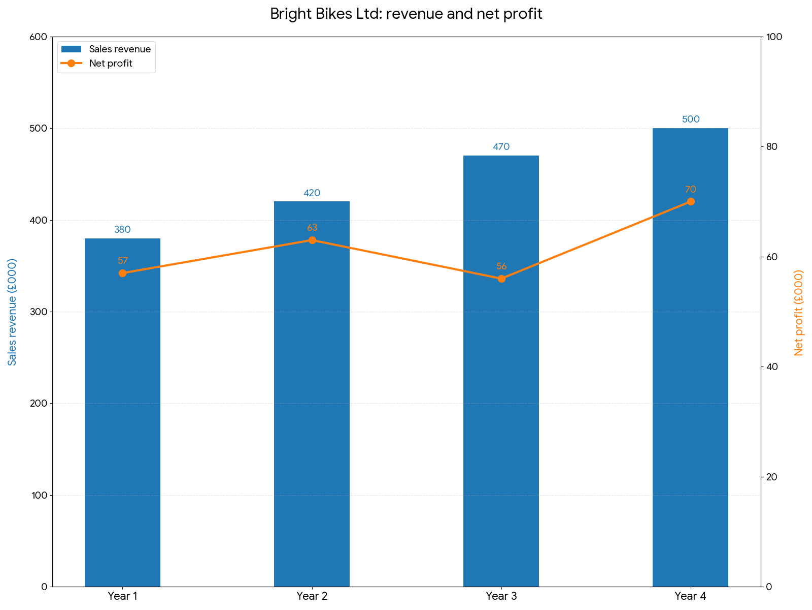
EDEXCEL GCSE BUSINESS · PAPER 2
Bright Bikes: Four Years of Performance
A chart shows at a glance what a table of numbers hides. Bright Bikes' revenue rose every year - but in Year 3 its net profit fell, even though sales were higher. That is the question a manager needs to ask: what went wrong with costs in Year 3?
Revenue rose every year, but net profit fell in Year 3.
Making financial decisions
openrevise.com
Lesson 2 of 2

Slide 11

EDEXCEL GCSE BUSINESS · PAPER 2
The Figures Behind the Chart
Year
Sales revenue
Net profit
Net profit margin
Year 1
£380,000
£57,000
15.0%
Year 2
£420,000
£63,000
15.0%
Year 3
£470,000
£56,000
11.9%
Year 4
£500,000
£70,000
14.0%
Making financial decisions
openrevise.com
Lesson 2 of 2

Slide 12
EDEXCEL GCSE BUSINESS · PAPER 2
Interpreting the Data
What a manager learns from Bright Bikes' figures.
Trend
Revenue grew every year, by £120,000 over four years - the business is winning more customers.
Year 3
Net profit fell and the margin dropped to 11.9% - costs rose faster than sales.
Recovery
In Year 4 the margin recovered to 14%, suggesting costs were brought back under control.
The next question
Data shows what happened, but not always why - the manager needs to find out what caused the Year 3 costs.
Making financial decisions
openrevise.com
Lesson 2 of 2

Slide 13
EDEXCEL GCSE BUSINESS · PAPER 2
PART THREE
Using Data to Make Decisions
Different data, different uses.
openrevise.com

Slide 14
EDEXCEL GCSE BUSINESS · PAPER 2
Types of Business Data
Financial data
Revenue, costs, profit, margins, cash flow and ARR - how well the business is performing financially.
Market data
The size of the market, how fast it is growing, market share and what competitors are doing.
Marketing data
Results of promotions, website visits, customer feedback, sales by product and by segment.
Making financial decisions
openrevise.com
Lesson 2 of 2

Slide 15

EDEXCEL GCSE BUSINESS · PAPER 2
Quantitative or Qualitative Data?
QUANTITATIVE DATA (NUMBERS)
QUALITATIVE DATA (OPINIONS)
• Revenue, profit, margins, market share.
• Easy to compare over time and with competitors.
• Easy to present in graphs and charts.
• But: shows what happened, not why.
• Can be out of date, or based on forecasts that turn out wrong.
• Customer reviews, staff feedback, focus groups.
• Explains why customers and staff behave as they do.
• Gives ideas for improvement.
• But: harder to measure and compare.
• Can be biased, and based on a few people's views.
Making financial decisions
openrevise.com
Lesson 2 of 2

Slide 16

EDEXCEL GCSE BUSINESS · PAPER 2
The Limitations of Financial Information
Financial data is vital, but it never tells the whole story.
It looks backwards
Accounts show what has already happened, not what will happen next.
It ignores non-financial factors
Staff morale, customer satisfaction and reputation do not appear in the accounts.
Forecasts may be wrong
Future figures, such as ARR returns, are estimates.
Context matters
A fall in profit may be due to a one-off cost or a recession, not poor management.
Making financial decisions
openrevise.com
Lesson 2 of 2

Slide 17

EDEXCEL GCSE BUSINESS · PAPER 2
Key Terms
Investment
Spending money now in the hope of earning more in the future.
Average rate of return (ARR)
Average annual profit from an investment as a percentage of its cost.
Financial data
Information about a business's revenue, costs, profit and cash.
Market data
Information about the market, such as its size, growth and market share.
Marketing data
Information about the results of a business's marketing, such as sales and customer feedback.
Quantitative data
Data in the form of numbers.
Qualitative data
Data about opinions, feelings and reasons.
Making financial decisions
openrevise.com
Lesson 2 of 2

Slide 18

EDEXCEL GCSE BUSINESS · PAPER 2
YOUR TASK
15 minutes
Which Investment?
Bright Bikes has £60,000 to invest. Option A: a new shop costing £60,000, with total returns of £90,000 over 5 years. Option B: a website upgrade costing £60,000, with total returns of £84,000 over 3 years. Calculate the ARR of each, recommend one, and give one non-financial factor Bright Bikes should also consider.
1
Calculate ARR for Option A.
2
Calculate ARR for Option B.
3
Recommend one.
Give a non-financial factor.
4
WHAT A GOOD ANSWER SHOWS
Option A ARR 10% (£30,000 ÷ 5 = £6,000; £6,000 ÷ £60,000 × 100). Option B ARR 13.3% (£24,000 ÷ 3 = £8,000; £8,000 ÷ £60,000 × 100). A recommendation using ARR plus a non-financial factor such as staff or customer experience.
Making financial decisions
openrevise.com
Lesson 2 of 2
Notes:
Option B has the higher ARR, but its returns come from a forecast; a good answer questions how reliable each forecast is.

Slide 19

EDEXCEL GCSE BUSINESS · PAPER 2
Can I...?
Explain what ARR shows.
Interpret a graph of business data.
Calculate average annual profit.
Explain financial, market and marketing data.
Calculate ARR.
Explain the limits of quantitative and qualitative data.
Use ARR to compare investments.
Explain the limits of financial information.
Making financial decisions
openrevise.com
Lesson 2 of 2

Slide 20
EDEXCEL GCSE BUSINESS · PAPER 2
Summary & Exam Focus
ARR = (average annual profit ÷ cost of investment) × 100.
Graphs and charts reveal trends that tables hide.
Financial, market and marketing data all inform decisions.
Quantitative data shows what; qualitative data shows why; financial data has limits.
EXAM FOCUS
Calculate the average rate of return on an investment costing £50,000 that returns £70,000 in total over 5 years. (2 marks)
For ARR, subtract the cost first, then divide by the years, then by the cost. For data questions, quote the actual figures from the question in your answer.
openrevise.com

Slide 21
EDEXCEL GCSE BUSINESS · PAPER 2
Exam Practice: Understanding Business Performance
Answer all questions. Show your working in calculations. · 25 minutes
Question 1 · 1 mark · Define
Define the term 'average rate of return'.
Question 2 · 2 marks · Calculate
A business buys new equipment costing £50,000. It expects total returns of £70,000 over 5 years. Calculate the average rate of return. You…
Question 3 · 2 marks · Outline
Outline one limitation of using financial information to make business decisions.
Making financial decisions
openrevise.com
Lesson 2 of 2

Slide 22
EDEXCEL GCSE BUSINESS · PAPER 2
Exam Practice: Understanding Business Performance (cont.)
Question 4 · 3 marks · Explain
Explain one benefit to a business of using qualitative data alongside financial data.
Question 5 · 9 marks · Justify
Justify which one of these two options Crest Hotels Ltd should choose.
Making financial decisions
openrevise.com
Lesson 2 of 2

Slide 23
EDEXCEL GCSE BUSINESS · PAPER 2
Question 1 · 1 mark · Define
“
Define the term 'average rate of return'.
HOW TO ANSWER IT
Command word: Define. Worth 1 mark, so plan before writing.
Making financial decisions
openrevise.com
Lesson 2 of 2

Slide 24
EDEXCEL GCSE BUSINESS · PAPER 2
Question 1 · mark scheme
1 mark available. Award a mark for each point made.
Average yearly profit as a % of the cost of investment
1 mark
Making financial decisions
openrevise.com
Lesson 2 of 2

Slide 25
EDEXCEL GCSE BUSINESS · PAPER 2
Question 2 · 2 marks · Calculate
“
A business buys new equipment costing £50,000. It expects total returns of £70,000 over 5 years. Calculate the average rate of return. You are advised to show your working.
HOW TO ANSWER IT
Command word: Calculate. Worth 2 marks, so plan before writing.
Making financial decisions
openrevise.com
Lesson 2 of 2

Slide 26
EDEXCEL GCSE BUSINESS · PAPER 2
Question 2 · mark scheme
2 marks available. Award a mark for each point made.
Correct method: ((total returns - cost) ÷ years) ÷ cost × 100
1 mark
Correct answer: 8%
1 mark (award 2 marks for the correct answer with no working)
Making financial decisions
openrevise.com
Lesson 2 of 2

Slide 27
EDEXCEL GCSE BUSINESS · PAPER 2
Question 3 · 2 marks · Outline
“
Outline one limitation of using financial information to make business decisions.
HOW TO ANSWER IT
Command word: Outline. Worth 2 marks, so plan before writing.
Making financial decisions
openrevise.com
Lesson 2 of 2

Slide 28
EDEXCEL GCSE BUSINESS · PAPER 2
Question 3 · mark scheme
2 marks available. Award a mark for each point made.
A limitation identified, e.g. backward-looking / ignores non-financial factors / forecasts may be wrong
1 mark
Developed
1 mark
Making financial decisions
openrevise.com
Lesson 2 of 2

Slide 29
EDEXCEL GCSE BUSINESS · PAPER 2
Question 4 · 3 marks · Explain
“
Explain one benefit to a business of using qualitative data alongside financial data.
HOW TO ANSWER IT
Command word: Explain. Worth 3 marks, so plan before writing.
Making financial decisions
openrevise.com
Lesson 2 of 2

Slide 30
EDEXCEL GCSE BUSINESS · PAPER 2
Question 4 · mark scheme
3 marks available. Award a mark for each point made.
A benefit identified
1 mark
First linked point of explanation
1 mark
Second linked point of explanation
1 mark
Making financial decisions
openrevise.com
Lesson 2 of 2

Slide 31
EDEXCEL GCSE BUSINESS · PAPER 2
Question 5 · 9 marks · Justify
“
Justify which one of these two options Crest Hotels Ltd should choose.
— Crest Hotels Ltd has £200,000 to invest. Option 1: Build 10 new rooms, with an ARR of 12%. Option 2: Build a spa, with an ARR of 9%. Customer reviews often mention that the hotel…
HOW TO ANSWER IT
Command word: Justify. Worth 9 marks, so plan before writing.
Making financial decisions
openrevise.com
Lesson 2 of 2

Slide 32
EDEXCEL GCSE BUSINESS · PAPER 2
Question 5 · mark scheme
9 marks available. Award a mark for each point made.
AO2 (Application, 3 marks): uses the context - 12% vs 9% ARR, reviews, the new competitor
Level 1-3
AO3a (Analysis, 3 marks): chains of reasoning using both financial and qualitative data
Level 1-3
AO3b (Evaluation, 3 marks): a justified choice with a supported judgement
Level 1-3
Making financial decisions
openrevise.com
Lesson 2 of 2

