Slide 1

EDEXCEL GCSE BUSINESS · PAPER 2
Training
Making human resource decisions
Lesson 3 of 4
openrevise.com

Slide 2

EDEXCEL GCSE BUSINESS · PAPER 2
Last Lesson
Answer from memory before the answers appear.
What is a job description?
1
What is a person specification?
2
Give one benefit of internal recruitment.
3
Give one benefit of external recruitment.
4
Making human resource decisions
openrevise.com
Lesson 3 of 4

Slide 3
EDEXCEL GCSE BUSINESS · PAPER 2
Last Lesson - Answers
What is a job description?
A document describing the job's tasks, responsibilities and conditions.
1
What is a person specification?
A document describing the ideal person for the job.
2
Give one benefit of internal recruitment.
Cheaper, quicker, known ability or motivating.
3
Give one benefit of external recruitment.
New ideas, new skills and a wider choice.
4
Making human resource decisions
openrevise.com
Lesson 3 of 4

Slide 4

EDEXCEL GCSE BUSINESS · PAPER 2
Learning Objectives
Explain induction training.
1
Explain on-the-job and off-the-job training.
2
Explain formal and informal training, self-learning and ongoing training.
3
Explain target setting and performance reviews.
4
Explain why businesses train their staff.
5
Making human resource decisions
openrevise.com
Lesson 3 of 4

Slide 5

EDEXCEL GCSE BUSINESS · PAPER 2
Induction Training
Induction training introduces new employees to the business when they start.
What it covers
The business's aims, the building and facilities, health and safety, key people and the rules and procedures.
Why it matters
New staff settle in faster, feel welcome and become productive sooner.
Safety
It makes sure new staff know how to work safely from day one.
Retention
Staff who are welcomed properly are less likely to leave in their first months.
Making human resource decisions
openrevise.com
Lesson 3 of 4

Slide 6

EDEXCEL GCSE BUSINESS · PAPER 2
PART ONE
On-the-job and Off-the-job
Learning at work, or away from it.
openrevise.com

Slide 7

EDEXCEL GCSE BUSINESS · PAPER 2
On-the-job or Off-the-job Training?
ON-THE-JOB TRAINING
OFF-THE-JOB TRAINING
• Learning while doing the job, at the workplace.
• Watching and copying an experienced colleague, or being coached.
• Cheap: no course fees or travel.
• Staff keep working and producing while they learn.
• But: only as good as the person teaching, who may pass on bad habits.
• Learning away from the workplace - at a college, training centre or on a course.
• Taught by specialists, often leading to qualifications.
• Staff can focus without the distractions of work.
• But: expensive, and staff are not working while they train.
• Qualified staff may leave for better-paid jobs.
Making human resource decisions
openrevise.com
Lesson 3 of 4

Slide 8

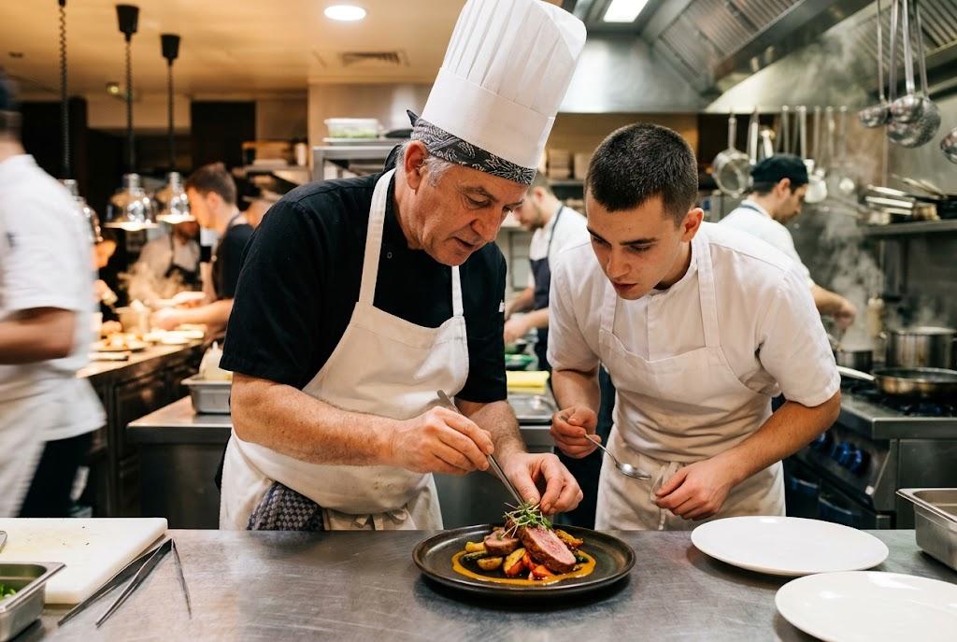

EDEXCEL GCSE BUSINESS · PAPER 2
Two Ways to Learn
At work, or away from it.
On-the-job: learning by doing, alongside an expert.
Off-the-job: a course away from the workplace.
Making human resource decisions
openrevise.com
Lesson 3 of 4

Slide 9

EDEXCEL GCSE BUSINESS · PAPER 2
Other Types of Training and Development
Formal training
Planned, structured training, such as a course or programme with set content.
Informal training
Learning as you go, picking up skills from colleagues without a set programme.
Self-learning
Staff learn on their own - online courses, videos and reading - often at their own pace.
Ongoing training
Regular training throughout an employee's career, to keep skills up to date as technology and the job change.
Making human resource decisions
openrevise.com
Lesson 3 of 4

Slide 10
EDEXCEL GCSE BUSINESS · PAPER 2
PART TWO
Developing Staff
Setting targets and reviewing performance.
openrevise.com

Slide 11
EDEXCEL GCSE BUSINESS · PAPER 2
Target Setting and Performance Reviews
Businesses help staff improve by setting goals and reviewing progress.
Target setting
Agreeing clear, measurable targets for each employee, linked to the business's objectives.
Performance reviews
Regular meetings between an employee and their manager to discuss progress against targets.
Identifying training needs
Reviews show where an employee needs more training or support.
Motivation
Staff who know what is expected, and are recognised for achieving it, are more motivated.
Making human resource decisions
openrevise.com
Lesson 3 of 4

Slide 12

EDEXCEL GCSE BUSINESS · PAPER 2
Why Train Staff?
Training costs money, but the benefits are large.
Productivity
Skilled staff work faster and make fewer mistakes.
Quality and service
Better-trained staff produce better products and serve customers better.
Motivation and retention
Staff who are invested in feel valued and are less likely to leave, cutting recruitment costs.
Making human resource decisions
openrevise.com
Lesson 3 of 4

Slide 13
EDEXCEL GCSE BUSINESS · PAPER 2
Why Train Staff? (cont.)
Keeping up
Training helps staff use new technology and adapt to change.
The risk
Well-trained staff may be poached by competitors.
Making human resource decisions
openrevise.com
Lesson 3 of 4

Slide 14

EDEXCEL GCSE BUSINESS · PAPER 2
CASE STUDY
McDonald's: Hamburger University
McDonald's opened its first "Hamburger University" training centre in the USA in 1961 to train managers in how to run its restaurants. Today McDonald's trains hundreds of thousands of staff worldwide. In the UK it offers apprenticeships and qualifications to its restaurant staff, combining on-the-job training in the restaurant with structured learning towards a recognised qualification. Consistent training means a customer gets the same service and food in every restaurant - and staff can build a career, from crew member to restaurant manager.
1961
Apprenticeships
Hamburger University opens
Offered to UK staff alongside their work
Making human resource decisions
openrevise.com
Lesson 3 of 4

Slide 15
EDEXCEL GCSE BUSINESS · PAPER 2
Key Terms
Induction training
Training that introduces new employees to the business.
On-the-job training
Training while doing the job at the workplace.
Off-the-job training
Training away from the workplace.
Formal training
Planned, structured training with set content.
Informal training
Learning skills from colleagues without a set programme.
Self-learning
Staff learning on their own, at their own pace.
Performance review
A meeting to discuss an employee's progress against their targets.
Making human resource decisions
openrevise.com
Lesson 3 of 4

Slide 16

EDEXCEL GCSE BUSINESS · PAPER 2
YOUR TASK
12 minutes
Plan the Training
A hotel is taking on 10 new receptionists and upgrading its booking software for all staff. Plan the training: what induction the new receptionists need, whether the software training should be on-the-job or off-the-job, and how the hotel will check the training has worked.
1
Plan the induction.
2
Choose on-the-job or off-the-job for the software.
3
Explain how you will check it worked.
WHAT A GOOD ANSWER SHOWS
An induction covering safety, systems and the hotel's standards; a justified choice of on- or off-the-job training for the software; and a check such as performance reviews or targets.
Making human resource decisions
openrevise.com
Lesson 3 of 4

Slide 17

EDEXCEL GCSE BUSINESS · PAPER 2
Can I...?
Explain induction training.
Explain formal and informal training.
Explain on-the-job training.
Explain self-learning and ongoing training.
Explain off-the-job training.
Explain target setting and performance reviews.
Compare on-the-job and off-the-job training.
Explain why businesses train staff.
Making human resource decisions
openrevise.com
Lesson 3 of 4

Slide 18
EDEXCEL GCSE BUSINESS · PAPER 2
Summary & Exam Focus
Induction training welcomes new staff and teaches safety and procedures.
On-the-job training is cheap and practical; off-the-job training is specialist but costly.
Formal, informal, self-learning and ongoing training keep skills up to date.
Target setting and performance reviews guide development and show training needs.
EXAM FOCUS
Explain one benefit to a business of off-the-job training. (3 marks)
Balance the cost of training against its benefits: productivity, quality, motivation and retention.
openrevise.com

