Slide 1

EDEXCEL GCSE MATHS · FOUNDATION & HIGHER
Number problems and reasoning
Number
Lesson 1 of 7
openrevise.com

Slide 2

EDEXCEL GCSE MATHS · FOUNDATION & HIGHER
Before We Start
Answer each one, then check.
1
Work out 3 × 4 × 5.
2
Work out 6 × 5 × 4.
3
A coin is flipped. How many possible outcomes are there?
4
A dice is rolled. How many possible outcomes are there?
5
List every two-digit number you can make from the digits 1 and 2, using each digit once.
Number
openrevise.com
Lesson 1 of 7

Slide 3
EDEXCEL GCSE MATHS · FOUNDATION & HIGHER
Before We Start - Answers
Work out 3 × 4 × 5.
60
1
Work out 6 × 5 × 4.
120
2
A coin is flipped. How many possible outcomes are there?
2: heads or tails.
3
A dice is rolled. How many possible outcomes are there?
6
4
List every two-digit number you can make from the digits 1 and 2, using each digit once.
12 and 21
5
Number
openrevise.com
Lesson 1 of 7

Slide 4

EDEXCEL GCSE MATHS · FOUNDATION & HIGHER
Learning Objectives
List all the possible outcomes of a situation systematically.
1
Use the product rule to count outcomes without listing them. (Higher)
2
Count arrangements when items cannot be used twice. (Higher)
3
Solve counting problems with restrictions. (Higher)
4
Count the pairs that can be chosen from a group. (Higher)
5
Number
openrevise.com
Lesson 1 of 7

Slide 5

EDEXCEL GCSE MATHS · FOUNDATION & HIGHER
Listing Systematically
A systematic list follows a pattern, so that no outcome is missed and none is written twice.
Fix the first choice
Keep the first item the same and work through every option for the second.
Then move on
Change the first item and repeat the same pattern.
Use letters
Write S for soup, C for chicken and so on - it is quicker and clearer.
Count at the end
Once the list is complete, count it.
Number
openrevise.com
Lesson 1 of 7

Slide 6

EDEXCEL GCSE MATHS · FOUNDATION & HIGHER
A Systematic List
A café offers 2 starters (Soup, Melon) and 3 mains (Chicken, Fish, Pasta).
Starter
With Chicken
With Fish
With Pasta
Soup (S)
SC
SF
SP
Melon (M)
MC
MF
MP
Total
2 rows
3 columns
2 × 3 = 6 meals
Number
openrevise.com
Lesson 1 of 7

Slide 7

EDEXCEL GCSE MATHS · FOUNDATION & HIGHER
PART ONE · HIGHER
The Product Rule
Counting without listing.
openrevise.com

Slide 8

EDEXCEL GCSE MATHS · FOUNDATION & HIGHER
The Product Rule for Counting
If one choice can be made in m ways and a second choice in n ways, the two choices together can be made in m × n ways.
Two choices
2 starters and 3 mains give 2 × 3 = 6 meals - exactly the list we wrote.
More choices
Keep multiplying: 5 sandwiches, 4 snacks and 3 drinks give 5 × 4 × 3 = 60 meal deals.
Why it works
Every one of the first choices can be paired with every one of the second.
When to use it
When the choices are made one after another and each choice does not affect the others.
Number
openrevise.com
Lesson 1 of 7

Slide 9

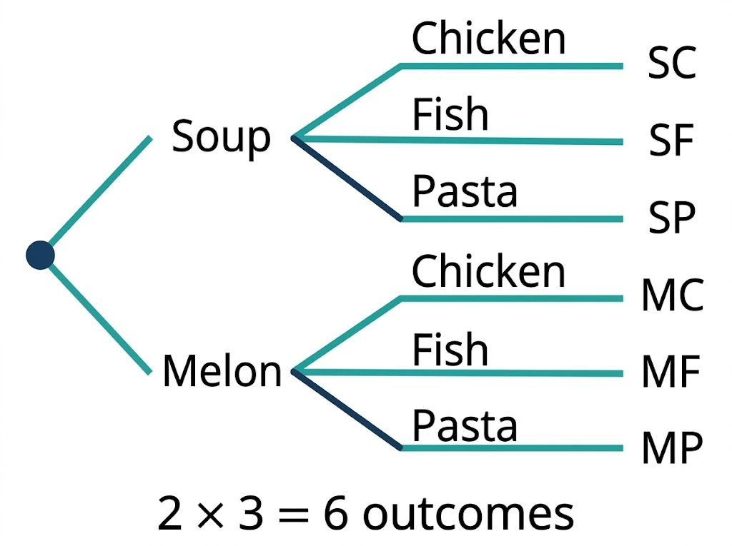
EDEXCEL GCSE MATHS · FOUNDATION & HIGHER
A Tree Diagram of Choices
A tree diagram shows why the product rule works. Each of the 2 first branches splits into 3, so there are 2 × 3 = 6 routes from start to finish - one for every possible meal.
Each starter branches into 3 mains: 2 × 3 = 6 outcomes.
Number
openrevise.com
Lesson 1 of 7

Slide 10

EDEXCEL GCSE MATHS · FOUNDATION & HIGHER
Counting Outfits
Priya has 4 T-shirts, 3 pairs of jeans and 2 pairs of trainers. How many different outfits of one T-shirt, one pair of jeans and one pair of trainers can she make?
Count the choices for the T-shirt
4
1
Count the choices for the jeans
3
2
Count the choices for the trainers
2
3
The choices are independent, so multiply
4 × 3 × 2 = 24
4
ANSWER
24 different outfits
Number
openrevise.com
Lesson 1 of 7

Slide 11
EDEXCEL GCSE MATHS · FOUNDATION & HIGHER
Counting Codes
A padlock code uses 4 digits from 0 to 9. (a) How many codes are possible? (b) How many are possible if no digit can be used twice?
1
(a) Each position can be any of 10 digits
10 × 10 × 10 × 10
2
Work it out
= 10 000
3
(b) The first digit has 10 choices
10
4
Each digit used leaves one fewer for the next
10 × 9 × 8 × 7
5
Work it out
= 5040
ANSWER
(a) 10 000 codes (b) 5040 codes
Number
openrevise.com
Lesson 1 of 7

Slide 12
EDEXCEL GCSE MATHS · FOUNDATION & HIGHER
PART TWO · HIGHER
Arrangements and Restrictions
When items cannot be used twice, and some positions have rules.
openrevise.com

Slide 13

EDEXCEL GCSE MATHS · FOUNDATION & HIGHER
Arranging Items in a Row
When items cannot be repeated, the number of choices goes down by one each time.
3 people in a line
3 × 2 × 1 = 6 ways.
5 people in a line
5 × 4 × 3 × 2 × 1 = 120 ways.
The pattern
n different items can be arranged in n × (n−1) × … × 2 × 1 ways.
Your calculator
The x! key (factorial) works this out: 5! = 120.
Number
openrevise.com
Lesson 1 of 7

Slide 14
EDEXCEL GCSE MATHS · FOUNDATION & HIGHER
Counting with a Restriction
How many three-digit numbers can be made from the digits 2, 3, 5 and 8, using each digit at most once, if the number must be even?
Deal with the restricted position first: the last digit must be even
2 or 8: 2 choices
1
The first digit can be any of the 3 digits left
3 choices
2
The middle digit can be any of the 2 digits left
2 choices
3
Multiply the choices
2 × 3 × 2 = 12
4
ANSWER
12 even three-digit numbers
Number
openrevise.com
Lesson 1 of 7

Slide 15
EDEXCEL GCSE MATHS · FOUNDATION & HIGHER
Choosing Pairs
When two people are chosen and the order does not matter, each pair gets counted twice.
Handshakes
10 people each shake hands with everyone else once. 10 × 9 = 90 counts every handshake twice (A with B, and B with A), so there are 90 ÷ 2 = 45 handshakes.
The pattern
n people make n(n−1)/2 pairs.
When order matters
Choosing a captain and a vice-captain from 10 people: 10 × 9 = 90 ways. Here A-then-B is different from B-then-A, so do not halve.
Number
openrevise.com
Lesson 1 of 7

Slide 16

EDEXCEL GCSE MATHS · FOUNDATION & HIGHER
Does the Order Matter?
ORDER MATTERS - DO NOT HALVE
ORDER DOES NOT MATTER - HALVE FOR PAIRS
• Captain and vice-captain.
• 1st and 2nd place in a race.
• Codes and PINs: 12 is not 21.
• Arranging people in a queue.
• Handshakes between two people.
• Choosing two people for a team.
• Two games in a round-robin chess club.
• Picking 2 toppings from a list.
Number
openrevise.com
Lesson 1 of 7

Slide 17
EDEXCEL GCSE MATHS · FOUNDATION & HIGHER
Counting Problem Checklist
Are repeats allowed?
Codes usually allow repeats; people in a queue cannot be used twice.
Does the order matter?
If swapping two choices gives the same outcome, you have double-counted.
Is there a restriction?
Fill the restricted positions first, then the rest.
Check with a small case
Try the method on a small version you can list, and see if it gives the same count.
Number
openrevise.com
Lesson 1 of 7

Slide 18
EDEXCEL GCSE MATHS · FOUNDATION & HIGHER
CASE STUDY
The Rubik's Cube
The Hungarian architecture lecturer Ernő Rubik invented his cube in 1974. It has 26 small visible pieces, and the product rule shows how the number of arrangements explodes: the 8 corner pieces alone can be placed in 8 × 7 × 6 × 5 × 4 × 3 × 2 × 1 = 40 320 orders, before they are even twisted. Multiply in the ways of placing and twisting the corners and edges, allow for the positions that cannot actually be reached, and the total number of positions is about 43 quintillion - 43 252 003 274 489 856 000.
1974
4.3 × 10¹⁹
Ernő Rubik invents the cube
Possible positions of a standard 3 × 3 × 3 cube
Number
openrevise.com
Lesson 1 of 7

Slide 19

EDEXCEL GCSE MATHS · FOUNDATION & HIGHER
Key Terms
Outcome
One possible result of a choice or experiment.
Systematic list
A list that follows a pattern so no outcome is missed or repeated.
Product rule for counting
If there are m ways to do one thing and n ways to do another, there are m × n ways to do both. (Higher)
Arrangement
An ordering of items, for example people in a queue.
Restriction
A rule that limits the choices, such as "the number must be even".
Factorial
n! = n × (n−1) × … × 2 × 1. For example, 4! = 24.
Number
openrevise.com
Lesson 1 of 7

Slide 20

EDEXCEL GCSE MATHS · FOUNDATION & HIGHER
YOUR TASK
10 minutes
The Ice Cream Van
An ice cream van sells 6 flavours, 3 types of cone and 4 toppings. Work out: (a) how many ice creams with one flavour, one cone and one topping are possible; (b) how many there are if the customer chooses two different flavours, and the order of the flavours does not matter; (c) how many two-flavour ices there are if the order of the scoops DOES matter.
1
Part (a): one flavour.
2
Part (b): two flavours, order does not matter.
3
Part (c): two flavours, order matters.
WHAT A GOOD ANSWER SHOWS
(a) 6 × 3 × 4 = 72. (b) Pairs of flavours: 6 × 5 ÷ 2 = 15, so 15 × 3 × 4 = 180. (c) 6 × 5 = 30, so 30 × 3 × 4 = 360.
Number
openrevise.com
Lesson 1 of 7
Notes:
Foundation students can list the pairs of flavours for (b) with 3 flavours first, then look for the pattern. Part (b) is where most students forget to halve.

Slide 21

EDEXCEL GCSE MATHS · FOUNDATION & HIGHER
Can I...?
List outcomes systematically.
Count arrangements of items in a row. (Higher)
Use a table to list combinations.
Fill a restricted position first. (Higher)
Use the product rule for counting. (Higher)
Count pairs chosen from a group. (Higher)
Count codes with and without repeats. (Higher)
Decide whether the order matters. (Higher)
Number
openrevise.com
Lesson 1 of 7

Slide 22
EDEXCEL GCSE MATHS · FOUNDATION & HIGHER
Summary & Exam Focus
List systematically: fix the first choice and work through the rest.
Product rule (Higher): m ways and n ways give m × n ways altogether.
No repeats: the choices go down by one each time.
Restrictions: fill the restricted position first.
Pairs where order does not matter: n(n−1)/2.
EXAM FOCUS
There are 12 students in a chess club. Each student plays every other student once. How many games are played? (3 marks)
Write the calculation as well as the answer: the method marks are for the product (12 × 11) and for dividing by 2 because each game was counted twice.
openrevise.com

Slide 23
EDEXCEL GCSE MATHS · FOUNDATION & HIGHER
Exam Practice: Number Problems and Reasoning
Answer all questions. Show your working. Questions 1 to 4 are non-calculator. · 25 minutes
Question 1 · 2 marks · Non-calculator
Here are three number cards: 2, 5 and 7. List all the three-digit numbers that can be made using each card once.
Question 2 · 2 marks · Non-calculator
Sam has 5 shirts and 4 ties. He chooses one shirt and one tie. How many different combinations of shirt and tie can he choose?
Question 3 · 3 marks · Non-calculator · Higher
There are 12 students in a chess club. Each student plays every other student once. How many games are played?
Number
openrevise.com
Lesson 1 of 7

Slide 24
EDEXCEL GCSE MATHS · FOUNDATION & HIGHER
Exam Practice: Number Problems and Reasoning (cont.)
Question 4 · 3 marks · Non-calculator · Higher
A security code is 2 letters followed by 3 digits. The letters are chosen from the 26 letters of the alphabet and cannot be repeated. The…
Question 5 · 4 marks · Calculator · Higher
How many odd numbers between 300 and 600 have three different digits?
Number
openrevise.com
Lesson 1 of 7

Slide 25
EDEXCEL GCSE MATHS · FOUNDATION & HIGHER
Question 1 · 2 marks · Non-calculator
“
Here are three number cards: 2, 5 and 7. List all the three-digit numbers that can be made using each card once.
HOW TO ANSWER IT
Command word: Non-calculator. Worth 2 marks, so plan before writing.
Number
openrevise.com
Lesson 1 of 7

Slide 26
EDEXCEL GCSE MATHS · FOUNDATION & HIGHER
Question 1 · mark scheme
2 marks available. Award a mark for each point made.
All 6 numbers listed, with no repeats and no extras
B2
At least 4 correct numbers listed
B1
Number
openrevise.com
Lesson 1 of 7

Slide 27
EDEXCEL GCSE MATHS · FOUNDATION & HIGHER
Question 2 · 2 marks · Non-calculator
“
Sam has 5 shirts and 4 ties. He chooses one shirt and one tie. How many different combinations of shirt and tie can he choose?
HOW TO ANSWER IT
Command word: Non-calculator. Worth 2 marks, so plan before writing.
Number
openrevise.com
Lesson 1 of 7

Slide 28
EDEXCEL GCSE MATHS · FOUNDATION & HIGHER
Question 2 · mark scheme
2 marks available. Award a mark for each point made.
5 × 4 seen, or a systematic list of at least 8 correct combinations
M1
20
A1
Number
openrevise.com
Lesson 1 of 7

Slide 29
EDEXCEL GCSE MATHS · FOUNDATION & HIGHER
Question 3 · 3 marks · Non-calculator · Higher
“
There are 12 students in a chess club. Each student plays every other student once. How many games are played?
HOW TO ANSWER IT
Command word: Non-calculator · Higher. Worth 3 marks, so plan before writing.
Number
openrevise.com
Lesson 1 of 7

Slide 30
EDEXCEL GCSE MATHS · FOUNDATION & HIGHER
Question 3 · mark scheme
3 marks available. Award a mark for each point made.
12 × 11 or 132 seen
M1
Dividing by 2
M1
66
A1
Number
openrevise.com
Lesson 1 of 7

Slide 31
EDEXCEL GCSE MATHS · FOUNDATION & HIGHER
Question 4 · 3 marks · Non-calculator · Higher
“
A security code is 2 letters followed by 3 digits. The letters are chosen from the 26 letters of the alphabet and cannot be repeated. The digits are chosen from 0 to 9 and can be repeated. How many different codes are possible?
HOW TO ANSWER IT
Command word: Non-calculator · Higher. Worth 3 marks, so plan before writing.
Number
openrevise.com
Lesson 1 of 7

Slide 32
EDEXCEL GCSE MATHS · FOUNDATION & HIGHER
Question 4 · mark scheme
3 marks available. Award a mark for each point made.
26 × 25 or 650
P1
10 × 10 × 10 or 1000
P1
650 000
A1
Number
openrevise.com
Lesson 1 of 7

Slide 33
EDEXCEL GCSE MATHS · FOUNDATION & HIGHER
Question 5 · 4 marks · Calculator · Higher
“
How many odd numbers between 300 and 600 have three different digits?
HOW TO ANSWER IT
Command word: Calculator · Higher. Worth 4 marks, so plan before writing.
Number
openrevise.com
Lesson 1 of 7

Slide 34
EDEXCEL GCSE MATHS · FOUNDATION & HIGHER
Question 5 · mark scheme
4 marks available. Award a mark for each point made.
Splits into cases by first digit (odd first digit and 4 as first digit)
P1
2 × 4 × 8 or 64
P1
1 × 5 × 8 or 40
P1
104
A1
Number
openrevise.com
Lesson 1 of 7

