Slide 1

EDEXCEL GCSE MATHS · FOUNDATION & HIGHER
Calculating with powers (indices)
Number
Lesson 4 of 7
openrevise.com

Slide 2

EDEXCEL GCSE MATHS · FOUNDATION & HIGHER
Last Lesson and Before
Answer each one, then check.
1
What is 5²?
2
What is √81?
3
Last lesson: write 72 as a product of prime factors in index form.
4
Last lesson: find the HCF of 12 and 18.
5
Last lesson: find the LCM of 4 and 10.
Number
openrevise.com
Lesson 4 of 7

Slide 3
EDEXCEL GCSE MATHS · FOUNDATION & HIGHER
Last Lesson and Before - Answers
What is 5²?
25
1
What is √81?
9
2
Last lesson: write 72 as a product of prime factors in index form.
2³ × 3²
3
Last lesson: find the HCF of 12 and 18.
6
4
Last lesson: find the LCM of 4 and 10.
20
5
Number
openrevise.com
Lesson 4 of 7

Slide 4

EDEXCEL GCSE MATHS · FOUNDATION & HIGHER
Learning Objectives
Know the square numbers to 15² and the cubes of 1, 2, 3, 4, 5 and 10.
1
Find square roots and cube roots, including negative roots.
2
Use index notation for powers.
3
Use the index laws to multiply, divide and raise powers.
4
Use the order of operations with powers and roots, with and without a calculator.
5
Number
openrevise.com
Lesson 4 of 7

Slide 5

EDEXCEL GCSE MATHS · FOUNDATION & HIGHER
Powers and Roots
A power (or index) tells you how many times a number is multiplied by itself.
Index notation
5³ = 5 × 5 × 5 = 125. The 5 is the base; the 3 is the index or power.
Squares and square roots
7² = 49, so √49 = 7. But the equation x² = 49 has two answers: x = 7 or x = −7, since (−7)² = 49 too.
Cubes and cube roots
4³ = 64, so ∛64 = 4. A cube root of a negative number is negative: ∛(−8) = −2.
Roots undo powers
Squaring and square-rooting are inverse operations, like × and ÷.
Number
openrevise.com
Lesson 4 of 7

Slide 6

EDEXCEL GCSE MATHS · FOUNDATION & HIGHER
Numbers to Know by Heart
Square numbers
1, 4, 9, 16, 25, 36, 49, 64, 81, 100, 121, 144, 169, 196, 225 (up to 15²).
Cube numbers
1, 8, 27, 64, 125 (1³ to 5³) and 10³ = 1000.
Powers of 2
2, 4, 8, 16, 32, 64, 128, 256, 512, 1024 (2¹ to 2¹⁰).
Powers of 10
10, 100, 1000, 10 000 - the index is the number of zeros.
Number
openrevise.com
Lesson 4 of 7

Slide 7

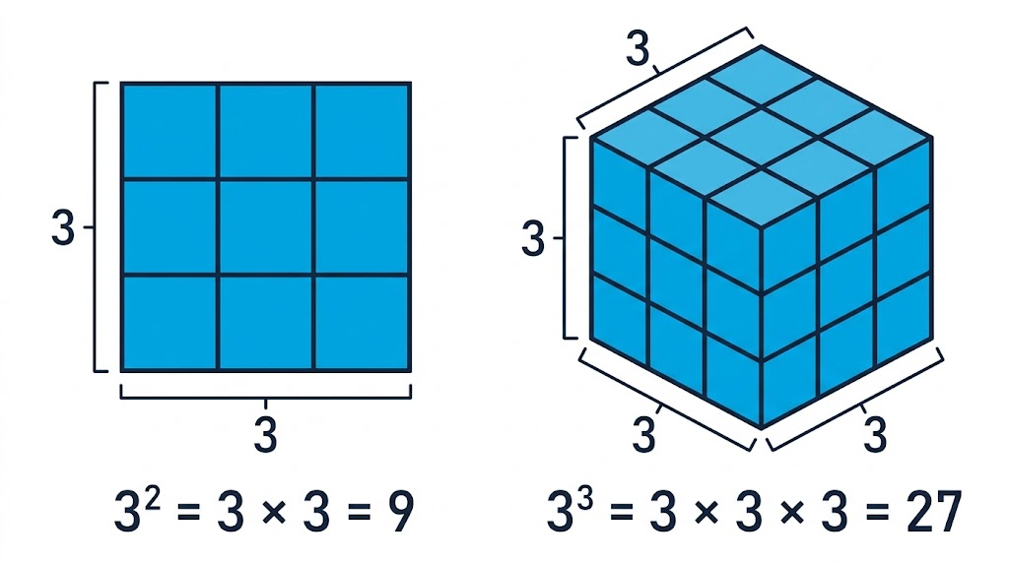
EDEXCEL GCSE MATHS · FOUNDATION & HIGHER
Why "Squared" and "Cubed"?
A square with sides 3 units long is made of 3 × 3 = 9 unit squares - that is why 3² is called "3 squared". A cube with edges 3 units long is made of 3 × 3 × 3 = 27 unit cubes - "3 cubed".
3² counts the squares in a square; 3³ counts the cubes in a cube.
Number
openrevise.com
Lesson 4 of 7

Slide 8

EDEXCEL GCSE MATHS · FOUNDATION & HIGHER
PART ONE
The Index Laws
Shortcuts for powers of the same number.
openrevise.com

Slide 9
EDEXCEL GCSE MATHS · FOUNDATION & HIGHER
The Three Index Laws
They only work when the base is the same.
Law
In words
Example
Multiplying
Add the indices
3⁴ × 3² = 3⁶
Dividing
Subtract the indices
5⁷ ÷ 5³ = 5⁴
Power of a power
Multiply the indices
(2³)⁴ = 2¹²
Different bases
The laws do not apply: work each power out
2³ × 5² = 8 × 25 = 200
Number
openrevise.com
Lesson 4 of 7

Slide 10

EDEXCEL GCSE MATHS · FOUNDATION & HIGHER
Why the Laws Work
Write the powers out in full and count.
Multiplying
3⁴ × 3² = (3 × 3 × 3 × 3) × (3 × 3): six 3s multiplied, so 3⁶.
Dividing
5⁷ ÷ 5³: three of the seven 5s cancel, leaving four: 5⁴.
Power of a power
(2³)⁴ = 2³ × 2³ × 2³ × 2³: four lots of three 2s, so 2¹².
In letters
a^m × aⁿ = a^(m+n), a^m ÷ aⁿ = a^(m−n) and (a^m)ⁿ = a^(mn).
Number
openrevise.com
Lesson 4 of 7

Slide 11

EDEXCEL GCSE MATHS · FOUNDATION & HIGHER
Using the Index Laws
Work out the value of (7⁵ × 7³)/7⁶
Multiplying: add the indices
7⁵ × 7³ = 7⁸
1
Dividing: subtract the indices
7⁸ ÷ 7⁶ = 7²
2
Work out the value
7² = 49
3
ANSWER
49
Number
openrevise.com
Lesson 4 of 7

Slide 12
EDEXCEL GCSE MATHS · FOUNDATION & HIGHER
Changing the Base
Write 4³ × 8² as a single power of 2.
Write each base as a power of 2
4 = 2² and 8 = 2³
1
Power of a power: multiply
4³ = (2²)³ = 2⁶ and 8² = (2³)² = 2⁶
2
Multiplying: add
2⁶ × 2⁶ = 2¹²
3
Check
4³ × 8² = 64 × 64 = 4096 = 2¹²
4
ANSWER
2¹²
Number
openrevise.com
Lesson 4 of 7

Slide 13
EDEXCEL GCSE MATHS · FOUNDATION & HIGHER
PART TWO
Calculating with Powers
Order of operations, with and without a calculator.
openrevise.com

Slide 14

EDEXCEL GCSE MATHS · FOUNDATION & HIGHER
Order of Operations
Powers and roots come before multiplying, dividing, adding and subtracting.
BIDMAS
Brackets, Indices (powers and roots), Division and Multiplication, Addition and Subtraction.
Negative numbers
−3² = −9 (square 3, then make it negative), but (−3)² = 9.
A root sign is a bracket
√(9 + 16) = √25 = 5. It is NOT √9 + √16 = 7.
On a calculator
Use brackets for the top and bottom of a fraction, and write down the full display before rounding.
Number
openrevise.com
Lesson 4 of 7

Slide 15
EDEXCEL GCSE MATHS · FOUNDATION & HIGHER
A Non-Calculator Calculation
Work out 2³ × 5² − √144
Powers and roots first
2³ = 8, 5² = 25, √144 = 12
1
Then multiply
8 × 25 = 200
2
Then subtract
200 − 12 = 188
3
ANSWER
188
Number
openrevise.com
Lesson 4 of 7

Slide 16

EDEXCEL GCSE MATHS · FOUNDATION & HIGHER
Mistakes to Avoid
WRONG
RIGHT
• 3⁴ × 3² = 9⁶
• 2³ = 6
• 5² + 5³ = 5⁵
• (−4)² = −16
• 3⁴ × 3² = 3⁶ - the base stays the same.
• 2³ = 2 × 2 × 2 = 8
• 5² + 5³ = 25 + 125 = 150 - no law for adding.
• (−4)² = 16 - negative times negative is positive.
Number
openrevise.com
Lesson 4 of 7

Slide 17
EDEXCEL GCSE MATHS · FOUNDATION & HIGHER
CASE STUDY
Rice on a Chessboard
An old legend tells of a clever inventor who showed a king the game of chess. As a reward he asked for one grain of rice on the first square of the board, two on the second, four on the third, and so on, doubling each time. The king laughed at such a small request - until his treasurers did the maths. The 64th square alone needs 2⁶³ grains, and the whole board needs 2⁶⁴ − 1: about 18 quintillion grains, far more rice than has ever been grown. The story is a legend, but the numbers are real, and they show how fast powers grow.
2⁶³
1.8 × 10¹⁹
Grains on the last square alone
Grains on the whole board
Number
openrevise.com
Lesson 4 of 7

Slide 18

EDEXCEL GCSE MATHS · FOUNDATION & HIGHER
Key Terms
Power (index)
The small number that says how many times the base is multiplied by itself.
Base
The number being multiplied, e.g. the 5 in 5³.
Square number
A number made by multiplying a whole number by itself, e.g. 49 = 7².
Cube number
A number made by multiplying a whole number by itself three times, e.g. 64 = 4³.
Square root
The number that squares to give a number: √49 = 7.
Cube root
The number that cubes to give a number: ∛64 = 4.
Index laws
The rules for multiplying, dividing and raising powers of the same base.
Number
openrevise.com
Lesson 4 of 7

Slide 19

EDEXCEL GCSE MATHS · FOUNDATION & HIGHER
YOUR TASK
10 minutes
Power Pyramids
Write each as a single power, then as an ordinary number. (a) 2⁵ × 2³ (b) 10⁸ ÷ 10⁵ (c) (3²)³ (d) 5⁹ ÷ (5² × 5⁴) (e) 9² × 3³ as a power of 3 (f) find n if 2ⁿ = 4⁵ ÷ 2³
1
Use the index laws.
2
Change a base where you need to.
3
Check one answer the long way.
WHAT A GOOD ANSWER SHOWS
(a) 2⁸ = 256 (b) 10³ = 1000 (c) 3⁶ = 729 (d) 5³ = 125 (e) 3⁴ × 3³ = 3⁷ = 2187 (f) 4⁵ = 2¹⁰, so 2¹⁰ ÷ 2³ = 2⁷ and n = 7
Number
openrevise.com
Lesson 4 of 7

Slide 20

EDEXCEL GCSE MATHS · FOUNDATION & HIGHER
Can I...?
Recall square numbers to 15².
Multiply powers of the same base.
Recall the cubes of 1, 2, 3, 4, 5 and 10.
Divide powers of the same base.
Find square roots and cube roots.
Raise a power to a power.
Give both square roots of a number.
Use BIDMAS with powers and roots.
Number
openrevise.com
Lesson 4 of 7

Slide 21
EDEXCEL GCSE MATHS · FOUNDATION & HIGHER
Summary & Exam Focus
5³ means 5 × 5 × 5; a root undoes a power.
Same base: multiply, add indices; divide, subtract indices; power of a power, multiply indices.
Different bases: work each power out separately.
Powers and roots come before ×, ÷, + and −; a root sign acts as a bracket.
EXAM FOCUS
Show that 9⁴ × 27² = 3¹⁴ (3 marks)
In a "show that" question the answer is given, so the marks are all for the working. Write every step, including 9 = 3² and 27 = 3³.
openrevise.com

