Slide 1

EDEXCEL GCSE MATHS · HIGHER TIER
Surds
Number
Lesson 7 of 7
openrevise.com

Slide 2

EDEXCEL GCSE MATHS · HIGHER TIER
Last Lesson and Before
Answer each one, then check.
1
What is √36?
2
What is √4 × √9?
3
Expand 3(x + 2).
4
Last lesson: write 4 × 10³ as an ordinary number.
5
Which of these is a whole number: √16 or √17?
Number
openrevise.com
Lesson 7 of 7

Slide 3
EDEXCEL GCSE MATHS · HIGHER TIER
Last Lesson and Before - Answers
What is √36?
6
1
What is √4 × √9?
2 × 3 = 6 - the same as √36.
2
Expand 3(x + 2).
3x + 6
3
Last lesson: write 4 × 10³ as an ordinary number.
4000
4
Which of these is a whole number: √16 or √17?
√16 = 4. √17 is not a whole number.
5
Number
openrevise.com
Lesson 7 of 7

Slide 4

EDEXCEL GCSE MATHS · HIGHER TIER
Learning Objectives
Know what rational and irrational numbers are, and what a surd is.
1
Simplify surds such as √72.
2
Multiply, divide, add and subtract surds.
3
Expand brackets containing surds.
4
Rationalise the denominator of a fraction such as 6/(√3).
5
Number
openrevise.com
Lesson 7 of 7

Slide 5

EDEXCEL GCSE MATHS · HIGHER TIER
What Is a Surd?
A surd is a root that cannot be written exactly as a fraction or a terminating or recurring decimal.
Rational numbers
Can be written as a fraction of two integers: ¾, −7, 0.6, √25 = 5.
Irrational numbers
Cannot: √2 = 1.414 213 56…, π= 3.141 592 65… The decimals never end and never repeat.
Surds
Roots that are irrational: √2, √10, ∛5. √9 is not a surd, because √9 = 3.
Why use them
√2 is exact; 1.414 is not. When a question says "give your answer in surd form", it wants the exact answer.
Number
openrevise.com
Lesson 7 of 7

Slide 6

EDEXCEL GCSE MATHS · HIGHER TIER
Rational or Irrational?
RATIONAL
IRRATIONAL
• ¾
• 0.666…= ⅔
• √25 = 5
• −7
• √(4/9) = ⅔
• √2
• √10
• π
• ∛5
• 1 + √3
Number
openrevise.com
Lesson 7 of 7

Slide 7

EDEXCEL GCSE MATHS · HIGHER TIER
The Rules for Surds
Roots can be split up and combined when multiplying and dividing - but not when adding.
Multiplying
√a × √b = √ab. √2 × √8 = √16 = 4.
Dividing
√a/(√b) = √(a/b). √50/(√2) = √25 = 5.
A surd times itself
√a × √a = a. √7 × √7 = 7.
Not for adding
√(a + b) is NOT √a + √b: √(9 + 16) = √25 = 5, but √9 + √16 = 7.
Number
openrevise.com
Lesson 7 of 7

Slide 8

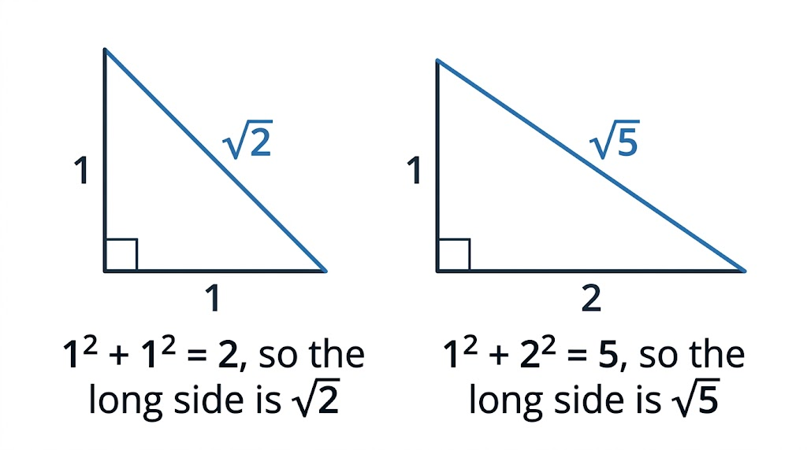
EDEXCEL GCSE MATHS · HIGHER TIER
Surds in Right-Angled Triangles
Surds turn up all the time in geometry. A right-angled triangle with shorter sides 1 and 1 has a hypotenuse of exactly √2 - a length you can draw perfectly but never write exactly as a decimal.
The long side of a right-angled triangle is often a surd.
Number
openrevise.com
Lesson 7 of 7

Slide 9

EDEXCEL GCSE MATHS · HIGHER TIER
PART ONE
Simplifying Surds
Take out the biggest square factor.
openrevise.com

Slide 10

EDEXCEL GCSE MATHS · HIGHER TIER
Simplifying a Surd
Simplify √72
Find the largest square number that is a factor of 72
Square numbers: 4, 9, 16, 25, 36 ... and 36 × 2 = 72
1
Split the root
√72 = √36 × √2
2
Work out the square root
√36 = 6
3
ANSWER
√72 = 6√2
Number
openrevise.com
Lesson 7 of 7

Slide 11
EDEXCEL GCSE MATHS · HIGHER TIER
Adding Surds
Simplify √50 + √18
Simplify each surd
√50 = √25 × √2 = 5√2 and √18 = √9 × √2 = 3√2
1
They are now "like surds" - both multiples of √2
5√2 + 3√2
2
Add them like algebra: 5x + 3x = 8x
8√2
3
ANSWER
8√2
Number
openrevise.com
Lesson 7 of 7

Slide 12
EDEXCEL GCSE MATHS · HIGHER TIER
Expanding Brackets with Surds
Expand and simplify (3 + √2)(5 − √2)
First times first
3 × 5 = 15
1
Outer and inner
3 × (−√2) = −3√2 and √2 × 5 = 5√2
2
Last times last
√2 × (−√2) = −2
3
Collect like terms
15 − 2 = 13 and −3√2 + 5√2 = 2√2
4
ANSWER
13 + 2√2
Number
openrevise.com
Lesson 7 of 7

Slide 13
EDEXCEL GCSE MATHS · HIGHER TIER
PART TWO
Rationalising the Denominator
Getting the surd out of the bottom of a fraction.
openrevise.com

Slide 14
EDEXCEL GCSE MATHS · HIGHER TIER
Rationalising the Denominator
To rationalise a fraction like a/(√b), multiply the top AND the bottom by √b.
Why it works
Multiplying top and bottom by the same number does not change a fraction's value, and √b × √b = b removes the surd from the bottom.
Example
6/(√3) = (6 × √3)/(√3 × √3) = 6√3/3 = 2√3.
Always simplify
Cancel any common factors, and simplify any surd left on top.
Exam wording
"Rationalise the denominator" and "give your answer in the form a√b" both mean do this.
Number
openrevise.com
Lesson 7 of 7

Slide 15
EDEXCEL GCSE MATHS · HIGHER TIER
Rationalising
Rationalise the denominator of 10/(√5). Give your answer in its simplest form.
Multiply the top and the bottom by √5
(10 × √5)/(√5 × √5)
1
The bottom becomes a whole number
√5 × √5 = 5
2
So
10√5/5
3
Simplify
10 ÷ 5 = 2
4
ANSWER
2√5
Number
openrevise.com
Lesson 7 of 7

Slide 16

EDEXCEL GCSE MATHS · HIGHER TIER
CASE STUDY
A4 Paper and the Square Root of 2
Every A-size sheet of paper - A3, A4, A5 - has its long side √2 times its short side. That is the one shape that stays exactly the same when you fold it in half: halve the long side of a sheet with sides 1 and √2 and you get sides √2/2 and 1, which is the same shape again. It is why an A4 page shrinks perfectly onto A5 on a photocopier. An A4 sheet is 210 mm by 297 mm, and 297 ÷ 210 = 1.414…, which is √2 to the nearest millimetre.
210 × 297 mm
1 : √2
The size of an A4 sheet
The ratio of the sides of every A-size sheet
Number
openrevise.com
Lesson 7 of 7

Slide 17
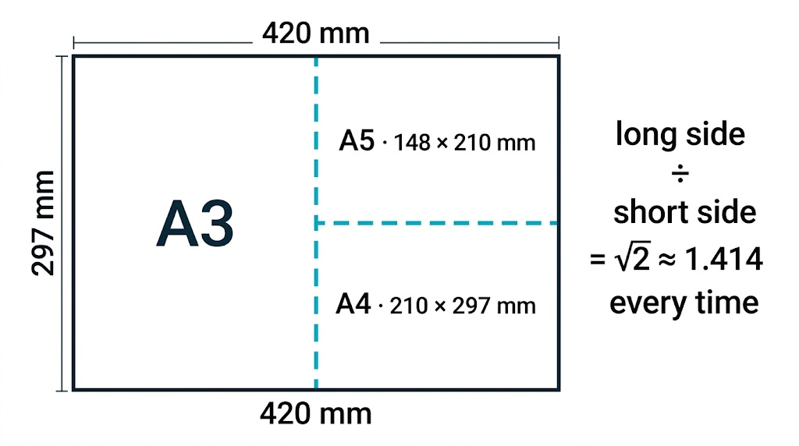
EDEXCEL GCSE MATHS · HIGHER TIER
Folding A-Size Paper
Halving an A-size sheet always makes the next size down, with exactly the same shape. The ratio of the sides is 1 : √2 at every size - a surd you use every day.
Fold A3 in half and you get A4; fold A4 in half and you get A5.
Number
openrevise.com
Lesson 7 of 7

Slide 18

EDEXCEL GCSE MATHS · HIGHER TIER
Key Terms
Rational number
A number that can be written as a fraction of two integers.
Irrational number
A number that cannot be written as a fraction; its decimal never ends or repeats.
Surd
A root that is irrational, such as √2 or √10.
Like surds
Multiples of the same surd, such as 5√2 and 3√2, which can be added and subtracted.
Simplest form
A surd with the largest possible square number taken out, e.g. 6√2.
Rationalise the denominator
Rewrite a fraction so there is no surd on the bottom.
Number
openrevise.com
Lesson 7 of 7

Slide 19

EDEXCEL GCSE MATHS · HIGHER TIER
YOUR TASK
12 minutes
Surd Simplifying Race
Simplify each. (a) √12 (b) √45 (c) √200 (d) √8 + √32 (e) √75 − √27 (f) √3 × √15 (g) (1 + √3)² (h) 12/(√6)
1
Look for the largest square factor.
2
Simplify before adding or subtracting.
3
Rationalise any surd in the denominator.
WHAT A GOOD ANSWER SHOWS
(a) 2√3 (b) 3√5 (c) 10√2 (d) 2√2 + 4√2 = 6√2 (e) 5√3 − 3√3 = 2√3 (f) √45 = 3√5 (g) 1 + 2√3 + 3 = 4 + 2√3 (h) 12√6/6 = 2√6
Number
openrevise.com
Lesson 7 of 7
Notes:
Part (g) catches students who square each term separately and get 1 + 3 = 4. Expand it as two brackets.

Slide 20

EDEXCEL GCSE MATHS · HIGHER TIER
Can I...?
Explain what a surd is.
Add and subtract like surds.
Say whether a number is rational or irrational.
Expand brackets containing surds.
Simplify a surd such as √72.
Rationalise a denominator like a/(√b).
Multiply and divide surds.
Give an exact answer in surd form.
Number
openrevise.com
Lesson 7 of 7

Slide 21
EDEXCEL GCSE MATHS · HIGHER TIER
Summary & Exam Focus
A surd is an irrational root, and gives an exact value.
√ab = √a × √b: take out the largest square factor to simplify.
Only like surds can be added or subtracted.
Rationalise a/(√b) by multiplying the top and the bottom by √b.
EXAM FOCUS
Rationalise the denominator of 12/(√3). Give your answer in its simplest form. (2 marks)
"Exact" or "surd form" means do not use a decimal. Leave the root in the answer and simplify it as far as it goes.
openrevise.com

Slide 22
EDEXCEL GCSE MATHS · HIGHER TIER
Exam Practice: Surds
Answer all questions. Show your working. All questions are non-calculator. · 25 minutes
Question 1 · 1 mark · Non-calculator
Write √45 in the form k√5, where k is an integer.
Question 2 · 2 marks · Non-calculator
Rationalise the denominator of 12/(√3). Give your answer in its simplest form.
Question 3 · 3 marks · Non-calculator
Expand and simplify (2 + √3)(4 − √3). Give your answer in the form a + b√3, where a and b are integers.
Number
openrevise.com
Lesson 7 of 7

Slide 23
EDEXCEL GCSE MATHS · HIGHER TIER
Exam Practice: Surds (cont.)
Question 4 · 3 marks · Non-calculator · Show that
Show that √98 + √8 = 9√2
Question 5 · 3 marks · Non-calculator
The diagram shows the right-angled triangle ABC. AB = √5 cm and BC = √11 cm. Work out the length of AC.
Question 6 · 3 marks · Non-calculator
A rectangle has length (3 + √5) cm and width (3 − √5) cm. Work out the area of the rectangle.
Number
openrevise.com
Lesson 7 of 7

Slide 24
EDEXCEL GCSE MATHS · HIGHER TIER
Question 1 · 1 mark · Non-calculator
“
Write √45 in the form k√5, where k is an integer.
HOW TO ANSWER IT
Command word: Non-calculator. Worth 1 mark, so plan before writing.
Number
openrevise.com
Lesson 7 of 7

Slide 25
EDEXCEL GCSE MATHS · HIGHER TIER
Question 1 · mark scheme
1 mark available. Award a mark for each point made.
3√5
B1
Number
openrevise.com
Lesson 7 of 7

Slide 26
EDEXCEL GCSE MATHS · HIGHER TIER
Question 2 · 2 marks · Non-calculator
“
Rationalise the denominator of 12/(√3). Give your answer in its simplest form.
HOW TO ANSWER IT
Command word: Non-calculator. Worth 2 marks, so plan before writing.
Number
openrevise.com
Lesson 7 of 7

Slide 27
EDEXCEL GCSE MATHS · HIGHER TIER
Question 2 · mark scheme
2 marks available. Award a mark for each point made.
Multiplying the top and the bottom by √3
M1
4√3
A1
Number
openrevise.com
Lesson 7 of 7

Slide 28
EDEXCEL GCSE MATHS · HIGHER TIER
Question 3 · 3 marks · Non-calculator
“
Expand and simplify (2 + √3)(4 − √3). Give your answer in the form a + b√3, where a and b are integers.
HOW TO ANSWER IT
Command word: Non-calculator. Worth 3 marks, so plan before writing.
Number
openrevise.com
Lesson 7 of 7

Slide 29
EDEXCEL GCSE MATHS · HIGHER TIER
Question 3 · mark scheme
3 marks available. Award a mark for each point made.
At least 3 of the 4 terms correct: 8, −2√3, 4√3, −3
M1
All 4 terms correct
M1
5 + 2√3
A1
Number
openrevise.com
Lesson 7 of 7

Slide 30
EDEXCEL GCSE MATHS · HIGHER TIER
Question 4 · 3 marks · Non-calculator · Show that
“
Show that √98 + √8 = 9√2
HOW TO ANSWER IT
Command word: Non-calculator · Show that. Worth 3 marks, so plan before writing.
Number
openrevise.com
Lesson 7 of 7

Slide 31
EDEXCEL GCSE MATHS · HIGHER TIER
Question 4 · mark scheme
3 marks available. Award a mark for each point made.
√98 = 7√2 or √8 = 2√2
M1
Both simplified correctly
M1
Correctly added to reach 9√2
A1
Number
openrevise.com
Lesson 7 of 7

Slide 32
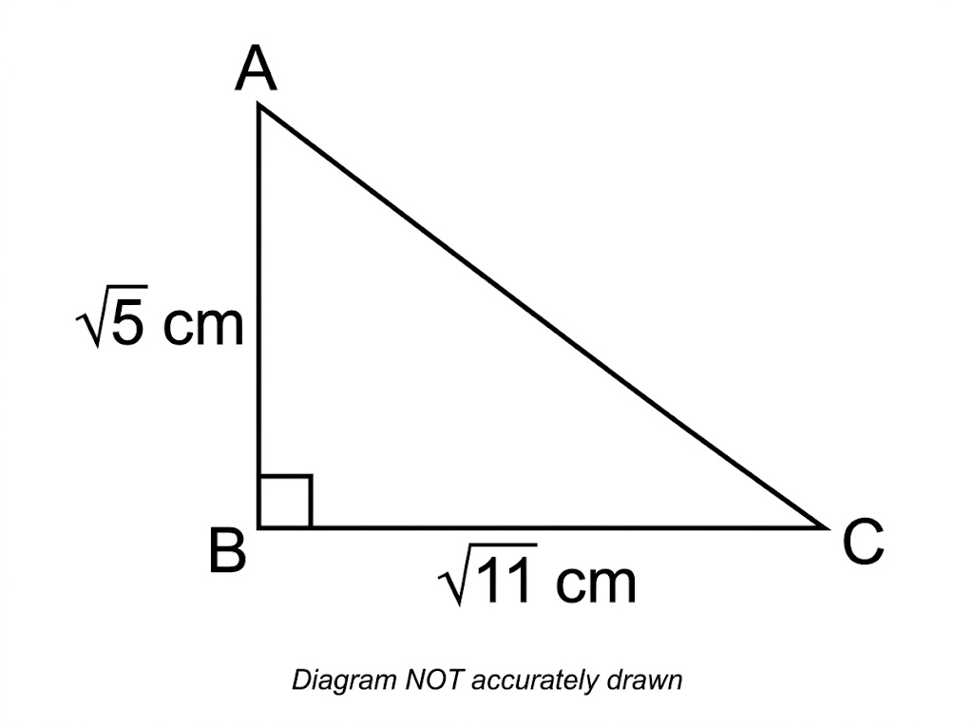
EDEXCEL GCSE MATHS · HIGHER TIER
Question 5 · 3 marks · Non-calculator
The diagram shows the right-angled triangle ABC. AB = √5 cm and BC = √11 cm. Work out the length of AC. (3 marks)
Number
openrevise.com
Lesson 7 of 7

Slide 33
EDEXCEL GCSE MATHS · HIGHER TIER
Question 5 · mark scheme
3 marks available. Award a mark for each point made.
(√5)² + (√11)² or 5 + 11
M1
√16
M1
4 (cm)
A1
Number
openrevise.com
Lesson 7 of 7

Slide 34
EDEXCEL GCSE MATHS · HIGHER TIER
Question 6 · 3 marks · Non-calculator
“
A rectangle has length (3 + √5) cm and width (3 − √5) cm. Work out the area of the rectangle.
HOW TO ANSWER IT
Command word: Non-calculator. Worth 3 marks, so plan before writing.
Number
openrevise.com
Lesson 7 of 7

Slide 35
EDEXCEL GCSE MATHS · HIGHER TIER
Question 6 · mark scheme
3 marks available. Award a mark for each point made.
Area = (3 + √5)(3 − √5)
M1
At least 3 of the 4 terms correct: 9, −3√5, +3√5, −5
M1
4 (cm²)
A1
Number
openrevise.com
Lesson 7 of 7

