Slide 1

EDEXCEL GCSE MATHS · FOUNDATION & HIGHER
Algebraic indices
Algebra
Lesson 1 of 7
openrevise.com

Slide 2

EDEXCEL GCSE MATHS · FOUNDATION & HIGHER
From the Number Chapter
Answer each one, then check.
1
Write 2⁵ × 2³ as a single power of 2.
2
Write (3²)⁴ as a single power of 3.
3
What is 5⁰?
4
What is 3⁻²?
5
Simplify 3a × 4b.
Algebra
openrevise.com
Lesson 1 of 7

Slide 3
EDEXCEL GCSE MATHS · FOUNDATION & HIGHER
From the Number Chapter - Answers
Write 2⁵ × 2³ as a single power of 2.
2⁸
1
Write (3²)⁴ as a single power of 3.
3⁸
2
What is 5⁰?
1
3
What is 3⁻²?
1/9
4
Simplify 3a × 4b.
12ab
5
Algebra
openrevise.com
Lesson 1 of 7

Slide 4

EDEXCEL GCSE MATHS · FOUNDATION & HIGHER
Learning Objectives
Use the index laws with letters.
1
Simplify expressions with numbers and several letters.
2
Raise a bracket to a power, such as (2x³)⁴.
3
Use negative and fractional indices in algebra. (Higher)
4
Solve equations with unknown powers, such as 9^x = 27^(x−1). (Higher)
5
Algebra
openrevise.com
Lesson 1 of 7

Slide 5

EDEXCEL GCSE MATHS · FOUNDATION & HIGHER
The Index Laws with Letters
Exactly the laws from the Number chapter - the base is now a letter.
Law
In words
Example
Multiplying
Add the indices
x⁵ × x² = x⁷
Dividing
Subtract the indices
y⁸ ÷ y² = y⁶
Power of a power
Multiply the indices
(z³)⁵ = z¹⁵
Zero index
Anything (except 0) to the power 0 is 1
x⁰ = 1
A letter on its own
Has an index of 1
x × x⁴ = x¹ × x⁴ = x⁵
Algebra
openrevise.com
Lesson 1 of 7

Slide 6

EDEXCEL GCSE MATHS · FOUNDATION & HIGHER
Multiplying Terms
Simplify 3x²y⁴ × 5x³y
Multiply the numbers
3 × 5 = 15
1
Multiply the x terms: add the indices
x² × x³ = x⁵
2
Multiply the y terms: y is y¹
y⁴ × y¹ = y⁵
3
Put them together
15x⁵y⁵
4
ANSWER
15x⁵y⁵
Algebra
openrevise.com
Lesson 1 of 7

Slide 7
EDEXCEL GCSE MATHS · FOUNDATION & HIGHER
Dividing Terms
Simplify 24a⁷b³ ÷ 8a²b³
Divide the numbers
24 ÷ 8 = 3
1
Divide the a terms: subtract the indices
a⁷ ÷ a² = a⁵
2
Divide the b terms
b³ ÷ b³ = b⁰ = 1
3
Put them together
3 × a⁵ × 1
4
ANSWER
3a⁵
Algebra
openrevise.com
Lesson 1 of 7

Slide 8
EDEXCEL GCSE MATHS · FOUNDATION & HIGHER
A Bracket to a Power
Simplify (3x²y⁵)³
Everything inside the bracket is raised to the power 3
3³ × (x²)³ × (y⁵)³
1
The number
3³ = 27
2
Power of a power: multiply the indices
(x²)³ = x⁶ and (y⁵)³ = y¹⁵
3
ANSWER
27x⁶y¹⁵
Algebra
openrevise.com
Lesson 1 of 7

Slide 9

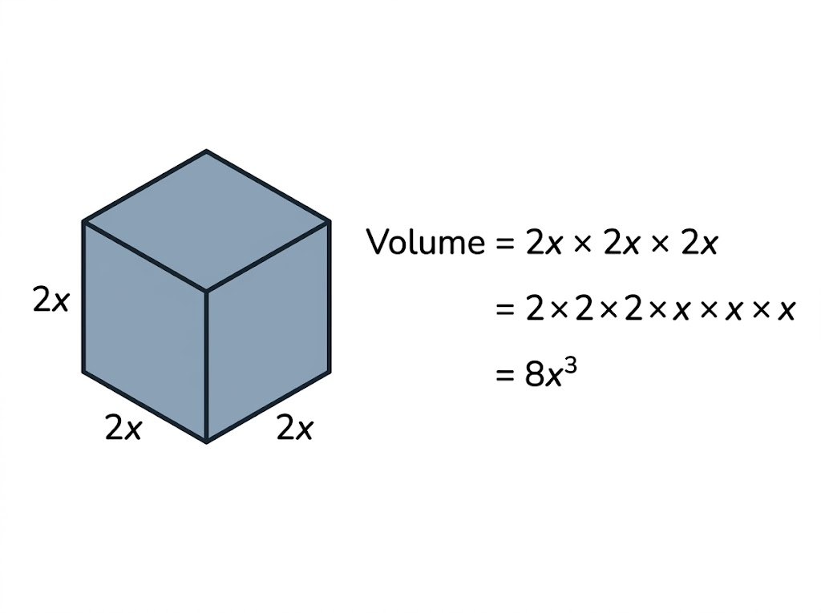
EDEXCEL GCSE MATHS · FOUNDATION & HIGHER
Why a Bracket Cubed Cubes the Number Too
The power on a bracket applies to everything inside it - the number as well as the letter. A cube with edges of 2x has a volume of 2x × 2x × 2x = 8x³. Writing 2x³ would mean only the x was cubed.
(2x)³ = 2x × 2x × 2x = 8x³, not 2x³.
Algebra
openrevise.com
Lesson 1 of 7

Slide 10

EDEXCEL GCSE MATHS · FOUNDATION & HIGHER
Mistakes to Avoid
WRONG
RIGHT
• (2x)³ = 2x³
• 3x² × 2x = 6x²
• x² + x³ = x⁵
• (x³)² = x⁵
• 12x⁶ ÷ 4x² = 3x³
• (2x)³ = 8x³ - cube the 2 as well.
• 3x² × 2x = 6x³ - x is x¹.
• x² + x³ cannot be simplified: they are not like terms.
• (x³)² = x⁶ - multiply the indices.
• 12x⁶ ÷ 4x² = 3x⁴ - subtract the indices.
Algebra
openrevise.com
Lesson 1 of 7

Slide 11

EDEXCEL GCSE MATHS · FOUNDATION & HIGHER
PART TWO · HIGHER
Negative and Fractional Indices
The rest of the index rules, now with letters.
openrevise.com

Slide 12

EDEXCEL GCSE MATHS · FOUNDATION & HIGHER
Negative and Fractional Powers of Letters
The meanings are the same as for numbers.
Negative powers
x⁻¹ = 1/x and x⁻³ = 1/x³. So 1/x⁴ can be written as x⁻⁴.
Fractional powers
x^(1/2) = √x and x^(1/3) = ∛x. So 1/(√x) = x^(−1/2).
"Write in the form xⁿ"
Turn roots and fractions into single powers: 1/x² = x⁻², √x³ = x^(3/2).
Brackets
Raise each part inside the bracket to the power: (16x⁸)^(1/2) = 16^(1/2) × x⁴ = 4x⁴.
Algebra
openrevise.com
Lesson 1 of 7

Slide 13
EDEXCEL GCSE MATHS · FOUNDATION & HIGHER
A Negative Fractional Power
Simplify (27x⁶y⁻³)^(−1/3)
1
Raise each part to the power −⅓
27^(−1/3) × (x⁶)^(−1/3) × (y⁻³)^(−1/3)
2
The number: flip and cube root
27^(−1/3) = ⅓
3
The x: multiply the indices
6 × (−⅓) = −2, so x⁻² = 1/x²
4
The y: multiply the indices
−3 × (−⅓) = 1, so y¹ = y
5
Put them together
⅓ × 1/x² × y
ANSWER
y/3x²
Algebra
openrevise.com
Lesson 1 of 7

Slide 14
EDEXCEL GCSE MATHS · FOUNDATION & HIGHER
Solving an Equation with Powers
Solve 2^(x+1) = 8^x
Write both sides with the same base
8 = 2³, so 8^x = 2^(3x)
1
So
2^(x+1) = 2^(3x)
2
Same base, so the indices are equal
x + 1 = 3x
3
Solve
1 = 2x
4
ANSWER
x = ½
Algebra
openrevise.com
Lesson 1 of 7

Slide 15

EDEXCEL GCSE MATHS · FOUNDATION & HIGHER
Key Terms
Index (power)
The small number showing how many times the base is multiplied by itself.
Coefficient
The number in front of a letter, e.g. 5 in 5x³.
Like terms
Terms with exactly the same letters and powers, e.g. 3x² and 7x².
Simplify
Write an expression in its shortest form.
Negative index (Higher)
x⁻ⁿ = 1/xⁿ.
Fractional index (Higher)
x^(1/n) = ⁿ√x.
Algebra
openrevise.com
Lesson 1 of 7

Slide 16

EDEXCEL GCSE MATHS · FOUNDATION & HIGHER
YOUR TASK
12 minutes
Index Pyramids
Simplify each. (a) a⁴ × a⁶ (b) 6m⁵ × 2m (c) 18p⁸q³ ÷ 6p²q (d) (4x³)² (e) (2a²b)³ × 3ab⁴ (f) (x⁷ × x²)/x⁵. Higher: (g) (9x⁴)^(1/2) (h) (8y⁶)^(−1/3) (i) solve 4^x = 2^(x+3).
1
Numbers first.
2
Then each letter in turn.
3
Check every bracket's power applies to everything inside.
WHAT A GOOD ANSWER SHOWS
(a) a¹⁰ (b) 12m⁶ (c) 3p⁶q² (d) 16x⁶ (e) 8a⁶b³ × 3ab⁴ = 24a⁷b⁷ (f) x⁴ (g) 3x² (h) 1/2y² (i) 2^(2x) = 2^(x+3), so x = 3.
Algebra
openrevise.com
Lesson 1 of 7

Slide 17

EDEXCEL GCSE MATHS · FOUNDATION & HIGHER
Can I...?
Multiply terms using the index laws.
Use x⁰ = 1.
Divide terms using the index laws.
Use negative powers of letters. (Higher)
Raise a power to a power.
Use fractional powers of letters. (Higher)
Raise a bracket to a power.
Solve equations with unknown powers. (Higher)
Algebra
openrevise.com
Lesson 1 of 7

Slide 18
EDEXCEL GCSE MATHS · FOUNDATION & HIGHER
Summary & Exam Focus
Multiply: add indices. Divide: subtract indices. Power of a power: multiply indices.
A power on a bracket applies to everything inside, including the number.
Only like terms can be added; x² + x³ does not simplify.
(Higher) x⁻ⁿ = 1/xⁿ and x^(1/n) = ⁿ√x.
EXAM FOCUS
Simplify (2a³b)⁵ (2 marks)
Work through the numbers first, then each letter in alphabetical order. The two marks are usually one for the number and one for the letters.
openrevise.com

