Slide 1

EDEXCEL GCSE MATHS · FOUNDATION & HIGHER
Algebraic indices
Algebra
Lesson 1 of 7
openrevise.com

Slide 2

EDEXCEL GCSE MATHS · FOUNDATION & HIGHER
From the Number Chapter
Answer each one, then check.
1
Write 2⁵ × 2³ as a single power of 2.
2
Write (3²)⁴ as a single power of 3.
3
What is 5⁰?
4
What is 3⁻²?
5
Simplify 3a × 4b.
Algebra
openrevise.com
Lesson 1 of 7

Slide 3
EDEXCEL GCSE MATHS · FOUNDATION & HIGHER
From the Number Chapter - Answers
Write 2⁵ × 2³ as a single power of 2.
2⁸
1
Write (3²)⁴ as a single power of 3.
3⁸
2
What is 5⁰?
1
3
What is 3⁻²?
1/9
4
Simplify 3a × 4b.
12ab
5
Algebra
openrevise.com
Lesson 1 of 7

Slide 4

EDEXCEL GCSE MATHS · FOUNDATION & HIGHER
Learning Objectives
Use the index laws with letters.
1
Simplify expressions with numbers and several letters.
2
Raise a bracket to a power, such as (2x³)⁴.
3
Use negative and fractional indices in algebra. (Higher)
4
Solve equations with unknown powers, such as 9^x = 27^(x−1). (Higher)
5
Algebra
openrevise.com
Lesson 1 of 7

Slide 5

EDEXCEL GCSE MATHS · FOUNDATION & HIGHER
The Index Laws with Letters
Exactly the laws from the Number chapter - the base is now a letter.
Law
In words
Example
Multiplying
Add the indices
x⁵ × x² = x⁷
Dividing
Subtract the indices
y⁸ ÷ y² = y⁶
Power of a power
Multiply the indices
(z³)⁵ = z¹⁵
Zero index
Anything (except 0) to the power 0 is 1
x⁰ = 1
A letter on its own
Has an index of 1
x × x⁴ = x¹ × x⁴ = x⁵
Algebra
openrevise.com
Lesson 1 of 7

Slide 6

EDEXCEL GCSE MATHS · FOUNDATION & HIGHER
Multiplying Terms
Simplify 3x²y⁴ × 5x³y
Multiply the numbers
3 × 5 = 15
1
Multiply the x terms: add the indices
x² × x³ = x⁵
2
Multiply the y terms: y is y¹
y⁴ × y¹ = y⁵
3
Put them together
15x⁵y⁵
4
ANSWER
15x⁵y⁵
Algebra
openrevise.com
Lesson 1 of 7

Slide 7
EDEXCEL GCSE MATHS · FOUNDATION & HIGHER
Dividing Terms
Simplify 24a⁷b³ ÷ 8a²b³
Divide the numbers
24 ÷ 8 = 3
1
Divide the a terms: subtract the indices
a⁷ ÷ a² = a⁵
2
Divide the b terms
b³ ÷ b³ = b⁰ = 1
3
Put them together
3 × a⁵ × 1
4
ANSWER
3a⁵
Algebra
openrevise.com
Lesson 1 of 7

Slide 8
EDEXCEL GCSE MATHS · FOUNDATION & HIGHER
A Bracket to a Power
Simplify (3x²y⁵)³
Everything inside the bracket is raised to the power 3
3³ × (x²)³ × (y⁵)³
1
The number
3³ = 27
2
Power of a power: multiply the indices
(x²)³ = x⁶ and (y⁵)³ = y¹⁵
3
ANSWER
27x⁶y¹⁵
Algebra
openrevise.com
Lesson 1 of 7

Slide 9

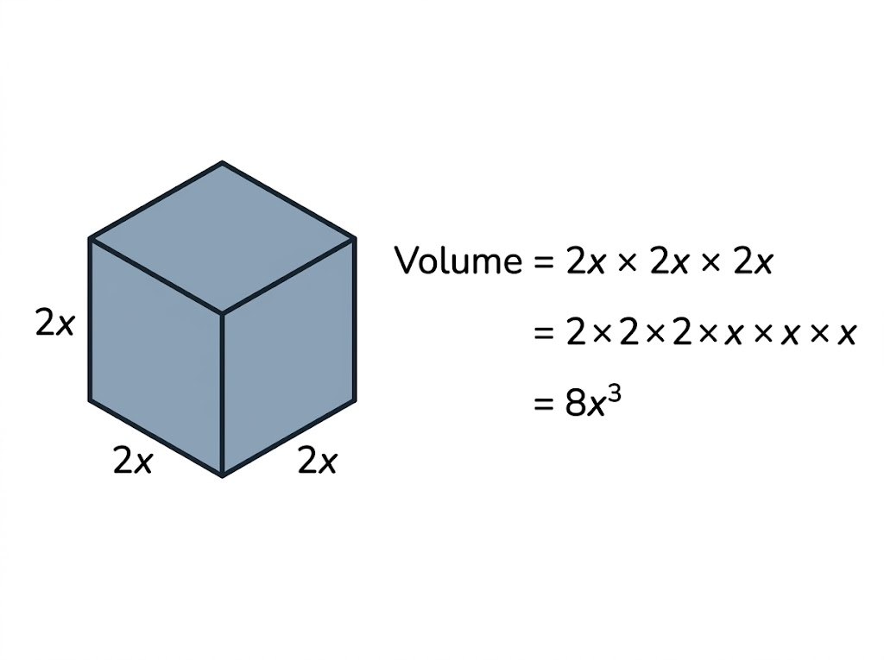
EDEXCEL GCSE MATHS · FOUNDATION & HIGHER
Why a Bracket Cubed Cubes the Number Too
The power on a bracket applies to everything inside it - the number as well as the letter. A cube with edges of 2x has a volume of 2x × 2x × 2x = 8x³. Writing 2x³ would mean only the x was cubed.
(2x)³ = 2x × 2x × 2x = 8x³, not 2x³.
Algebra
openrevise.com
Lesson 1 of 7

Slide 10

EDEXCEL GCSE MATHS · FOUNDATION & HIGHER
Mistakes to Avoid
WRONG
RIGHT
• (2x)³ = 2x³
• 3x² × 2x = 6x²
• x² + x³ = x⁵
• (x³)² = x⁵
• 12x⁶ ÷ 4x² = 3x³
• (2x)³ = 8x³ - cube the 2 as well.
• 3x² × 2x = 6x³ - x is x¹.
• x² + x³ cannot be simplified: they are not like terms.
• (x³)² = x⁶ - multiply the indices.
• 12x⁶ ÷ 4x² = 3x⁴ - subtract the indices.
Algebra
openrevise.com
Lesson 1 of 7

Slide 11

EDEXCEL GCSE MATHS · FOUNDATION & HIGHER
PART TWO · HIGHER
Negative and Fractional Indices
The rest of the index rules, now with letters.
openrevise.com

Slide 12

EDEXCEL GCSE MATHS · FOUNDATION & HIGHER
Negative and Fractional Powers of Letters
The meanings are the same as for numbers.
Negative powers
x⁻¹ = 1/x and x⁻³ = 1/x³. So 1/x⁴ can be written as x⁻⁴.
Fractional powers
x^(1/2) = √x and x^(1/3) = ∛x. So 1/(√x) = x^(−1/2).
"Write in the form xⁿ"
Turn roots and fractions into single powers: 1/x² = x⁻², √x³ = x^(3/2).
Brackets
Raise each part inside the bracket to the power: (16x⁸)^(1/2) = 16^(1/2) × x⁴ = 4x⁴.
Algebra
openrevise.com
Lesson 1 of 7

Slide 13
EDEXCEL GCSE MATHS · FOUNDATION & HIGHER
A Negative Fractional Power
Simplify (27x⁶y⁻³)^(−1/3)
1
Raise each part to the power −⅓
27^(−1/3) × (x⁶)^(−1/3) × (y⁻³)^(−1/3)
2
The number: flip and cube root
27^(−1/3) = ⅓
3
The x: multiply the indices
6 × (−⅓) = −2, so x⁻² = 1/x²
4
The y: multiply the indices
−3 × (−⅓) = 1, so y¹ = y
5
Put them together
⅓ × 1/x² × y
ANSWER
y/3x²
Algebra
openrevise.com
Lesson 1 of 7

Slide 14
EDEXCEL GCSE MATHS · FOUNDATION & HIGHER
Solving an Equation with Powers
Solve 2^(x+1) = 8^x
Write both sides with the same base
8 = 2³, so 8^x = 2^(3x)
1
So
2^(x+1) = 2^(3x)
2
Same base, so the indices are equal
x + 1 = 3x
3
Solve
1 = 2x
4
ANSWER
x = ½
Algebra
openrevise.com
Lesson 1 of 7

Slide 15

EDEXCEL GCSE MATHS · FOUNDATION & HIGHER
Key Terms
Index (power)
The small number showing how many times the base is multiplied by itself.
Coefficient
The number in front of a letter, e.g. 5 in 5x³.
Like terms
Terms with exactly the same letters and powers, e.g. 3x² and 7x².
Simplify
Write an expression in its shortest form.
Negative index (Higher)
x⁻ⁿ = 1/xⁿ.
Fractional index (Higher)
x^(1/n) = ⁿ√x.
Algebra
openrevise.com
Lesson 1 of 7

Slide 16

EDEXCEL GCSE MATHS · FOUNDATION & HIGHER
YOUR TASK
12 minutes
Index Pyramids
Simplify each. (a) a⁴ × a⁶ (b) 6m⁵ × 2m (c) 18p⁸q³ ÷ 6p²q (d) (4x³)² (e) (2a²b)³ × 3ab⁴ (f) (x⁷ × x²)/x⁵. Higher: (g) (9x⁴)^(1/2) (h) (8y⁶)^(−1/3) (i) solve 4^x = 2^(x+3).
1
Numbers first.
2
Then each letter in turn.
3
Check every bracket's power applies to everything inside.
WHAT A GOOD ANSWER SHOWS
(a) a¹⁰ (b) 12m⁶ (c) 3p⁶q² (d) 16x⁶ (e) 8a⁶b³ × 3ab⁴ = 24a⁷b⁷ (f) x⁴ (g) 3x² (h) 1/2y² (i) 2^(2x) = 2^(x+3), so x = 3.
Algebra
openrevise.com
Lesson 1 of 7
Notes:
Part (d) is the most common mistake: 4 must be squared too.

Slide 17

EDEXCEL GCSE MATHS · FOUNDATION & HIGHER
Can I...?
Multiply terms using the index laws.
Use x⁰ = 1.
Divide terms using the index laws.
Use negative powers of letters. (Higher)
Raise a power to a power.
Use fractional powers of letters. (Higher)
Raise a bracket to a power.
Solve equations with unknown powers. (Higher)
Algebra
openrevise.com
Lesson 1 of 7

Slide 18
EDEXCEL GCSE MATHS · FOUNDATION & HIGHER
Summary & Exam Focus
Multiply: add indices. Divide: subtract indices. Power of a power: multiply indices.
A power on a bracket applies to everything inside, including the number.
Only like terms can be added; x² + x³ does not simplify.
(Higher) x⁻ⁿ = 1/xⁿ and x^(1/n) = ⁿ√x.
EXAM FOCUS
Simplify (2a³b)⁵ (2 marks)
Work through the numbers first, then each letter in alphabetical order. The two marks are usually one for the number and one for the letters.
openrevise.com

Slide 19
EDEXCEL GCSE MATHS · FOUNDATION & HIGHER
Exam Practice: Algebraic Indices
Answer all questions. Show your working. All questions are non-calculator. · 20 minutes
Question 1 · 1 mark · Non-calculator
Simplify m⁵ × m³
Question 2 · 1 mark · Non-calculator
Simplify (p⁴)³
Question 3 · 2 marks · Non-calculator
Simplify 4x²y³ × 3x⁵y
Algebra
openrevise.com
Lesson 1 of 7

Slide 20
EDEXCEL GCSE MATHS · FOUNDATION & HIGHER
Exam Practice: Algebraic Indices (cont.)
Question 4 · 2 marks · Non-calculator
Simplify (2a³b)⁵
Question 5 · 2 marks · Non-calculator · Higher
Simplify (64x⁶)^(2/3)
Question 6 · 3 marks · Non-calculator · Higher
Solve 9^x = 27^(x−1)
Algebra
openrevise.com
Lesson 1 of 7

Slide 21
EDEXCEL GCSE MATHS · FOUNDATION & HIGHER
Question 1 · 1 mark · Non-calculator
“
Simplify m⁵ × m³
HOW TO ANSWER IT
Command word: Non-calculator. Worth 1 mark, so plan before writing.
Algebra
openrevise.com
Lesson 1 of 7

Slide 22
EDEXCEL GCSE MATHS · FOUNDATION & HIGHER
Question 1 · mark scheme
1 mark available. Award a mark for each point made.
m⁸
B1
Algebra
openrevise.com
Lesson 1 of 7

Slide 23
EDEXCEL GCSE MATHS · FOUNDATION & HIGHER
Question 2 · 1 mark · Non-calculator
“
Simplify (p⁴)³
HOW TO ANSWER IT
Command word: Non-calculator. Worth 1 mark, so plan before writing.
Algebra
openrevise.com
Lesson 1 of 7

Slide 24
EDEXCEL GCSE MATHS · FOUNDATION & HIGHER
Question 2 · mark scheme
1 mark available. Award a mark for each point made.
p¹²
B1
Algebra
openrevise.com
Lesson 1 of 7

Slide 25
EDEXCEL GCSE MATHS · FOUNDATION & HIGHER
Question 3 · 2 marks · Non-calculator
“
Simplify 4x²y³ × 3x⁵y
HOW TO ANSWER IT
Command word: Non-calculator. Worth 2 marks, so plan before writing.
Algebra
openrevise.com
Lesson 1 of 7

Slide 26
EDEXCEL GCSE MATHS · FOUNDATION & HIGHER
Question 3 · mark scheme
2 marks available. Award a mark for each point made.
12x⁷y⁴
B2
Two of 12, x⁷ and y⁴ in a single term
B1
Algebra
openrevise.com
Lesson 1 of 7

Slide 27
EDEXCEL GCSE MATHS · FOUNDATION & HIGHER
Question 4 · 2 marks · Non-calculator
“
Simplify (2a³b)⁵
HOW TO ANSWER IT
Command word: Non-calculator. Worth 2 marks, so plan before writing.
Algebra
openrevise.com
Lesson 1 of 7

Slide 28
EDEXCEL GCSE MATHS · FOUNDATION & HIGHER
Question 4 · mark scheme
2 marks available. Award a mark for each point made.
32a¹⁵b⁵
B2
Two of 32, a¹⁵ and b⁵ in a single term
B1
Algebra
openrevise.com
Lesson 1 of 7

Slide 29
EDEXCEL GCSE MATHS · FOUNDATION & HIGHER
Question 5 · 2 marks · Non-calculator · Higher
“
Simplify (64x⁶)^(2/3)
HOW TO ANSWER IT
Command word: Non-calculator · Higher. Worth 2 marks, so plan before writing.
Algebra
openrevise.com
Lesson 1 of 7

Slide 30
EDEXCEL GCSE MATHS · FOUNDATION & HIGHER
Question 5 · mark scheme
2 marks available. Award a mark for each point made.
16x⁴
B2
16 or x⁴ in a single term
B1
Algebra
openrevise.com
Lesson 1 of 7

Slide 31
EDEXCEL GCSE MATHS · FOUNDATION & HIGHER
Question 6 · 3 marks · Non-calculator · Higher
“
Solve 9^x = 27^(x−1)
HOW TO ANSWER IT
Command word: Non-calculator · Higher. Worth 3 marks, so plan before writing.
Algebra
openrevise.com
Lesson 1 of 7

Slide 32
EDEXCEL GCSE MATHS · FOUNDATION & HIGHER
Question 6 · mark scheme
3 marks available. Award a mark for each point made.
Both sides written as powers of 3
M1
2x = 3x − 3
M1
x = 3
A1
Algebra
openrevise.com
Lesson 1 of 7

