Slide 1

EDEXCEL GCSE MATHS · FOUNDATION & HIGHER
Expanding and factorising
Algebra
Lesson 2 of 7
openrevise.com

Slide 2

EDEXCEL GCSE MATHS · FOUNDATION & HIGHER
Last Lesson and Before
Answer each one, then check.
1
Simplify 3a + 5a − 2a.
2
Work out −3 × −4.
3
What is the HCF of 12 and 18?
4
Last lesson: simplify x × x.
5
Last lesson: simplify 2x × 5x².
Algebra
openrevise.com
Lesson 2 of 7

Slide 3
EDEXCEL GCSE MATHS · FOUNDATION & HIGHER
Last Lesson and Before - Answers
Simplify 3a + 5a − 2a.
6a
1
Work out −3 × −4.
12
2
What is the HCF of 12 and 18?
6
3
Last lesson: simplify x × x.
x²
4
Last lesson: simplify 2x × 5x².
10x³
5
Algebra
openrevise.com
Lesson 2 of 7

Slide 4

EDEXCEL GCSE MATHS · FOUNDATION & HIGHER
Learning Objectives
Expand single brackets and simplify.
1
Factorise expressions by taking out the highest common factor.
2
Expand double brackets.
3
Factorise quadratic expressions of the form x² + bx + c.
4
Factorise the difference of two squares, x² − a².
5
Algebra
openrevise.com
Lesson 2 of 7

Slide 5

EDEXCEL GCSE MATHS · FOUNDATION & HIGHER
The Words You Need
Term
One part of an expression: 3x, −5 and x² are terms.
Expression
Terms added or subtracted, with no equals sign: 3x² − 5x + 2.
Coefficient
The number in front of a letter: the 3 in 3x².
Like terms
Same letters and powers: 4x and −7x, but not 4x and 4x².
Expand
Multiply out the brackets.
Factorise
Put back into brackets - the opposite of expanding.
Algebra
openrevise.com
Lesson 2 of 7

Slide 6

EDEXCEL GCSE MATHS · FOUNDATION & HIGHER
Expanding Single Brackets
Multiply every term inside the bracket by the term outside.
Numbers
4(3x − 7) = 12x − 28.
Letters
x(x + 5) = x² + 5x.
Negative outside
−3(x − 4) = −3x + 12: a negative times a negative is positive.
Expand and simplify
Expand every bracket, then collect like terms.
Algebra
openrevise.com
Lesson 2 of 7

Slide 7

EDEXCEL GCSE MATHS · FOUNDATION & HIGHER
Expand and Simplify
Expand and simplify 5(2x + 3) − 3(x − 4)
Expand the first bracket
5(2x + 3) = 10x + 15
1
Expand the second: the −3 multiplies both terms
−3(x − 4) = −3x + 12
2
Write it all out
10x + 15 − 3x + 12
3
Collect like terms
10x − 3x = 7x and 15 + 12 = 27
4
ANSWER
7x + 27
Algebra
openrevise.com
Lesson 2 of 7

Slide 8
EDEXCEL GCSE MATHS · FOUNDATION & HIGHER
Factorising Fully
Factorise fully 12x²y − 18xy²
Find the HCF of the numbers
HCF of 12 and 18 = 6
1
Find the HCF of the letters
Both terms have x and y: xy
2
The HCF goes outside
6xy(…)
3
Divide each term by the HCF
12x²y ÷ 6xy = 2x and 18xy² ÷ 6xy = 3y
4
ANSWER
6xy(2x − 3y)
Algebra
openrevise.com
Lesson 2 of 7

Slide 9

EDEXCEL GCSE MATHS · FOUNDATION & HIGHER
PART ONE
Double Brackets
Every term in the first bracket multiplies every term in the second.
openrevise.com

Slide 10
EDEXCEL GCSE MATHS · FOUNDATION & HIGHER
The Grid Method for (x + 4)(x - 3)
Multiply each row by each column, then collect like terms: x² − 3x + 4x − 12 = x² + x − 12.
×
x
−3
x
x²
−3x
+4
+4x
−12
Algebra
openrevise.com
Lesson 2 of 7

Slide 11
EDEXCEL GCSE MATHS · FOUNDATION & HIGHER
Squaring a Bracket
Expand and simplify (2x − 5)²
1
Write it as two brackets
(2x − 5)(2x − 5)
2
First times first
2x × 2x = 4x²
3
Outer and inner
2x × (−5) = −10x and (−5) × 2x = −10x
4
Last times last
(−5) × (−5) = +25
5
Collect like terms
4x² − 20x + 25
ANSWER
4x² − 20x + 25 (not 4x² + 25)
Algebra
openrevise.com
Lesson 2 of 7

Slide 12
EDEXCEL GCSE MATHS · FOUNDATION & HIGHER
PART TWO
Factorising Quadratics
Double brackets in reverse.
openrevise.com

Slide 13

EDEXCEL GCSE MATHS · FOUNDATION & HIGHER
Factorising x² + bx + c
Find two numbers that MULTIPLY to give c and ADD to give b.
The brackets
x² + bx + c = (x + p)(x + q), where pq = c and p + q = b.
c positive
Both numbers have the same sign as b: x² − 7x + 12 = (x − 3)(x − 4).
c negative
The numbers have opposite signs: x² + x − 12 = (x + 4)(x − 3).
Check
Expand your answer: it should give the expression you started with.
Algebra
openrevise.com
Lesson 2 of 7

Slide 14
EDEXCEL GCSE MATHS · FOUNDATION & HIGHER
Factorising a Quadratic
Factorise x² − 2x − 15
List pairs that multiply to −15
1 and −15, −1 and 15, 3 and −5, −3 and 5
1
Pick the pair that adds to −2
3 + (−5) = −2
2
Write the brackets
(x + 3)(x − 5)
3
Check by expanding
x² − 5x + 3x − 15 = x² − 2x − 15
4
ANSWER
(x + 3)(x − 5)
Algebra
openrevise.com
Lesson 2 of 7

Slide 15
EDEXCEL GCSE MATHS · FOUNDATION & HIGHER
The Difference of Two Squares
One square number (or square term) minus another factorises straight away.
The rule
x² − a² = (x + a)(x − a).
Examples
x² − 49 = (x + 7)(x − 7). x² − 1 = (x + 1)(x − 1).
Why it works
(x + 7)(x − 7) = x² − 7x + 7x − 49: the middle terms cancel.
Spot it
Two terms, both square, with a MINUS between them. x² + 49 does not factorise.
Algebra
openrevise.com
Lesson 2 of 7

Slide 16

EDEXCEL GCSE MATHS · FOUNDATION & HIGHER
Match the Expression to Its Factors
Expression
Factorised
A
x² + 5x + 6
4(x + 3)
1
B
x² − 9
x(x + 3)
2
C
x² + x − 6
(x + 2)(x + 3)
3
D
x² − 5x + 6
(x + 3)(x − 3)
4
E
4x + 12
(x + 3)(x − 2)
5
F
x² + 3x
(x − 2)(x − 3)
6
Algebra
openrevise.com
Lesson 2 of 7

Slide 17

EDEXCEL GCSE MATHS · FOUNDATION & HIGHER
Key Terms
Expand
Multiply out brackets.
Factorise
Write an expression as a product of factors, using brackets.
Factorise fully
Take out the highest common factor, so no common factor is left inside.
Quadratic expression
An expression whose highest power is x², such as x² + 5x + 6.
Difference of two squares
An expression of the form x² − a², which factorises to (x + a)(x − a).
Identity
Two expressions that are equal for every value of x, written with ≡.
Algebra
openrevise.com
Lesson 2 of 7

Slide 18

EDEXCEL GCSE MATHS · FOUNDATION & HIGHER
YOUR TASK
12 minutes
Expand, Then Undo
Work in pairs. Partner A expands (a) (x + 5)(x + 2) (b) (x − 4)(x + 6) (c) (x − 3)². Partner B factorises (d) x² + 9x + 14 (e) x² − 4x − 21 (f) x² − 100. Then swap papers and check each other's answers by doing the opposite process.
1
Partner A: expand.
2
Partner B: factorise.
3
Swap and check by reversing.
WHAT A GOOD ANSWER SHOWS
(a) x² + 7x + 10 (b) x² + 2x − 24 (c) x² − 6x + 9 (d) (x + 2)(x + 7) (e) (x − 7)(x + 3) (f) (x + 10)(x − 10)
Algebra
openrevise.com
Lesson 2 of 7
Notes:
Checking by doing the opposite process is the habit to build - it catches almost every sign error.

Slide 19

EDEXCEL GCSE MATHS · FOUNDATION & HIGHER
Can I...?
Expand a single bracket.
Expand double brackets.
Expand and simplify two single brackets.
Square a bracket.
Factorise by taking out the HCF.
Factorise x² + bx + c.
Factorise fully.
Factorise the difference of two squares.
Algebra
openrevise.com
Lesson 2 of 7

Slide 20
EDEXCEL GCSE MATHS · FOUNDATION & HIGHER
Summary & Exam Focus
Expand: multiply every term inside by every term outside.
Factorise: take out the HCF of the numbers AND the letters.
Double brackets: four multiplications, then collect like terms.
x² + bx + c: find two numbers that multiply to c and add to b.
x² − a² = (x + a)(x − a).
EXAM FOCUS
Factorise x² + 9x + 20 (2 marks)
Always check a factorisation by expanding it again. It takes ten seconds and catches sign errors that would cost the mark.
openrevise.com

Slide 21
EDEXCEL GCSE MATHS · FOUNDATION & HIGHER
Exam Practice: Expanding and Factorising
Answer all questions. Show your working. All questions are non-calculator. · 25 minutes
Question 1 · 1 mark · Non-calculator
Expand 4(3x − 7)
Question 2 · 2 marks · Non-calculator
Expand and simplify 3(2y + 5) − 2(y − 4)
Question 3 · 2 marks · Non-calculator
Factorise fully 15y² + 10y
Algebra
openrevise.com
Lesson 2 of 7

Slide 22
EDEXCEL GCSE MATHS · FOUNDATION & HIGHER
Exam Practice: Expanding and Factorising (cont.)
Question 4 · 2 marks · Non-calculator
Expand and simplify (x + 6)(x − 2)
Question 5 · 2 marks · Non-calculator
Factorise x² + 9x + 20
Question 6 · 1 mark · Non-calculator
Factorise x² − 64
Question 7 · 3 marks · Non-calculator · Show that
The diagram shows a rectangle. The length is (x + 5) cm and the width is (x − 2) cm. Show that the area of the rectangle, in cm², is x² +…
Algebra
openrevise.com
Lesson 2 of 7

Slide 23
EDEXCEL GCSE MATHS · FOUNDATION & HIGHER
Question 1 · 1 mark · Non-calculator
“
Expand 4(3x − 7)
HOW TO ANSWER IT
Command word: Non-calculator. Worth 1 mark, so plan before writing.
Algebra
openrevise.com
Lesson 2 of 7

Slide 24
EDEXCEL GCSE MATHS · FOUNDATION & HIGHER
Question 1 · mark scheme
1 mark available. Award a mark for each point made.
12x − 28
B1
Algebra
openrevise.com
Lesson 2 of 7

Slide 25
EDEXCEL GCSE MATHS · FOUNDATION & HIGHER
Question 2 · 2 marks · Non-calculator
“
Expand and simplify 3(2y + 5) − 2(y − 4)
HOW TO ANSWER IT
Command word: Non-calculator. Worth 2 marks, so plan before writing.
Algebra
openrevise.com
Lesson 2 of 7

Slide 26
EDEXCEL GCSE MATHS · FOUNDATION & HIGHER
Question 2 · mark scheme
2 marks available. Award a mark for each point made.
6y + 15 or −2y + 8 correct
M1
4y + 23
A1
Algebra
openrevise.com
Lesson 2 of 7

Slide 27
EDEXCEL GCSE MATHS · FOUNDATION & HIGHER
Question 3 · 2 marks · Non-calculator
“
Factorise fully 15y² + 10y
HOW TO ANSWER IT
Command word: Non-calculator. Worth 2 marks, so plan before writing.
Algebra
openrevise.com
Lesson 2 of 7

Slide 28
EDEXCEL GCSE MATHS · FOUNDATION & HIGHER
Question 3 · mark scheme
2 marks available. Award a mark for each point made.
5y(3y + 2)
B2
A correct partial factorisation, e.g. 5(3y² + 2y) or y(15y + 10)
B1
Algebra
openrevise.com
Lesson 2 of 7

Slide 29
EDEXCEL GCSE MATHS · FOUNDATION & HIGHER
Question 4 · 2 marks · Non-calculator
“
Expand and simplify (x + 6)(x − 2)
HOW TO ANSWER IT
Command word: Non-calculator. Worth 2 marks, so plan before writing.
Algebra
openrevise.com
Lesson 2 of 7

Slide 30
EDEXCEL GCSE MATHS · FOUNDATION & HIGHER
Question 4 · mark scheme
2 marks available. Award a mark for each point made.
At least 3 of the 4 terms correct: x², −2x, +6x, −12
M1
x² + 4x − 12
A1
Algebra
openrevise.com
Lesson 2 of 7

Slide 31
EDEXCEL GCSE MATHS · FOUNDATION & HIGHER
Question 5 · 2 marks · Non-calculator
“
Factorise x² + 9x + 20
HOW TO ANSWER IT
Command word: Non-calculator. Worth 2 marks, so plan before writing.
Algebra
openrevise.com
Lesson 2 of 7

Slide 32
EDEXCEL GCSE MATHS · FOUNDATION & HIGHER
Question 5 · mark scheme
2 marks available. Award a mark for each point made.
(x + 4)(x + 5)
B2
(x ± 4)(x ± 5)
B1
Algebra
openrevise.com
Lesson 2 of 7

Slide 33
EDEXCEL GCSE MATHS · FOUNDATION & HIGHER
Question 6 · 1 mark · Non-calculator
“
Factorise x² − 64
HOW TO ANSWER IT
Command word: Non-calculator. Worth 1 mark, so plan before writing.
Algebra
openrevise.com
Lesson 2 of 7

Slide 34
EDEXCEL GCSE MATHS · FOUNDATION & HIGHER
Question 6 · mark scheme
1 mark available. Award a mark for each point made.
(x + 8)(x − 8)
B1
Algebra
openrevise.com
Lesson 2 of 7

Slide 35
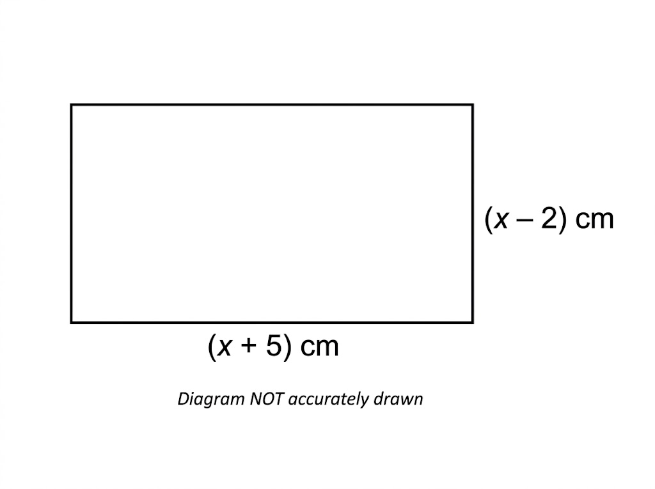
EDEXCEL GCSE MATHS · FOUNDATION & HIGHER
Question 7 · 3 marks · Non-calculator · Show that
The diagram shows a rectangle. The length is (x + 5) cm and the width is (x − 2) cm. Show that the area of the rectangle, in cm², is x² + 3x − 10. (3 marks)
Algebra
openrevise.com
Lesson 2 of 7

Slide 36
EDEXCEL GCSE MATHS · FOUNDATION & HIGHER
Question 7 · mark scheme
3 marks available. Award a mark for each point made.
Area = (x + 5)(x − 2)
M1
At least 3 of the 4 terms correct
M1
Fully correct expansion reaching x² + 3x − 10
A1
Algebra
openrevise.com
Lesson 2 of 7

