Slide 1

EDEXCEL GCSE MATHS · FOUNDATION & HIGHER
Equations
Algebra
Lesson 3 of 7
openrevise.com

Slide 2

EDEXCEL GCSE MATHS · FOUNDATION & HIGHER
Last Lesson and Before
Answer each one, then check.
1
Solve x + 7 = 12.
2
What is the inverse of "multiply by 4"?
3
Work out −6 ÷ 2.
4
Last lesson: expand 3(x − 2).
5
Last lesson: factorise 6x + 9.
Algebra
openrevise.com
Lesson 3 of 7

Slide 3
EDEXCEL GCSE MATHS · FOUNDATION & HIGHER
Last Lesson and Before - Answers
Solve x + 7 = 12.
x = 5
1
What is the inverse of "multiply by 4"?
Divide by 4.
2
Work out −6 ÷ 2.
−3
3
Last lesson: expand 3(x − 2).
3x − 6
4
Last lesson: factorise 6x + 9.
3(2x + 3)
5
Algebra
openrevise.com
Lesson 3 of 7

Slide 4

EDEXCEL GCSE MATHS · FOUNDATION & HIGHER
Learning Objectives
Solve linear equations with the unknown on both sides.
1
Solve equations with brackets.
2
Solve equations with fractions.
3
Form equations from words and diagrams.
4
Solve problems by forming and solving an equation.
5
Algebra
openrevise.com
Lesson 3 of 7

Slide 5

EDEXCEL GCSE MATHS · FOUNDATION & HIGHER
Keeping the Balance
An equation says two things are equal. Solving it means finding the value of the letter that makes it true.
Same on both sides
Add, subtract, multiply or divide both sides by the same thing, and the equation stays true.
Inverse operations
Undo + with −, and × with ÷.
One step at a time
Write each step on a new line, with the = signs lined up.
Check
Put your answer back into the original equation. Both sides should give the same number.
Algebra
openrevise.com
Lesson 3 of 7

Slide 6

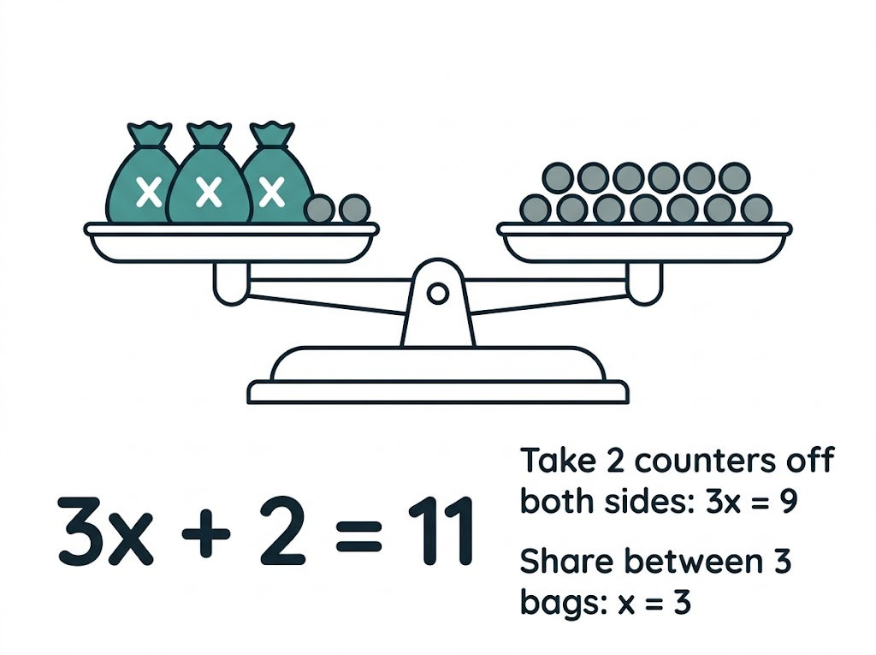
EDEXCEL GCSE MATHS · FOUNDATION & HIGHER
An Equation Is a Balance
The scales stay level as long as you do the same thing to both pans. Take 2 counters off each side and 3 bags balance 9 counters; share them out and each bag must hold 3. That is exactly how you solve 3x + 2 = 11.
3x + 2 = 11: take 2 from both sides, then divide by 3.
Algebra
openrevise.com
Lesson 3 of 7

Slide 7

EDEXCEL GCSE MATHS · FOUNDATION & HIGHER
A Method for Any Linear Equation
Not every equation needs every step - skip the ones that do not apply.
1
2
3
4
5
Brackets
Expand any brackets.
Fractions
Multiply both sides to clear any fractions.
Letters
Collect the letter terms on the side with more of them.
Numbers
Collect the numbers on the other side.
Divide
Divide by the number in front of the letter.
Algebra
openrevise.com
Lesson 3 of 7

Slide 8

EDEXCEL GCSE MATHS · FOUNDATION & HIGHER
The Unknown on Both Sides
Solve 5x − 7 = 2x + 11
Subtract 2x from both sides (there are more xs on the left)
3x − 7 = 11
1
Add 7 to both sides
3x = 18
2
Divide both sides by 3
x = 6
3
Check: both sides give 23
5(6) − 7 = 23 and 2(6) + 11 = 23
4
ANSWER
x = 6
Algebra
openrevise.com
Lesson 3 of 7

Slide 9
EDEXCEL GCSE MATHS · FOUNDATION & HIGHER
Equations with Brackets
Solve 3(2x − 1) = 4(x + 5)
Expand both brackets
6x − 3 = 4x + 20
1
Subtract 4x from both sides
2x − 3 = 20
2
Add 3 to both sides
2x = 23
3
Divide by 2
x = 11.5
4
ANSWER
x = 11.5 (or 23/2)
Algebra
openrevise.com
Lesson 3 of 7

Slide 10
EDEXCEL GCSE MATHS · FOUNDATION & HIGHER
Equations with Fractions
Solve (2x + 1)/3 = (x − 2)/2
1
Multiply both sides by 3 and by 2 (by 6)
2(2x + 1) = 3(x − 2)
2
Expand
4x + 2 = 3x − 6
3
Subtract 3x
x + 2 = −6
4
Subtract 2
x = −8
5
Check: both sides give −5
(−16 + 1)/3 = −5 and (−8 − 2)/2 = −5
ANSWER
x = −8
Algebra
openrevise.com
Lesson 3 of 7

Slide 11
EDEXCEL GCSE MATHS · FOUNDATION & HIGHER
Two Fractions on One Side
Solve x/4 + x/6 = 5
The lowest common multiple of 4 and 6 is 12: multiply every term by 12
3x + 2x = 60
1
Collect like terms
5x = 60
2
Divide by 5
x = 12
3
ANSWER
x = 12
Algebra
openrevise.com
Lesson 3 of 7

Slide 12

EDEXCEL GCSE MATHS · FOUNDATION & HIGHER
PART TWO
Forming Equations
Turning words and diagrams into algebra.
openrevise.com

Slide 13
EDEXCEL GCSE MATHS · FOUNDATION & HIGHER
From Words to an Equation
Four steps turn a problem into an equation you can solve.
Choose a letter
Let x be the thing you do not know - say exactly what it stands for.
Write expressions
Write everything else in terms of x.
Make an equation
Use the fact the question gives you: a total, a perimeter, angles adding to 180°.
Answer the question
Solve for x, then use it to find what the question actually asked for.
Algebra
openrevise.com
Lesson 3 of 7

Slide 14
EDEXCEL GCSE MATHS · FOUNDATION & HIGHER
A Perimeter Problem
A rectangle has length (3x + 2) cm and width (x − 1) cm. Its perimeter is 42 cm. Find the length and the width.
1
Perimeter = 2 lengths + 2 widths
2(3x + 2) + 2(x − 1) = 42
2
Expand
6x + 4 + 2x − 2 = 42
3
Simplify
8x + 2 = 42
4
Solve
8x = 40, so x = 5
5
Answer the question
Length = 3(5) + 2 = 17, width = 5 − 1 = 4
ANSWER
Length 17 cm, width 4 cm (check: 2 × 17 + 2 × 4 = 42)
Algebra
openrevise.com
Lesson 3 of 7

Slide 15
EDEXCEL GCSE MATHS · FOUNDATION & HIGHER
A Word Problem
An adult cinema ticket costs £4 more than a child ticket. Two adult tickets and three child tickets cost £38. Find the price of each ticket.
Let a child ticket cost £x
An adult ticket costs £(x + 4)
1
Write the equation
2(x + 4) + 3x = 38
2
Expand and simplify
2x + 8 + 3x = 38, so 5x + 8 = 38
3
Solve
5x = 30, so x = 6
4
ANSWER
Child £6, adult £10 (check: 2 × 10 + 3 × 6 = 38)
Algebra
openrevise.com
Lesson 3 of 7

Slide 16

EDEXCEL GCSE MATHS · FOUNDATION & HIGHER
Key Terms
Equation
A statement that two expressions are equal, true for particular values of the letter.
Solve
Find the value of the letter that makes the equation true.
Solution
The value that makes the equation true.
Inverse operation
The operation that undoes another: − undoes +, ÷ undoes ×.
Linear equation
An equation where the highest power of the letter is 1.
Algebra
openrevise.com
Lesson 3 of 7

Slide 17

EDEXCEL GCSE MATHS · FOUNDATION & HIGHER
YOUR TASK
15 minutes
Equation Relay
Solve each equation; each answer is used in the next. (a) 4x + 3 = 23. (b) Let a be your answer to (a): solve 2y − a = y + 1. (c) Let b be your answer to (b): solve 3(z − 2) = b + z. (d) Let c be your answer to (c): solve w/2 + w/3 = c + 1.
1
Solve each equation in turn.
2
Check each answer before passing it on.
3
The first team with a correct (d) wins.
WHAT A GOOD ANSWER SHOWS
(a) x = 5 (b) y = 6 (c) 3z − 6 = 6 + z, so z = 6 (d) 5w/6 = 7, so w = 8.4
Algebra
openrevise.com
Lesson 3 of 7
Notes:
A wrong answer anywhere carries through - which makes checking each answer by substitution worthwhile.

Slide 18

EDEXCEL GCSE MATHS · FOUNDATION & HIGHER
Can I...?
Solve two-step equations.
Solve equations with two fractions.
Solve equations with the unknown on both sides.
Check a solution by substituting.
Solve equations with brackets.
Form an equation from words.
Solve equations with one fraction.
Form an equation from a diagram.
Algebra
openrevise.com
Lesson 3 of 7

Slide 19
EDEXCEL GCSE MATHS · FOUNDATION & HIGHER
Summary & Exam Focus
Do the same to both sides to keep the equation balanced.
Expand brackets, clear fractions, collect letters, collect numbers, divide.
Clear fractions by multiplying every term by the LCM of the denominators.
For word problems: choose a letter, write expressions, form an equation, then answer the question asked.
EXAM FOCUS
Solve 4(3 − 2x) = 2(x + 11) (3 marks)
Write each step on a new line. If the final answer is wrong, the method marks for expanding and collecting terms are still there to win.
openrevise.com

Slide 20
EDEXCEL GCSE MATHS · FOUNDATION & HIGHER
Exam Practice: Equations
Answer all questions. Show your working. Questions 1 to 4 are non-calculator. · 25 minutes
Question 1 · 2 marks · Non-calculator
Solve 7x + 4 = 3x − 12
Question 2 · 3 marks · Non-calculator
Solve 4(3 − 2x) = 2(x + 11)
Question 3 · 3 marks · Non-calculator
Solve (5x − 2)/3 = (x + 4)/2
Algebra
openrevise.com
Lesson 3 of 7

Slide 21
EDEXCEL GCSE MATHS · FOUNDATION & HIGHER
Exam Practice: Equations (cont.)
Question 4 · 4 marks · Non-calculator
The diagram shows a triangle. The sizes of its angles, in degrees, are 2x + 10, 3x − 5 and x + 25. Work out the size of the largest angle.
Question 5 · 4 marks · Calculator
Amy is 3 times as old as Ben. In 8 years' time, Amy will be twice as old as Ben. How old is Amy now?
Algebra
openrevise.com
Lesson 3 of 7

Slide 22
EDEXCEL GCSE MATHS · FOUNDATION & HIGHER
Question 1 · 2 marks · Non-calculator
“
Solve 7x + 4 = 3x − 12
HOW TO ANSWER IT
Command word: Non-calculator. Worth 2 marks, so plan before writing.
Algebra
openrevise.com
Lesson 3 of 7

Slide 23
EDEXCEL GCSE MATHS · FOUNDATION & HIGHER
Question 1 · mark scheme
2 marks available. Award a mark for each point made.
4x = −16, or a correct first step collecting x terms or numbers
M1
x = −4
A1
Algebra
openrevise.com
Lesson 3 of 7

Slide 24
EDEXCEL GCSE MATHS · FOUNDATION & HIGHER
Question 2 · 3 marks · Non-calculator
“
Solve 4(3 − 2x) = 2(x + 11)
HOW TO ANSWER IT
Command word: Non-calculator. Worth 3 marks, so plan before writing.
Algebra
openrevise.com
Lesson 3 of 7

Slide 25
EDEXCEL GCSE MATHS · FOUNDATION & HIGHER
Question 2 · mark scheme
3 marks available. Award a mark for each point made.
Both brackets expanded correctly
M1
Correctly collects x terms on one side and numbers on the other
M1
x = −1
A1
Algebra
openrevise.com
Lesson 3 of 7

Slide 26
EDEXCEL GCSE MATHS · FOUNDATION & HIGHER
Question 3 · 3 marks · Non-calculator
“
Solve (5x − 2)/3 = (x + 4)/2
HOW TO ANSWER IT
Command word: Non-calculator. Worth 3 marks, so plan before writing.
Algebra
openrevise.com
Lesson 3 of 7

Slide 27
EDEXCEL GCSE MATHS · FOUNDATION & HIGHER
Question 3 · mark scheme
3 marks available. Award a mark for each point made.
Multiplies both sides to clear the fractions, e.g. 2(5x − 2) = 3(x + 4)
M1
7x = 16
M1
x = 16/7 (or 22/7)
A1
Algebra
openrevise.com
Lesson 3 of 7

Slide 28
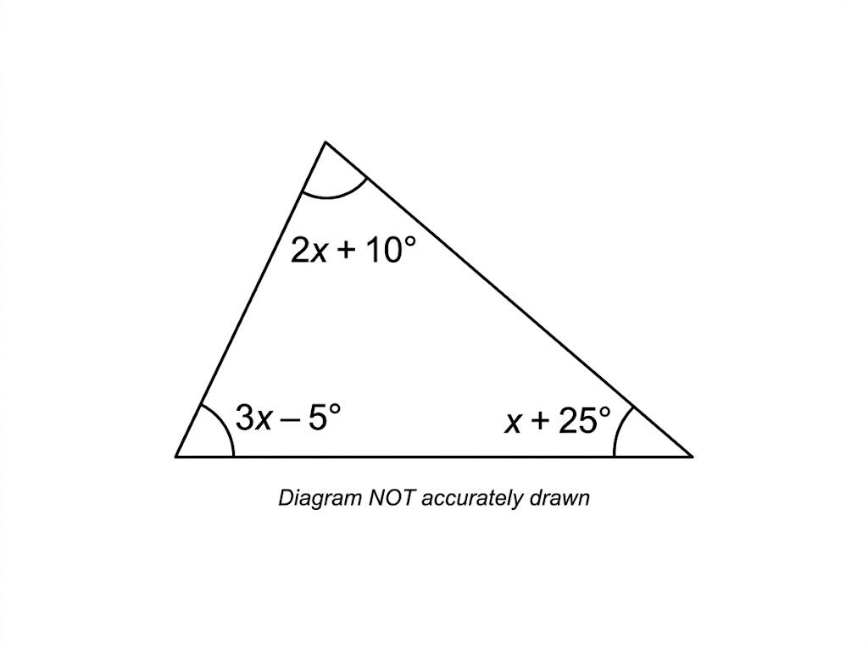
EDEXCEL GCSE MATHS · FOUNDATION & HIGHER
Question 4 · 4 marks · Non-calculator
The diagram shows a triangle. The sizes of its angles, in degrees, are 2x + 10, 3x − 5 and x + 25. Work out the size of the largest angle. (4 marks)
Algebra
openrevise.com
Lesson 3 of 7

Slide 29
EDEXCEL GCSE MATHS · FOUNDATION & HIGHER
Question 4 · mark scheme
4 marks available. Award a mark for each point made.
Sets the sum of the angles equal to 180
P1
6x + 30 = 180
P1
x = 25
P1
70°
A1
Algebra
openrevise.com
Lesson 3 of 7

Slide 30
EDEXCEL GCSE MATHS · FOUNDATION & HIGHER
Question 5 · 4 marks · Calculator
“
Amy is 3 times as old as Ben. In 8 years' time, Amy will be twice as old as Ben. How old is Amy now?
HOW TO ANSWER IT
Command word: Calculator. Worth 4 marks, so plan before writing.
Algebra
openrevise.com
Lesson 3 of 7

Slide 31
EDEXCEL GCSE MATHS · FOUNDATION & HIGHER
Question 5 · mark scheme
4 marks available. Award a mark for each point made.
Ben = b and Amy = 3b, or equivalent
P1
3b + 8 = 2(b + 8)
P1
b = 8
P1
Amy is 24
A1
Algebra
openrevise.com
Lesson 3 of 7

