Slide 1

EDEXCEL GCSE MATHS · FOUNDATION & HIGHER
Formulae
Algebra
Lesson 4 of 7
openrevise.com

Slide 2

EDEXCEL GCSE MATHS · FOUNDATION & HIGHER
Last Lesson and Before
Answer each one, then check.
1
If x = 3, what is 2x + 5?
2
If y = −2, what is y²?
3
What is (−2)³?
4
Last lesson: solve 3x − 4 = 11.
5
Last lesson: solve 2(x + 3) = 14.
Algebra
openrevise.com
Lesson 4 of 7

Slide 3
EDEXCEL GCSE MATHS · FOUNDATION & HIGHER
Last Lesson and Before - Answers
If x = 3, what is 2x + 5?
11
1
If y = −2, what is y²?
4
2
What is (−2)³?
−8
3
Last lesson: solve 3x − 4 = 11.
x = 5
4
Last lesson: solve 2(x + 3) = 14.
x = 4
5
Algebra
openrevise.com
Lesson 4 of 7

Slide 4

EDEXCEL GCSE MATHS · FOUNDATION & HIGHER
Learning Objectives
Tell the difference between an expression, an equation, a formula and an identity.
1
Substitute positive and negative numbers into formulae.
2
Write a formula from a description.
3
Change the subject of a formula.
4
Change the subject when the subject is squared or appears twice. (Higher)
5
Algebra
openrevise.com
Lesson 4 of 7

Slide 5

EDEXCEL GCSE MATHS · FOUNDATION & HIGHER
Four Words, Four Meanings
Expression
Terms with no equals sign: 3x + 2. It cannot be solved.
Equation
Two expressions that are equal for particular values: 3x + 2 = 11 is only true when x = 3.
Formula
A rule linking quantities, each with its own letter: v = u + at, A = πr².
Identity
Two expressions equal for EVERY value of the letter, written with ≡: 2(x + 3) ≡ 2x + 6.
Algebra
openrevise.com
Lesson 4 of 7

Slide 6

EDEXCEL GCSE MATHS · FOUNDATION & HIGHER
Substituting into a Formula
Replace each letter with its value, then follow the order of operations.
Use brackets
Put negative numbers in brackets: if a = −2, then a² = (−2)² = 4.
Powers first
In ½at², square t before multiplying.
Show the substitution
Write the formula with the numbers in before working it out: it earns the method mark.
Units
Give the answer in the right units if the question has them.
Algebra
openrevise.com
Lesson 4 of 7

Slide 7

EDEXCEL GCSE MATHS · FOUNDATION & HIGHER
Substituting Negative Numbers
s = ut + ½at². Work out s when u = 3, t = 4 and a = −2.
Substitute
s = 3 × 4 + ½ × (−2) × 4²
1
Powers first
4² = 16
2
Multiply
3 × 4 = 12 and ½ × (−2) × 16 = −16
3
Add
12 + (−16) = −4
4
ANSWER
s = −4
Algebra
openrevise.com
Lesson 4 of 7

Slide 8

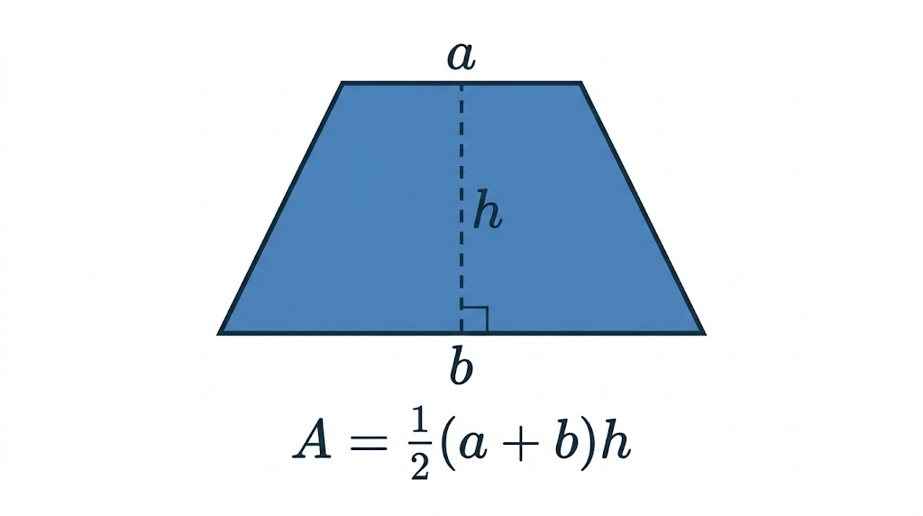
EDEXCEL GCSE MATHS · FOUNDATION & HIGHER
The Area of a Trapezium
The area of a trapezium is A = ½(a + b)h, where a and b are the parallel sides and h is the perpendicular height. With a = 5 cm, b = 9 cm and h = 4 cm: A = ½ × (5 + 9) × 4 = ½ × 14 × 4 = 28 cm².
A = ½(a + b)h: add the parallel sides, halve, multiply by the height.
Algebra
openrevise.com
Lesson 4 of 7

Slide 9

EDEXCEL GCSE MATHS · FOUNDATION & HIGHER
PART ONE
Changing the Subject
Rearranging a formula to work out a different letter.
openrevise.com

Slide 10

EDEXCEL GCSE MATHS · FOUNDATION & HIGHER
What Is the Subject?
The subject of a formula is the letter on its own on one side: in v = u + at, the subject is v.
The idea
Rearrange the formula so a different letter is on its own.
The method
Exactly like solving an equation: undo what has been done to the new subject, in reverse order, doing the same to both sides.
Why
To find a when you know v, u and t, it is quicker to rearrange once than to solve a new equation every time.
Algebra
openrevise.com
Lesson 4 of 7

Slide 11
EDEXCEL GCSE MATHS · FOUNDATION & HIGHER
Changing the Subject
Make t the subject of v = u + at.
Subtract u from both sides
v − u = at
1
Divide both sides by a
(v − u)/a = t
2
Write the subject on the left
t = (v − u)/a
3
ANSWER
t = (v − u)/a
Algebra
openrevise.com
Lesson 4 of 7

Slide 12
EDEXCEL GCSE MATHS · FOUNDATION & HIGHER
Rearranging the Trapezium Formula
Make h the subject of A = ½(a + b)h.
Multiply both sides by 2
2A = (a + b)h
1
Divide both sides by (a + b)
2A/(a + b) = h
2
ANSWER
h = 2A/(a + b)
Algebra
openrevise.com
Lesson 4 of 7

Slide 13
EDEXCEL GCSE MATHS · FOUNDATION & HIGHER
PART TWO · HIGHER
Harder Rearranging
When the subject is squared, or appears twice.
openrevise.com

Slide 14
EDEXCEL GCSE MATHS · FOUNDATION & HIGHER
The Subject Is Squared
Make r the subject of A = πr².
Divide both sides by π
A/π = r²
1
Square root both sides
√(A/π) = r
2
ANSWER
r = √(A/π)
Algebra
openrevise.com
Lesson 4 of 7

Slide 15
EDEXCEL GCSE MATHS · FOUNDATION & HIGHER
The Subject Appears Twice
Make x the subject of y = (x + 2)/(x − 3).
1
Multiply both sides by (x − 3)
y(x − 3) = x + 2
2
Expand
xy − 3y = x + 2
3
Collect the x terms on one side
xy − x = 3y + 2
4
Factorise out x
x(y − 1) = 3y + 2
5
Divide by (y − 1)
x = (3y + 2)/(y − 1)
ANSWER
x = (3y + 2)/(y − 1)
Algebra
openrevise.com
Lesson 4 of 7

Slide 16
EDEXCEL GCSE MATHS · FOUNDATION & HIGHER
CASE STUDY
Celsius and Fahrenheit
The Fahrenheit temperature scale, still used in the USA, is linked to Celsius by the formula F = 1.8C + 32. Rearranging it gives C = (F − 32)/1.8, so a weather forecast of 77 °F becomes (77 − 32)/1.8 = 25 °C. There is one temperature that reads the same on both scales: solve C = 1.8C + 32 and you get C = −40. So −40 °C and −40 °F are exactly the same temperature.
−40°
100 °C = 212 °F
The one temperature that is the same on both scales
The boiling point of water
Algebra
openrevise.com
Lesson 4 of 7

Slide 17

EDEXCEL GCSE MATHS · FOUNDATION & HIGHER
Key Terms
Formula
A rule linking two or more quantities, written with letters.
Substitute
Replace the letters in a formula with numbers.
Subject
The letter on its own on one side of a formula.
Change the subject
Rearrange a formula so a different letter is the subject.
Identity
Two expressions that are equal for every value of the letters, written with ≡.
Algebra
openrevise.com
Lesson 4 of 7

Slide 18

EDEXCEL GCSE MATHS · FOUNDATION & HIGHER
YOUR TASK
12 minutes
Rearrange It
Make the letter in brackets the subject. (a) P = 4s (s) (b) y = mx + c (x) (c) C = 2πr (r) (d) V = IR (I) (e) A = ½bh (b). Higher: (f) E = ½mv² (v) (g) a(x − 2) = x + 5 (x).
1
Undo operations in reverse order.
2
Do the same to both sides.
3
Higher: collect the subject, then factorise.
WHAT A GOOD ANSWER SHOWS
(a) s = P/4 (b) x = (y − c)/m (c) r = C/2π (d) I = V/R (e) b = 2A/h (f) v = √(2E/m) (g) ax − 2a = x + 5, so ax − x = 5 + 2a, x(a − 1) = 5 + 2a and x = (5 + 2a)/(a − 1)
Algebra
openrevise.com
Lesson 4 of 7

Slide 19

EDEXCEL GCSE MATHS · FOUNDATION & HIGHER
Can I...?
Tell a formula from an equation, expression and identity.
Change the subject in one step.
Substitute positive numbers into a formula.
Change the subject in two or more steps.
Substitute negative numbers into a formula.
Change the subject when it is squared. (Higher)
Write a formula from words.
Change the subject when it appears twice. (Higher)
Algebra
openrevise.com
Lesson 4 of 7

Slide 20
EDEXCEL GCSE MATHS · FOUNDATION & HIGHER
Summary & Exam Focus
Expression: no equals sign. Equation: true for some values. Formula: links quantities. Identity: true for all values.
Substitute: numbers in, brackets round negatives, powers first.
Change the subject: undo operations in reverse order, doing the same to both sides.
(Higher) Subject twice: collect those terms, factorise, then divide.
EXAM FOCUS
Make t the subject of the formula v = u + at (2 marks)
Write the substitution before calculating, and put negative numbers in brackets. Most lost marks on substitution come from squaring a negative number without brackets.
openrevise.com

