Slide 1

EDEXCEL GCSE MATHS · FOUNDATION & HIGHER
Linear sequences
Algebra
Lesson 5 of 7
openrevise.com

Slide 2

EDEXCEL GCSE MATHS · FOUNDATION & HIGHER
Last Lesson and Before
Answer each one, then check.
1
Write down the next term: 3, 7, 11, 15, ...
2
What is the difference between the terms of 20, 17, 14, ...?
3
Solve 3n + 2 = 50.
4
Last lesson: work out 2n + 1 when n = 10.
5
Last lesson: make n the subject of T = 4n − 1.
Algebra
openrevise.com
Lesson 5 of 7

Slide 3
EDEXCEL GCSE MATHS · FOUNDATION & HIGHER
Last Lesson and Before - Answers
Write down the next term: 3, 7, 11, 15, ...
19
1
What is the difference between the terms of 20, 17, 14, ...?
−3
2
Solve 3n + 2 = 50.
n = 16
3
Last lesson: work out 2n + 1 when n = 10.
21
4
Last lesson: make n the subject of T = 4n − 1.
n = (T + 1)/4
5
Algebra
openrevise.com
Lesson 5 of 7

Slide 4

EDEXCEL GCSE MATHS · FOUNDATION & HIGHER
Learning Objectives
Continue a sequence using a term-to-term rule.
1
Generate terms of a sequence from its nth term.
2
Find the nth term of a linear (arithmetic) sequence.
3
Decide whether a number is a term of a sequence.
4
Solve problems with linear sequences and patterns.
5
Algebra
openrevise.com
Lesson 5 of 7

Slide 5

EDEXCEL GCSE MATHS · FOUNDATION & HIGHER
Sequences
A sequence is a list of numbers that follows a rule.
Term
Each number in a sequence. The 1st term, 2nd term and so on.
Term-to-term rule
How to get from one term to the next: "add 3".
Position-to-term rule (nth term)
A formula for any term from its position n: the nth term 3n + 2 gives 5, 8, 11, ...
Linear (arithmetic) sequence
One that goes up or down by the same amount - the common difference - every time.
Algebra
openrevise.com
Lesson 5 of 7

Slide 6

EDEXCEL GCSE MATHS · FOUNDATION & HIGHER
Where the nth Term Comes From
The sequence 5, 8, 11, 14, ... goes up by 3, so compare it with the 3 times table.
Position n
3n
Term
Term − 3n
1
3
5
+2
2
6
8
+2
3
9
11
+2
4
12
14
+2
n
3n
3n + 2
+2
Algebra
openrevise.com
Lesson 5 of 7

Slide 7

EDEXCEL GCSE MATHS · FOUNDATION & HIGHER
Finding the nth Term
Works for every linear sequence.
1
2
3
4
5
Difference
Find the common difference, d.
Times table
Write down dn: the d times table.
Compare
How do you get from dn to the sequence?
Adjust
Add or subtract that number.
Check
Put n = 1 and n = 2 into your answer.
Algebra
openrevise.com
Lesson 5 of 7

Slide 8

EDEXCEL GCSE MATHS · FOUNDATION & HIGHER
Finding the nth Term
Find the nth term of 7, 11, 15, 19, ...
1
The common difference is +4
so it starts 4n
2
The 4 times table
4, 8, 12, 16
3
Compare with the sequence
7 − 4 = 3: each term is 3 more
4
Write the nth term
4n + 3
5
Check n = 3
4 × 3 + 3 = 15
ANSWER
4n + 3
Algebra
openrevise.com
Lesson 5 of 7

Slide 9
EDEXCEL GCSE MATHS · FOUNDATION & HIGHER
A Decreasing Sequence
Find the nth term of 20, 17, 14, 11, ...
1
The common difference is −3
so it starts −3n
2
The −3 times table
−3, −6, −9, −12
3
Compare with the sequence
20 − (−3) = 23: each term is 23 more
4
Write the nth term
−3n + 23, usually written 23 − 3n
5
Check n = 1
23 − 3 = 20
ANSWER
23 − 3n
Algebra
openrevise.com
Lesson 5 of 7

Slide 10
EDEXCEL GCSE MATHS · FOUNDATION & HIGHER
Is It in the Sequence?
Is 100 a term of the sequence with nth term 4n + 3?
Set the nth term equal to 100
4n + 3 = 100
1
Solve
4n = 97, so n = 24.25
2
n must be a whole number (a position)
24.25 is not a whole number
3
ANSWER
No - 100 is not in the sequence (the 24th term is 99 and the 25th is 103).
Algebra
openrevise.com
Lesson 5 of 7

Slide 11

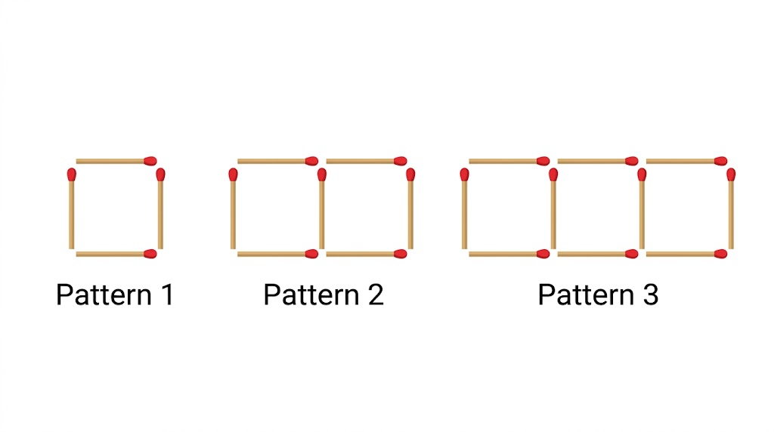
EDEXCEL GCSE MATHS · FOUNDATION & HIGHER
A Matchstick Pattern
Each new square needs 3 more matchsticks, so the sequence 4, 7, 10, ... has a common difference of 3. Comparing with 3n (3, 6, 9) shows each pattern uses one more: the nth pattern needs 3n + 1 matchsticks - the extra 1 is the first stick on the left.
4, 7, 10, ...: each new square needs 3 more matchsticks.
Algebra
openrevise.com
Lesson 5 of 7

Slide 12
EDEXCEL GCSE MATHS · FOUNDATION & HIGHER
Using the Pattern
Pattern n uses 3n + 1 matchsticks. (a) How many matchsticks does pattern 20 use? (b) What is the largest pattern that can be made with 100 matchsticks?
(a) Substitute n = 20
3 × 20 + 1 = 61
1
(b) The number of matchsticks must be 100 or fewer
3n + 1 ≤ 100
2
Solve
3n ≤ 99, so n ≤ 33
3
Pattern 33 uses exactly 3 × 33 + 1 = 100
it fits
4
ANSWER
(a) 61 matchsticks (b) Pattern 33
Algebra
openrevise.com
Lesson 5 of 7

Slide 13

EDEXCEL GCSE MATHS · FOUNDATION & HIGHER
Key Terms
Sequence
A list of numbers or patterns that follows a rule.
Term
One number in a sequence.
Term-to-term rule
The rule that gets you from one term to the next.
nth term
A formula that gives any term from its position, n.
Common difference
The amount a linear sequence goes up or down by each time.
Linear (arithmetic) sequence
A sequence with a common difference.
Algebra
openrevise.com
Lesson 5 of 7

Slide 14

EDEXCEL GCSE MATHS · FOUNDATION & HIGHER
YOUR TASK
12 minutes
Sequence Detectives
For each sequence, find the nth term and the 50th term. Then decide whether 150 is in it. (a) 6, 11, 16, 21, ... (b) 1, 4, 7, 10, ... (c) 40, 36, 32, 28, ... (d) −5, −3, −1, 1, ...
1
Find the difference.
2
Write the nth term and check it.
3
Solve nth term = 150.
WHAT A GOOD ANSWER SHOWS
(a) 5n + 1; 251; 150 is not in it (n = 29.8). (b) 3n − 2; 148; 150 is not in it (n = 50.67). (c) 44 − 4n; −156; 150 is not in it (it is decreasing from 40). (d) 2n − 7; 93; 150 is not in it (n = 78.5).
Algebra
openrevise.com
Lesson 5 of 7
Notes:
The trick answer is that 150 is in none of them - a good discussion of what "not a whole number" tells you.

Slide 15

EDEXCEL GCSE MATHS · FOUNDATION & HIGHER
Can I...?
Continue a sequence.
Find the nth term of a decreasing sequence.
Describe a term-to-term rule.
Decide whether a number is in a sequence.
Work out terms from an nth term.
Find the nth term of a pattern.
Find the nth term of an increasing sequence.
Use an nth term to solve a problem.
Algebra
openrevise.com
Lesson 5 of 7

Slide 16
EDEXCEL GCSE MATHS · FOUNDATION & HIGHER
Summary & Exam Focus
A linear sequence has a common difference.
nth term = (difference) × n, then adjust with a number.
To test a number, set the nth term equal to it: a whole-number n means it is in the sequence.
For patterns, the difference is how many more items each new pattern needs.
EXAM FOCUS
Here are the first five terms of a sequence: 5, 9, 13, 17, 21. Find an expression for the nth term. (2 marks)
"n + 4" is the term-to-term rule written wrongly, not an nth term. The nth term of a sequence going up by 4 always starts 4n.
openrevise.com

Slide 17
EDEXCEL GCSE MATHS · FOUNDATION & HIGHER
Exam Practice: Linear Sequences
Answer all questions. Show your working. Questions 1 to 3 are non-calculator. · 20 minutes
Question 1 · 2 marks · Non-calculator
Here are the first five terms of a sequence: 5, 9, 13, 17, 21. Find an expression, in terms of n, for the nth term of the sequence.
Question 2 · 2 marks · Non-calculator
Is 99 a term of the sequence 5, 9, 13, 17, 21, ...? You must give a reason for your answer.
Question 3 · 2 marks · Non-calculator
Find an expression for the nth term of the sequence 30, 26, 22, 18, ...
Algebra
openrevise.com
Lesson 5 of 7

Slide 18
EDEXCEL GCSE MATHS · FOUNDATION & HIGHER
Exam Practice: Linear Sequences (cont.)
Question 4 · 3 marks · Calculator
The diagram shows the first three patterns in a sequence made from matchsticks. Pattern 1 uses 4 matchsticks, pattern 2 uses 7 and pattern…
Question 5 · 3 marks · Calculator
Sequence A has nth term 3n + 5. Sequence B has nth term 50 − 2n. For which value of n are the nth terms of the two sequences equal, and…
Algebra
openrevise.com
Lesson 5 of 7

Slide 19
EDEXCEL GCSE MATHS · FOUNDATION & HIGHER
Question 1 · 2 marks · Non-calculator
“
Here are the first five terms of a sequence: 5, 9, 13, 17, 21. Find an expression, in terms of n, for the nth term of the sequence.
HOW TO ANSWER IT
Command word: Non-calculator. Worth 2 marks, so plan before writing.
Algebra
openrevise.com
Lesson 5 of 7

Slide 20
EDEXCEL GCSE MATHS · FOUNDATION & HIGHER
Question 1 · mark scheme
2 marks available. Award a mark for each point made.
4n + 1
B2
4n + k, where k ≠ 1
B1
Algebra
openrevise.com
Lesson 5 of 7

Slide 21
EDEXCEL GCSE MATHS · FOUNDATION & HIGHER
Question 2 · 2 marks · Non-calculator
“
Is 99 a term of the sequence 5, 9, 13, 17, 21, ...? You must give a reason for your answer.
HOW TO ANSWER IT
Command word: Non-calculator. Worth 2 marks, so plan before writing.
Algebra
openrevise.com
Lesson 5 of 7

Slide 22
EDEXCEL GCSE MATHS · FOUNDATION & HIGHER
Question 2 · mark scheme
2 marks available. Award a mark for each point made.
4n + 1 = 99, or listing terms to 97 and 101
M1
No, with a correct reason
C1
Algebra
openrevise.com
Lesson 5 of 7

Slide 23
EDEXCEL GCSE MATHS · FOUNDATION & HIGHER
Question 3 · 2 marks · Non-calculator
“
Find an expression for the nth term of the sequence 30, 26, 22, 18, ...
HOW TO ANSWER IT
Command word: Non-calculator. Worth 2 marks, so plan before writing.
Algebra
openrevise.com
Lesson 5 of 7

Slide 24
EDEXCEL GCSE MATHS · FOUNDATION & HIGHER
Question 3 · mark scheme
2 marks available. Award a mark for each point made.
34 − 4n
B2
−4n + k, where k ≠ 34
B1
Algebra
openrevise.com
Lesson 5 of 7

Slide 25
EDEXCEL GCSE MATHS · FOUNDATION & HIGHER
Question 4 · 3 marks · Calculator
The diagram shows the first three patterns in a sequence made from matchsticks. Pattern 1 uses 4 matchsticks, pattern 2 uses 7 and pattern 3 uses 10. Jack has 150 matchsticks. What is the largest pattern number he can make? (3 marks)
Algebra
openrevise.com
Lesson 5 of 7

Slide 26
EDEXCEL GCSE MATHS · FOUNDATION & HIGHER
Question 4 · mark scheme
3 marks available. Award a mark for each point made.
3n + 1, or the difference of 3 used
P1
3n + 1 = 150 or 3n + 1 ≤ 150, or 49.6… seen
P1
49
A1
Algebra
openrevise.com
Lesson 5 of 7

Slide 27
EDEXCEL GCSE MATHS · FOUNDATION & HIGHER
Question 5 · 3 marks · Calculator
“
Sequence A has nth term 3n + 5. Sequence B has nth term 50 − 2n. For which value of n are the nth terms of the two sequences equal, and what is that term?
HOW TO ANSWER IT
Command word: Calculator. Worth 3 marks, so plan before writing.
Algebra
openrevise.com
Lesson 5 of 7

Slide 28
EDEXCEL GCSE MATHS · FOUNDATION & HIGHER
Question 5 · mark scheme
3 marks available. Award a mark for each point made.
3n + 5 = 50 − 2n
M1
n = 9
A1
32
A1
Algebra
openrevise.com
Lesson 5 of 7

