Slide 1

EDEXCEL GCSE MATHS · HIGHER TIER
More expanding and factorising
Algebra
Lesson 7 of 7
openrevise.com

Slide 2

EDEXCEL GCSE MATHS · HIGHER TIER
From Earlier Lessons
Answer each one, then check.
1
Expand and simplify (x + 3)(x + 5).
2
Factorise x² + 5x + 6.
3
Factorise x² − 25.
4
Simplify 6x² ÷ 2x.
5
Work out 7² − 3².
Algebra
openrevise.com
Lesson 7 of 7

Slide 3
EDEXCEL GCSE MATHS · HIGHER TIER
From Earlier Lessons - Answers
Expand and simplify (x + 3)(x + 5).
x² + 8x + 15
1
Factorise x² + 5x + 6.
(x + 2)(x + 3)
2
Factorise x² − 25.
(x + 5)(x − 5)
3
Simplify 6x² ÷ 2x.
3x
4
Work out 7² − 3².
49 − 9 = 40
5
Algebra
openrevise.com
Lesson 7 of 7

Slide 4

EDEXCEL GCSE MATHS · HIGHER TIER
Learning Objectives
Expand the product of three binomials.
1
Factorise quadratics of the form ax² + bx + c.
2
Factorise the difference of two squares with coefficients, such as 9x² − 16y².
3
Simplify algebraic fractions by factorising.
4
Use expanding and factorising in algebraic proof.
5
Algebra
openrevise.com
Lesson 7 of 7

Slide 5

EDEXCEL GCSE MATHS · HIGHER TIER
Expanding Three Brackets
Expand and simplify (x + 1)(x + 2)(x + 3)
Expand the first two brackets
(x + 1)(x + 2) = x² + 3x + 2
1
Multiply every term by x
x(x² + 3x + 2) = x³ + 3x² + 2x
2
Multiply every term by +3
3(x² + 3x + 2) = 3x² + 9x + 6
3
Collect like terms
x³ + 6x² + 11x + 6
4
ANSWER
x³ + 6x² + 11x + 6
Algebra
openrevise.com
Lesson 7 of 7

Slide 6
EDEXCEL GCSE MATHS · HIGHER TIER
Three Brackets with Negatives
Expand and simplify (x − 2)(x + 3)(2x − 1)
Expand the first two
(x − 2)(x + 3) = x² + x − 6
1
Multiply by 2x
2x³ + 2x² − 12x
2
Multiply by −1
−x² − x + 6
3
Collect like terms
2x³ + x² − 13x + 6
4
ANSWER
2x³ + x² − 13x + 6 (check x = 1: (−1)(4)(1) = −4 and 2 + 1 − 13 + 6 = −4)
Algebra
openrevise.com
Lesson 7 of 7

Slide 7

EDEXCEL GCSE MATHS · HIGHER TIER
The Difference of Two Squares, Again
a² − b² = (a + b)(a − b) works for any two squares, not just x² and a number.
With coefficients
9x² − 16y² = (3x)² − (4y)² = (3x + 4y)(3x − 4y).
Take out a factor first
2x² − 18 = 2(x² − 9) = 2(x + 3)(x − 3).
With numbers
101² − 99² = (101 + 99)(101 − 99) = 200 × 2 = 400 - no squaring needed.
Watch for it
50 − 2x² = 2(25 − x²) = 2(5 + x)(5 − x).
Algebra
openrevise.com
Lesson 7 of 7

Slide 8

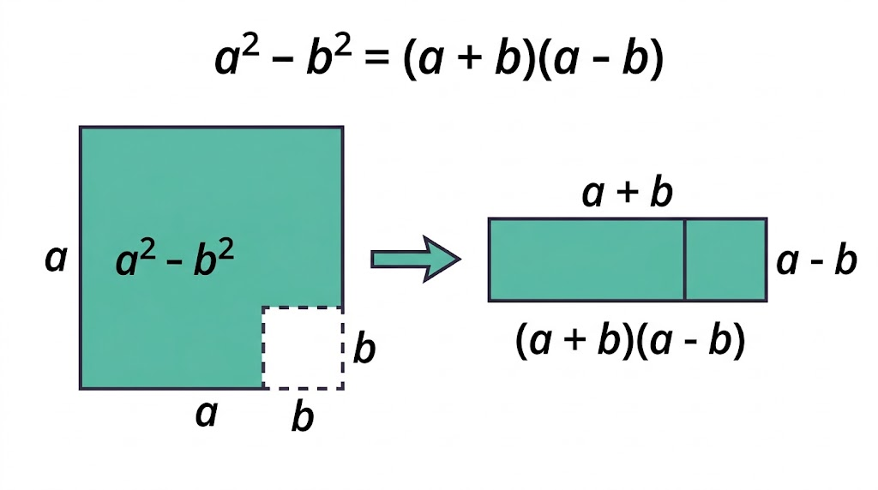
EDEXCEL GCSE MATHS · HIGHER TIER
Why the Difference of Two Squares Works
Take a square of side a and cut a square of side b from its corner. What is left has area a² − b². Slice it in two and rearrange the pieces, and they make a rectangle a + b long and a − b wide. Same area, two ways of writing it.
Cut the L-shape and rearrange it: a² − b² = (a + b)(a − b).
Algebra
openrevise.com
Lesson 7 of 7

Slide 9

EDEXCEL GCSE MATHS · HIGHER TIER
PART ONE
Factorising ax² + bx + c
When the squared term has a number in front.
openrevise.com

Slide 10

EDEXCEL GCSE MATHS · HIGHER TIER
Splitting the Middle Term
A reliable method for any quadratic ax² + bx + c.
1
2
3
4
5
Multiply
Work out a × c.
Find the pair
Two numbers that multiply to ac and add to b.
Split
Write bx as the sum of those two x terms.
Pairs
Factorise the first two terms and the last two terms.
Common bracket
Take out the bracket they share.
Algebra
openrevise.com
Lesson 7 of 7

Slide 11
EDEXCEL GCSE MATHS · HIGHER TIER
Factorising a Quadratic with a Coefficient
Factorise 6x² + 11x − 10
1
a × c
6 × (−10) = −60
2
Two numbers that multiply to −60 and add to 11
15 and −4
3
Split the middle term
6x² + 15x − 4x − 10
4
Factorise in pairs
3x(2x + 5) − 2(2x + 5)
5
Take out the common bracket
(2x + 5)(3x − 2)
ANSWER
(2x + 5)(3x − 2) (check: 6x² − 4x + 15x − 10)
Algebra
openrevise.com
Lesson 7 of 7

Slide 12

EDEXCEL GCSE MATHS · HIGHER TIER
Simplifying Algebraic Fractions
Factorise the top and the bottom, then cancel any bracket they share.
Cancel brackets, not terms
In (x + 3)/(x + 5), nothing cancels: the 3 and the 5 are not factors.
Factorise everything
Take out common factors, use the difference of two squares, factorise quadratics.
Then cancel
A bracket on the top and the bottom divides to 1.
Algebra
openrevise.com
Lesson 7 of 7

Slide 13
EDEXCEL GCSE MATHS · HIGHER TIER
Simplifying an Algebraic Fraction
Simplify fully (x² − 9)/(2x² + 5x − 3)
Top: difference of two squares
x² − 9 = (x + 3)(x − 3)
1
Bottom: ac = −6; 6 and −1 multiply to −6 and add to 5
2x² + 6x − x − 3 = (x + 3)(2x − 1)
2
Write it factorised
(x + 3)(x − 3)/((x + 3)(2x − 1))
3
Cancel (x + 3)
(x − 3)/(2x − 1)
4
ANSWER
(x − 3)/(2x − 1)
Algebra
openrevise.com
Lesson 7 of 7

Slide 14

EDEXCEL GCSE MATHS · HIGHER TIER
Algebraic Proof
Algebra can prove something is true for every number at once.
Even and odd
An even number is 2n; an odd number is 2n + 1, where n is an integer.
Consecutive numbers
n, n + 1, n + 2, ...
The method
Write the expression, expand and simplify, then factorise to show the property.
Example
(n + 3)² − (n + 1)² = n² + 6n + 9 − n² − 2n − 1 = 4n + 8 = 4(n + 2), which is always a multiple of 4.
Algebra
openrevise.com
Lesson 7 of 7

Slide 15

EDEXCEL GCSE MATHS · HIGHER TIER
Match the Quadratic to Its Factors
Expression
Factorised
A
2x² + 7x + 3
(3x − 1)(2x + 1)
1
B
3x² − 5x − 2
x(x + 2)(x − 2)
2
C
4x² − 25
(2x + 1)(x + 3)
3
D
2x² − 8
(3x + 1)(x − 2)
4
E
6x² + x − 1
(2x + 5)(2x − 5)
5
F
x³ − 4x
2(x + 2)(x − 2)
6
Algebra
openrevise.com
Lesson 7 of 7

Slide 16

EDEXCEL GCSE MATHS · HIGHER TIER
Key Terms
Binomial
An expression with two terms, such as (x + 3).
Product of three binomials
Three brackets multiplied, such as (x + 1)(x + 2)(x + 3).
Splitting the middle term
Writing bx as two terms so that ax² + bx + c can be factorised in pairs.
Algebraic fraction
A fraction with algebra on the top, the bottom or both.
Proof
An argument showing something is true in every case, not just the ones tested.
Algebra
openrevise.com
Lesson 7 of 7

Slide 17

EDEXCEL GCSE MATHS · HIGHER TIER
YOUR TASK
15 minutes
Factorise and Cancel
(a) Factorise 2x² + 9x + 4. (b) Factorise 3x² − 10x + 8. (c) Factorise fully 3x² − 75. (d) Simplify (x² + 3x − 10)/(x² − 4). (e) Expand (x + 2)³. (f) Prove that the sum of three consecutive integers is always a multiple of 3.
1
Look for a common factor first.
2
Then the difference of two squares or splitting the middle term.
3
Check by expanding.
WHAT A GOOD ANSWER SHOWS
(a) (2x + 1)(x + 4) (b) (3x − 4)(x − 2) (c) 3(x + 5)(x − 5) (d) (x + 5)(x − 2)/((x + 2)(x − 2)) = (x + 5)/(x + 2) (e) x³ + 6x² + 12x + 8 (f) n + (n + 1) + (n + 2) = 3n + 3 = 3(n + 1)
Algebra
openrevise.com
Lesson 7 of 7
Notes:
Part (c): many students stop at 3(x² − 25). Ask "can anything in the bracket be factorised again?"

Slide 18

EDEXCEL GCSE MATHS · HIGHER TIER
Can I...?
Expand three brackets.
Simplify algebraic fractions.
Factorise ax² + bx + c by splitting the middle term.
Use 2n and 2n + 1 for even and odd numbers.
Factorise the difference of two squares with coefficients.
Write an algebraic proof.
Take out a common factor before factorising.
Check a factorisation by expanding.
Algebra
openrevise.com
Lesson 7 of 7

Slide 19
EDEXCEL GCSE MATHS · HIGHER TIER
Summary & Exam Focus
Three brackets: expand two, then multiply every term by the third.
ax² + bx + c: find two numbers that multiply to ac and add to b, split, factorise in pairs.
a² − b² = (a + b)(a − b), with any squares; take out common factors first.
Algebraic fractions: factorise top and bottom, then cancel brackets.
EXAM FOCUS
Factorise 3x² + 10x + 8 (2 marks)
In a proof, finish with a sentence: "4(n + 2) is a multiple of 4, so the expression is always a multiple of 4". The last mark is for saying what you have shown.
openrevise.com

Slide 20
EDEXCEL GCSE MATHS · HIGHER TIER
Exam Practice: More Expanding and Factorising
Answer all questions. Show your working. All questions are non-calculator. · 30 minutes
Question 1 · 2 marks · Non-calculator
Factorise 3x² + 10x + 8
Question 2 · 3 marks · Non-calculator
Expand and simplify (x + 4)(x − 1)(x + 2)
Question 3 · 2 marks · Non-calculator
Factorise fully 50 − 2x²
Algebra
openrevise.com
Lesson 7 of 7

Slide 21
EDEXCEL GCSE MATHS · HIGHER TIER
Exam Practice: More Expanding and Factorising (cont.)
Question 4 · 3 marks · Non-calculator
Simplify fully (x² + 3x − 10)/(x² − 4)
Question 5 · 3 marks · Non-calculator · Prove
Prove that (2n + 1)² − (2n − 1)² is a multiple of 8 for all positive integer values of n.
Question 6 · 3 marks · Non-calculator · Show that
The diagram shows a square of side (2x + 3) cm with a square of side (x + 1) cm cut from one corner. Show that the shaded area, in cm², can…
Algebra
openrevise.com
Lesson 7 of 7

Slide 22
EDEXCEL GCSE MATHS · HIGHER TIER
Question 1 · 2 marks · Non-calculator
“
Factorise 3x² + 10x + 8
HOW TO ANSWER IT
Command word: Non-calculator. Worth 2 marks, so plan before writing.
Algebra
openrevise.com
Lesson 7 of 7

Slide 23
EDEXCEL GCSE MATHS · HIGHER TIER
Question 1 · mark scheme
2 marks available. Award a mark for each point made.
(3x ± 4)(x ± 2), or a correct split of the middle term
M1
(3x + 4)(x + 2)
A1
Algebra
openrevise.com
Lesson 7 of 7

Slide 24
EDEXCEL GCSE MATHS · HIGHER TIER
Question 2 · 3 marks · Non-calculator
“
Expand and simplify (x + 4)(x − 1)(x + 2)
HOW TO ANSWER IT
Command word: Non-calculator. Worth 3 marks, so plan before writing.
Algebra
openrevise.com
Lesson 7 of 7

Slide 25
EDEXCEL GCSE MATHS · HIGHER TIER
Question 2 · mark scheme
3 marks available. Award a mark for each point made.
Two brackets expanded correctly
M1
At least 6 correct terms from multiplying by the third bracket
M1
x³ + 5x² + 2x − 8
A1
Algebra
openrevise.com
Lesson 7 of 7

Slide 26
EDEXCEL GCSE MATHS · HIGHER TIER
Question 3 · 2 marks · Non-calculator
“
Factorise fully 50 − 2x²
HOW TO ANSWER IT
Command word: Non-calculator. Worth 2 marks, so plan before writing.
Algebra
openrevise.com
Lesson 7 of 7

Slide 27
EDEXCEL GCSE MATHS · HIGHER TIER
Question 3 · mark scheme
2 marks available. Award a mark for each point made.
2(25 − x²), or (10 + 2x)(5 − x)
M1
2(5 + x)(5 − x)
A1
Algebra
openrevise.com
Lesson 7 of 7

Slide 28
EDEXCEL GCSE MATHS · HIGHER TIER
Question 4 · 3 marks · Non-calculator
“
Simplify fully (x² + 3x − 10)/(x² − 4)
HOW TO ANSWER IT
Command word: Non-calculator. Worth 3 marks, so plan before writing.
Algebra
openrevise.com
Lesson 7 of 7

Slide 29
EDEXCEL GCSE MATHS · HIGHER TIER
Question 4 · mark scheme
3 marks available. Award a mark for each point made.
(x + 5)(x − 2)
M1
(x + 2)(x − 2)
M1
(x + 5)/(x + 2)
A1
Algebra
openrevise.com
Lesson 7 of 7

Slide 30
EDEXCEL GCSE MATHS · HIGHER TIER
Question 5 · 3 marks · Non-calculator · Prove
“
Prove that (2n + 1)² − (2n − 1)² is a multiple of 8 for all positive integer values of n.
HOW TO ANSWER IT
Command word: Non-calculator · Prove. Worth 3 marks, so plan before writing.
Algebra
openrevise.com
Lesson 7 of 7

Slide 31
EDEXCEL GCSE MATHS · HIGHER TIER
Question 5 · mark scheme
3 marks available. Award a mark for each point made.
One bracket expanded correctly
M1
8n
A1
A concluding statement: 8n is a multiple of 8
C1
Algebra
openrevise.com
Lesson 7 of 7

Slide 32
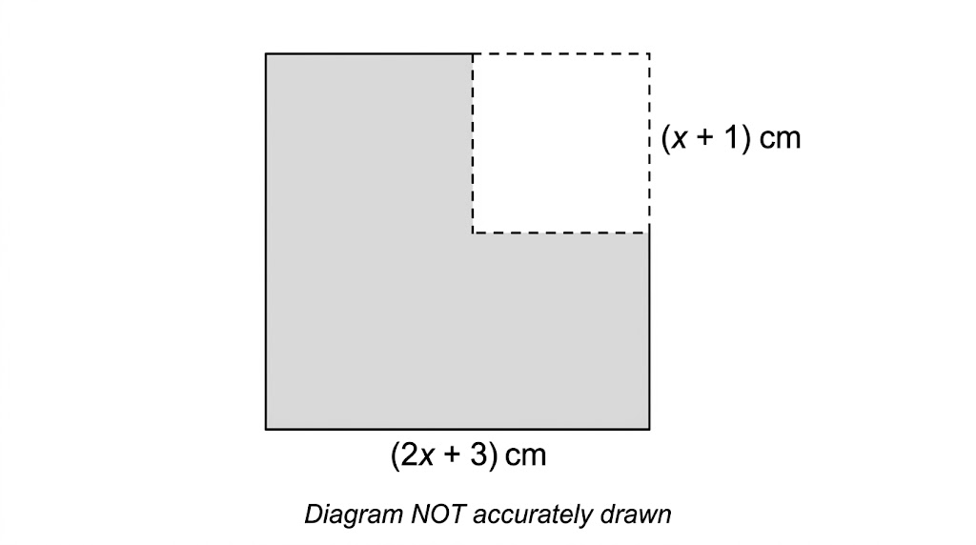
EDEXCEL GCSE MATHS · HIGHER TIER
Question 6 · 3 marks · Non-calculator · Show that
The diagram shows a square of side (2x + 3) cm with a square of side (x + 1) cm cut from one corner. Show that the shaded area, in cm², can be written as (3x + 4)(x + 2). (3 marks)
Algebra
openrevise.com
Lesson 7 of 7

Slide 33
EDEXCEL GCSE MATHS · HIGHER TIER
Question 6 · mark scheme
3 marks available. Award a mark for each point made.
(2x + 3)² − (x + 1)²
M1
Uses the difference of two squares, or expands both to reach 3x² + 10x + 8
M1
Correctly reaches (3x + 4)(x + 2)
A1
Algebra
openrevise.com
Lesson 7 of 7

