Slide 1

EDEXCEL GCSE MATHS · FOUNDATION & HIGHER
Line of best fit
Interpreting and representing data
Lesson 4 of 6
openrevise.com

Slide 2

EDEXCEL GCSE MATHS · FOUNDATION & HIGHER
Last Lesson
Answer each one, then check.
What does positive correlation mean?
1
What is an outlier?
2
Does correlation prove that one thing causes another?
3
Which correlation: temperature and hot drinks sold?
4
Interpreting and representing data
openrevise.com
Lesson 4 of 6

Slide 3
EDEXCEL GCSE MATHS · FOUNDATION & HIGHER
Last Lesson - Answers
What does positive correlation mean?
As one value increases, the other increases.
1
What is an outlier?
A value that does not fit the pattern.
2
Does correlation prove that one thing causes another?
No
3
Which correlation: temperature and hot drinks sold?
Negative
4
Interpreting and representing data
openrevise.com
Lesson 4 of 6

Slide 4

EDEXCEL GCSE MATHS · FOUNDATION & HIGHER
Learning Objectives
Draw a line of best fit on a scatter graph.
1
Use a line of best fit to estimate values (interpolation).
2
Explain why extrapolation can be unreliable.
3
Decide how reliable an estimate is.
4
Deal with outliers when drawing a line of best fit.
5
Interpreting and representing data
openrevise.com
Lesson 4 of 6

Slide 5

EDEXCEL GCSE MATHS · FOUNDATION & HIGHER
Drawing a Line of Best Fit
A line of best fit is a single straight line that follows the trend of the points.
Straight, with a ruler
One straight line - not a curve, and not dot to dot.
Through the middle
About the same number of points on each side, following the slope of the pattern.
Ignore outliers
An outlier would pull the line away from the rest.
Interpreting and representing data
openrevise.com
Lesson 4 of 6

Slide 6
EDEXCEL GCSE MATHS · FOUNDATION & HIGHER
Drawing a Line of Best Fit (cont.)
Not always from 0
The line does not have to go through the origin.
Only with correlation
If there is no correlation, there is no line of best fit.
Interpreting and representing data
openrevise.com
Lesson 4 of 6

Slide 7

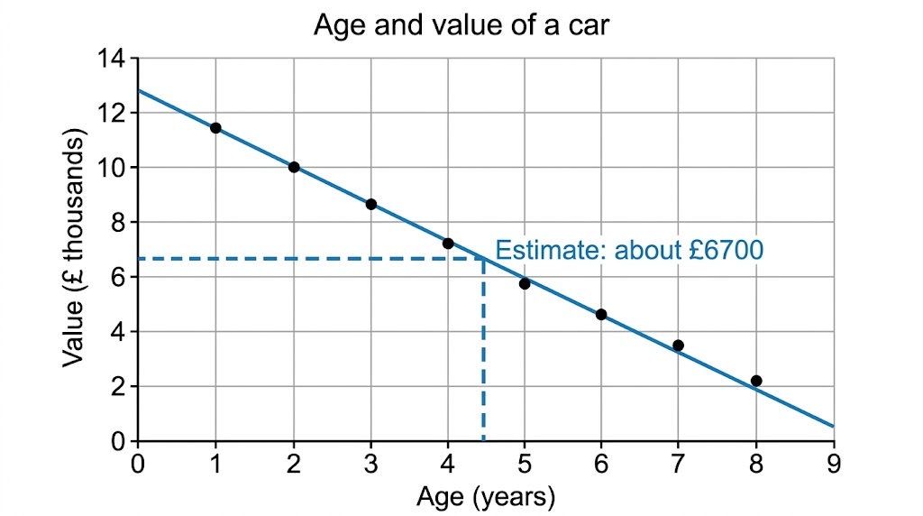
EDEXCEL GCSE MATHS · FOUNDATION & HIGHER
A Line of Best Fit in Use
To estimate a value, go from the known value to the line of best fit, then across to the other axis. Here, a car 4.5 years old is estimated to be worth about £6700. The estimate is reasonable because 4.5 years is inside the range of the data.
Up from 4.5 years, across to about £6700.
Interpreting and representing data
openrevise.com
Lesson 4 of 6

Slide 8

EDEXCEL GCSE MATHS · FOUNDATION & HIGHER
Interpolation and Extrapolation
INTERPOLATION - INSIDE THE DATA
EXTRAPOLATION - OUTSIDE THE DATA
• Estimating within the range of values you have.
• A 4.5-year-old car, when the data covers 1 to 8 years.
• Usually reliable, if the correlation is strong.
• Estimating beyond the range of values you have.
• A 15-year-old car, when the data stops at 8 years.
• Unreliable: the pattern may not continue - the line would say the car is worth less than nothing.
Interpreting and representing data
openrevise.com
Lesson 4 of 6

Slide 9

EDEXCEL GCSE MATHS · FOUNDATION & HIGHER
Using a Line of Best Fit
Use the car graph to estimate (a) the value of a car that is 4.5 years old, and (b) the age of a car worth £9000.
(a) Go up from 4.5 on the age axis to the line
then across to the value axis
1
Read the value
about 6.7 (£ thousands)
2
(b) Go across from 9 on the value axis to the line
then down to the age axis
3
Read the age
about 2.8 years
4
ANSWER
(a) About £6700 (b) About 2.8 years (accept answers close to these)
Interpreting and representing data
openrevise.com
Lesson 4 of 6

Slide 10
EDEXCEL GCSE MATHS · FOUNDATION & HIGHER
How Reliable Is the Estimate?
An estimate from a line of best fit is only as good as the data behind it.
Strong correlation
Points close to the line give more reliable estimates.
Inside the data
Interpolation is more reliable than extrapolation.
Enough data
Estimates from 30 points are more reliable than from 5.
Sensible values
A line might predict a negative price or a test score over 100 - a sign it has gone too far.
Interpreting and representing data
openrevise.com
Lesson 4 of 6

Slide 11

EDEXCEL GCSE MATHS · FOUNDATION & HIGHER
Key Terms
Line of best fit
A straight line drawn through the middle of the points on a scatter graph, following the trend.
Interpolation
Estimating a value inside the range of the data.
Extrapolation
Estimating a value outside the range of the data.
Reliable
Likely to be accurate.
Outlier
A point that does not fit the pattern, ignored when drawing the line.
Interpreting and representing data
openrevise.com
Lesson 4 of 6

Slide 12

EDEXCEL GCSE MATHS · FOUNDATION & HIGHER
YOUR TASK
15 minutes
Plot, Fit, Estimate
Ten students recorded their arm span and height, in cm: (150, 152), (155, 154), (158, 160), (162, 161), (165, 167), (168, 166), (171, 172), (175, 174), (178, 180), (182, 181). Plot a scatter graph, draw a line of best fit, estimate the height of a student with an arm span of 173 cm, and explain whether you could use the graph for an adult with an arm span of 200 cm.
1
Choose sensible scales and label the axes.
2
Plot the points and draw the line.
3
Estimate, and comment on reliability.
WHAT A GOOD ANSWER SHOWS
Strong positive correlation; the line is close to height = arm span. Estimate for 173 cm: about 173 cm. An arm span of 200 cm is outside the data (extrapolation), so the estimate would be less reliable.
Interpreting and representing data
openrevise.com
Lesson 4 of 6
Notes:
The line should run close to y = x - a nice discussion point about why arm span and height are so closely linked.

Slide 13

EDEXCEL GCSE MATHS · FOUNDATION & HIGHER
Can I...?
Draw a line of best fit.
Explain interpolation.
Leave out outliers when drawing it.
Explain extrapolation.
Estimate a y-value from an x-value.
Say why an estimate might be unreliable.
Estimate an x-value from a y-value.
Spot an estimate that makes no sense.
Interpreting and representing data
openrevise.com
Lesson 4 of 6

Slide 14
EDEXCEL GCSE MATHS · FOUNDATION & HIGHER
Summary & Exam Focus
One straight line through the middle of the points, ignoring outliers.
Up (or across) to the line, then across (or down) to read the estimate.
Interpolation is inside the data and usually reliable; extrapolation is outside it and often not.
Stronger correlation and more data give more reliable estimates.
EXAM FOCUS
Explain why it may not be sensible to use the line of best fit to estimate the score of a student who revised for 20 hours. (1 mark)
When asked to estimate from a graph, draw the lines you use on the graph. An answer in the accepted range earns the marks, and the lines show the examiner your method.
openrevise.com

Slide 15
EDEXCEL GCSE MATHS · FOUNDATION & HIGHER
Exam Practice: Line of Best Fit
Answer all questions. Draw any lines you use on the graph. · 15 minutes
Question 1 · 5 marks · Calculator
The scatter graph shows the number of hours ten students revised and their test scores. (a) One point is an outlier. Write down its…
Question 2 · 1 mark · Calculator
What is the difference between interpolation and extrapolation?
Interpreting and representing data
openrevise.com
Lesson 4 of 6

Slide 16
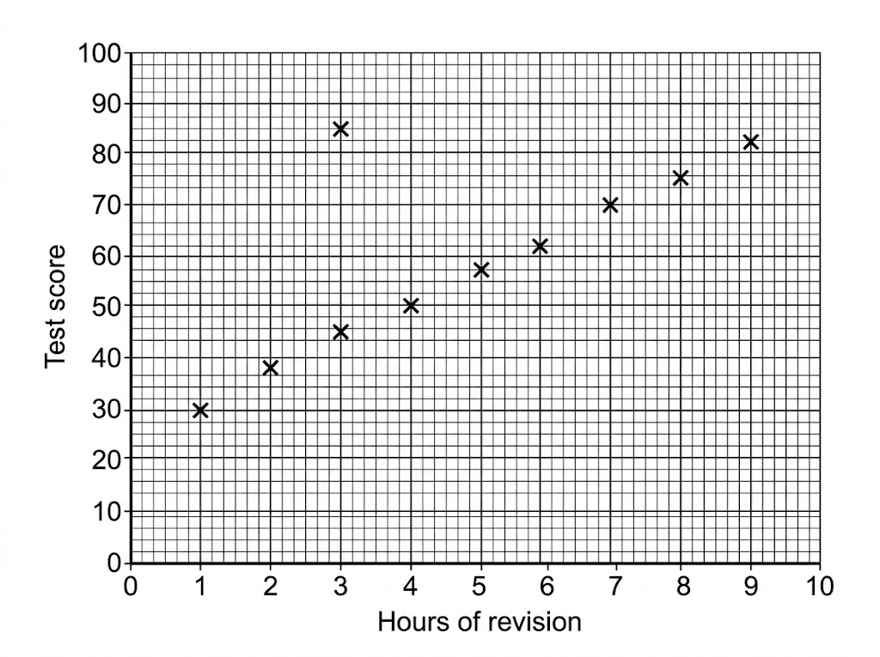
EDEXCEL GCSE MATHS · FOUNDATION & HIGHER
Question 1 · 5 marks · Calculator
The scatter graph shows the number of hours ten students revised and their test scores. (a) One point is an outlier. Write down its coordinates. (b) Draw a line of best fit on the graph. (c) Use your line to estimate the score of a student who revised for 5.5 hours. (d) Explain why it may not be… (5 marks)
Interpreting and representing data
openrevise.com
Lesson 4 of 6

Slide 17
EDEXCEL GCSE MATHS · FOUNDATION & HIGHER
Question 1 · mark scheme
5 marks available. Award a mark for each point made.
(a) (3, 85)
B1
(b) A single straight line within the band of the points, ignoring the outlier
B1
(c) Reading from their line at 5.5 hours
M1
Interpreting and representing data
openrevise.com
Lesson 4 of 6

Slide 18
EDEXCEL GCSE MATHS · FOUNDATION & HIGHER
Question 1 · mark scheme (cont.)
(c) An answer in the range 57 to 63
A1
(d) A reason such as outside the range of the data, or the score cannot exceed 100
C1
Interpreting and representing data
openrevise.com
Lesson 4 of 6

Slide 19
EDEXCEL GCSE MATHS · FOUNDATION & HIGHER
Question 2 · 1 mark · Calculator
“
What is the difference between interpolation and extrapolation?
HOW TO ANSWER IT
Command word: Calculator. Worth 1 mark, so plan before writing.
Interpreting and representing data
openrevise.com
Lesson 4 of 6

Slide 20
EDEXCEL GCSE MATHS · FOUNDATION & HIGHER
Question 2 · mark scheme
1 mark available. Award a mark for each point made.
Both described correctly
B1
Interpreting and representing data
openrevise.com
Lesson 4 of 6

