Slide 1

EDEXCEL GCSE MATHS · FOUNDATION & HIGHER
Statistical diagrams 2
Interpreting and representing data
Lesson 6 of 6
openrevise.com

Slide 2

EDEXCEL GCSE MATHS · FOUNDATION & HIGHER
Last Lesson
Answer each one, then check.
Find the median of 3, 5, 8, 10.
1
What is the range of 12, 4, 19, 7?
2
What is a modal class?
3
What is the midpoint of the class 20 < t ≤ 30?
4
Interpreting and representing data
openrevise.com
Lesson 6 of 6

Slide 3
EDEXCEL GCSE MATHS · FOUNDATION & HIGHER
Last Lesson - Answers
Find the median of 3, 5, 8, 10.
6.5 - the mean of 5 and 8.
1
What is the range of 12, 4, 19, 7?
19 − 4 = 15
2
What is a modal class?
The class with the highest frequency.
3
What is the midpoint of the class 20 < t ≤ 30?
25
4
Interpreting and representing data
openrevise.com
Lesson 6 of 6

Slide 4

EDEXCEL GCSE MATHS · FOUNDATION & HIGHER
Learning Objectives
Draw and read an ordered stem-and-leaf diagram, with a key.
1
Find averages and the range from a stem-and-leaf diagram.
2
Draw a frequency polygon for grouped data.
3
Compare two sets of data using an average and the range.
4
Recognise graphs that are misleading.
5
Interpreting and representing data
openrevise.com
Lesson 6 of 6

Slide 5

EDEXCEL GCSE MATHS · FOUNDATION & HIGHER
Stem-and-Leaf Diagrams
A stem-and-leaf diagram sorts data into order while keeping every value.
Stem and leaf
Split each value: for 73, the stem is 7 (the tens) and the leaf is 3 (the units).
Ordered
Write the leaves in order from smallest to largest along each row.
Key
Always include one, such as "7 then 3 means 73 beats per minute", written with a bar between the stem and the leaf.
Shape
Turned on its side, it looks like a bar chart of the data.
Interpreting and representing data
openrevise.com
Lesson 6 of 6

Slide 6

EDEXCEL GCSE MATHS · FOUNDATION & HIGHER
Resting Pulse Rates of 15 People
Key: 7 then 3 means 73 beats per minute.
Stem
Leaves
5
8
6
2 5 7
7
0 1 1 3 6 8
8
0 2 5
9
1 4
Interpreting and representing data
openrevise.com
Lesson 6 of 6

Slide 7

EDEXCEL GCSE MATHS · FOUNDATION & HIGHER
Reading a Stem-and-Leaf Diagram
Use the pulse rate diagram to find the median, the mode and the range.
Count the values
1 + 3 + 6 + 3 + 2 = 15, so the median is the 8th value
1
Count along the leaves to the 8th
58, 62, 65, 67, 70, 71, 71, 73
2
The mode: the only repeated value
71
3
The range: largest − smallest
94 − 58 = 36
4
ANSWER
Median 73, mode 71, range 36 beats per minute
Interpreting and representing data
openrevise.com
Lesson 6 of 6

Slide 8
EDEXCEL GCSE MATHS · FOUNDATION & HIGHER
Back-to-Back Stem-and-Leaf Diagrams
Two sets of data share one stem, with one set's leaves on each side.
Layout
The stem runs down the middle. The leaves of one set go to the right; the other set's go to the left.
Reading the left side
The leaves on the left are read from the stem outwards: a leaf 4 by stem 6 on the left means 64.
Two keys
One for each side, so there is no confusion.
Why
Two groups can be compared at a glance - for example, pulse rates before and after exercise.
Interpreting and representing data
openrevise.com
Lesson 6 of 6

Slide 9

EDEXCEL GCSE MATHS · FOUNDATION & HIGHER
PART TWO
Frequency Polygons
Grouped data drawn as a line.
openrevise.com

Slide 10

EDEXCEL GCSE MATHS · FOUNDATION & HIGHER
Drawing a Frequency Polygon
A frequency polygon plots the midpoint of each class against its frequency.
Midpoints
Work out the midpoint of each class.
Plot
Plot (midpoint, frequency) for each class.
Join
Join the points with straight lines. Do not join the last point back to the first.
Compare
Two frequency polygons on the same axes compare two sets of data clearly.
Interpreting and representing data
openrevise.com
Lesson 6 of 6

Slide 11

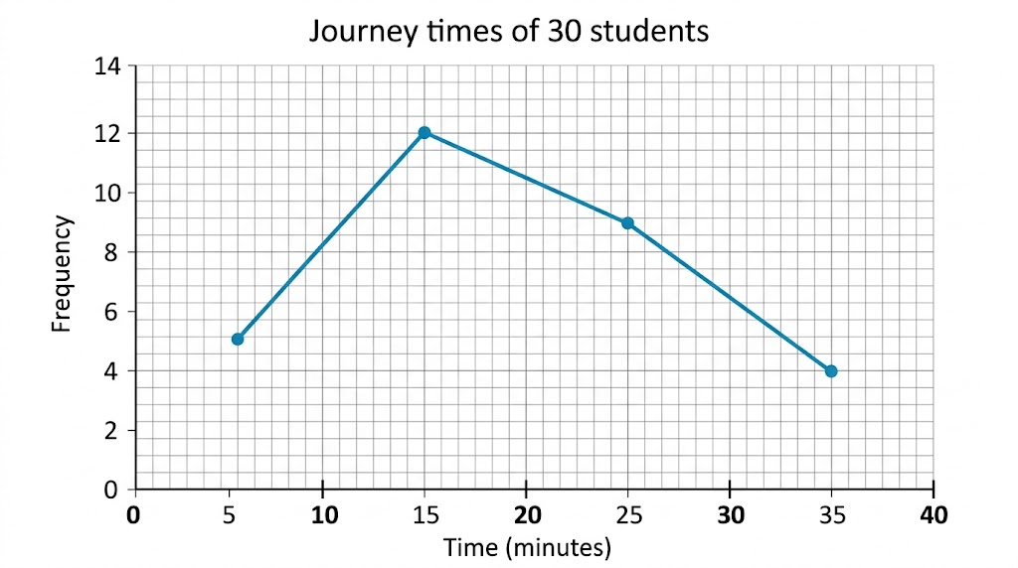
EDEXCEL GCSE MATHS · FOUNDATION & HIGHER
A Frequency Polygon
This is the journey time data from last lesson. The peak at 15 minutes shows the modal class, 10 < t ≤ 20, straight away. Drawing a second polygon on the same axes - say, for another year group - would let you compare the two.
Each point sits above the middle of its class.
Interpreting and representing data
openrevise.com
Lesson 6 of 6

Slide 12

EDEXCEL GCSE MATHS · FOUNDATION & HIGHER
Comparing Distributions
To compare two sets of data, always compare an average AND a measure of spread - in context.
An average
"The median pulse rate after exercise (112) is higher than before (73), so pulse rates were higher on average after exercise."
The spread
"The range after exercise (22) is smaller than before (36), so the pulse rates after exercise were more consistent."
In context
Use the words of the question: "pulse rates", not "the data".
Two sentences
One for the average, one for the spread - that is what most mark schemes want.
Interpreting and representing data
openrevise.com
Lesson 6 of 6

Slide 13
EDEXCEL GCSE MATHS · FOUNDATION & HIGHER
PART THREE
Misleading Graphs
How a graph can give the wrong impression.
openrevise.com

Slide 14
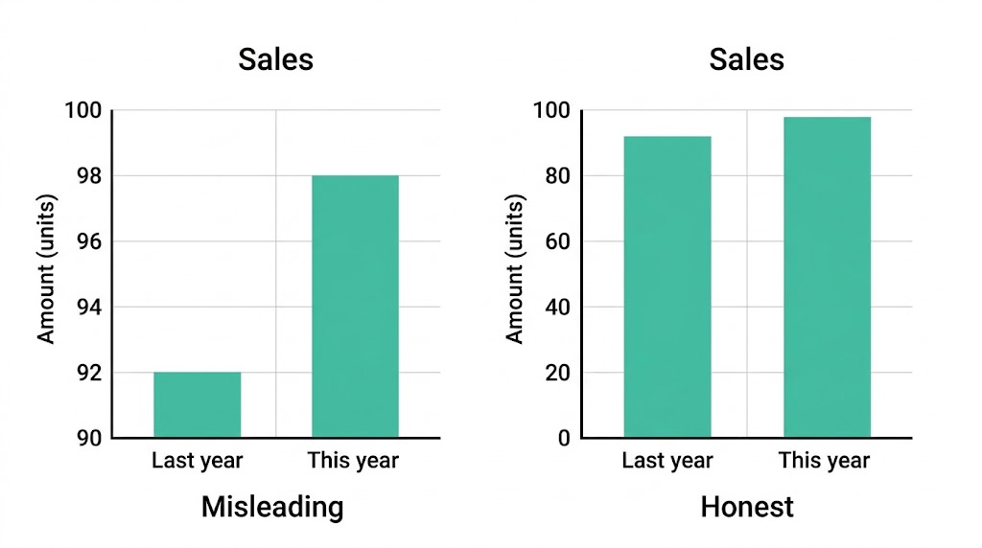
EDEXCEL GCSE MATHS · FOUNDATION & HIGHER
Spot the Trick
Sales rose from 92 to 98 - about 6%. Start the axis at 90 and the rise looks enormous. Look out for axes that do not start at zero, uneven scales, missing labels, and 3D charts that make the nearest sections look bigger.
The same numbers, two very different impressions.
Interpreting and representing data
openrevise.com
Lesson 6 of 6

Slide 15

EDEXCEL GCSE MATHS · FOUNDATION & HIGHER
Key Terms
Stem-and-leaf diagram
A diagram that orders data by splitting each value into a stem and a leaf.
Key
The line that explains how to read a diagram, e.g. 7 then 3 means 73.
Frequency polygon
A graph joining points plotted at the midpoints of classes against their frequencies.
Distribution
How the values of a set of data are spread out.
Misleading graph
A graph that gives a false impression of the data.
Interpreting and representing data
openrevise.com
Lesson 6 of 6

Slide 16

EDEXCEL GCSE MATHS · FOUNDATION & HIGHER
YOUR TASK
15 minutes
Before and After
Measure your resting pulse for 15 seconds and multiply by 4. Then do 1 minute of star jumps and measure it again. Collect the class results and draw a back-to-back stem-and-leaf diagram of "before" and "after". Find the median and range of each, and write two sentences comparing them.
1
Collect the data.
2
Draw the back-to-back diagram with keys.
3
Find the median and range of each.
Compare in two sentences.
4
WHAT A GOOD ANSWER SHOWS
A back-to-back diagram with ordered leaves and two keys; medians and ranges for both sets; one comparison of the medians and one of the ranges, both in context.
Interpreting and representing data
openrevise.com
Lesson 6 of 6
Notes:
Any student who should not exercise can record and plot the data instead.

Slide 17

EDEXCEL GCSE MATHS · FOUNDATION & HIGHER
Can I...?
Draw an ordered stem-and-leaf diagram with a key.
Compare two data sets using an average.
Find the median and range from a stem-and-leaf diagram.
Compare two data sets using the range.
Read a back-to-back stem-and-leaf diagram.
Write comparisons in context.
Draw a frequency polygon.
Explain why a graph is misleading.
Interpreting and representing data
openrevise.com
Lesson 6 of 6

Slide 18
EDEXCEL GCSE MATHS · FOUNDATION & HIGHER
Summary & Exam Focus
Stem-and-leaf: ordered leaves and a key; it keeps every value.
Frequency polygon: plot (midpoint, frequency) and join with straight lines.
Compare with an average AND a measure of spread, in context.
Misleading graphs: check that the axes start at zero and the scales are even.
EXAM FOCUS
Compare the times taken by the two groups. (2 marks)
Two marks means two comparisons: one about an average (which is higher) and one about the spread (which is more consistent), both in the context of the question.
openrevise.com

Slide 19
EDEXCEL GCSE MATHS · FOUNDATION & HIGHER
Exam Practice: Statistical Diagrams 2
Answer all questions. Show your working. All questions are non-calculator. · 20 minutes
Question 1 · 3 marks · Non-calculator
Here are the times, in seconds, that 12 students took to solve a puzzle: 23, 35, 41, 28, 32, 45, 38, 26, 31, 40, 36, 29. Draw an ordered…
Question 2 · 2 marks · Non-calculator
For the puzzle times in the last question, find (a) the median (b) the range.
Question 3 · 2 marks · Non-calculator
A second group of students solved the same puzzle. Their median time was 38 seconds and their range was 15 seconds. Compare the times of…
Interpreting and representing data
openrevise.com
Lesson 6 of 6

Slide 20
EDEXCEL GCSE MATHS · FOUNDATION & HIGHER
Exam Practice: Statistical Diagrams 2 (cont.)
Question 4 · 2 marks · Non-calculator
A company used this graph in an advert to show that its sales had "soared". Give two reasons why the graph is misleading.
Question 5 · 2 marks · Non-calculator
The table shows the heights, h cm, of 25 plants. 0 < h ≤ 10: 3 plants. 10 < h ≤ 20: 8 plants. 20 < h ≤ 30: 10 plants. 30 < h ≤ 40: 4…
Interpreting and representing data
openrevise.com
Lesson 6 of 6

Slide 21
EDEXCEL GCSE MATHS · FOUNDATION & HIGHER
Question 1 · 3 marks · Non-calculator
“
Here are the times, in seconds, that 12 students took to solve a puzzle: 23, 35, 41, 28, 32, 45, 38, 26, 31, 40, 36, 29. Draw an ordered stem-and-leaf diagram to show this information.
HOW TO ANSWER IT
Command word: Non-calculator. Worth 3 marks, so plan before writing.
Interpreting and representing data
openrevise.com
Lesson 6 of 6

Slide 22
EDEXCEL GCSE MATHS · FOUNDATION & HIGHER
Question 1 · mark scheme
3 marks available. Award a mark for each point made.
A correct stem-and-leaf diagram with the leaves in order
B2
A correct diagram with the leaves not in order, or one error
B1
A correct key
B1
Interpreting and representing data
openrevise.com
Lesson 6 of 6

Slide 23
EDEXCEL GCSE MATHS · FOUNDATION & HIGHER
Question 2 · 2 marks · Non-calculator
“
For the puzzle times in the last question, find (a) the median (b) the range.
HOW TO ANSWER IT
Command word: Non-calculator. Worth 2 marks, so plan before writing.
Interpreting and representing data
openrevise.com
Lesson 6 of 6

Slide 24
EDEXCEL GCSE MATHS · FOUNDATION & HIGHER
Question 2 · mark scheme
2 marks available. Award a mark for each point made.
(a) 33.5
B1
(b) 22
B1
Interpreting and representing data
openrevise.com
Lesson 6 of 6

Slide 25
EDEXCEL GCSE MATHS · FOUNDATION & HIGHER
Question 3 · 2 marks · Non-calculator
“
A second group of students solved the same puzzle. Their median time was 38 seconds and their range was 15 seconds. Compare the times of the two groups.
HOW TO ANSWER IT
Command word: Non-calculator. Worth 2 marks, so plan before writing.
Interpreting and representing data
openrevise.com
Lesson 6 of 6

Slide 26
EDEXCEL GCSE MATHS · FOUNDATION & HIGHER
Question 3 · mark scheme
2 marks available. Award a mark for each point made.
A correct comparison of the medians, in context
C1
A correct comparison of the ranges, in context
C1
Interpreting and representing data
openrevise.com
Lesson 6 of 6

Slide 27
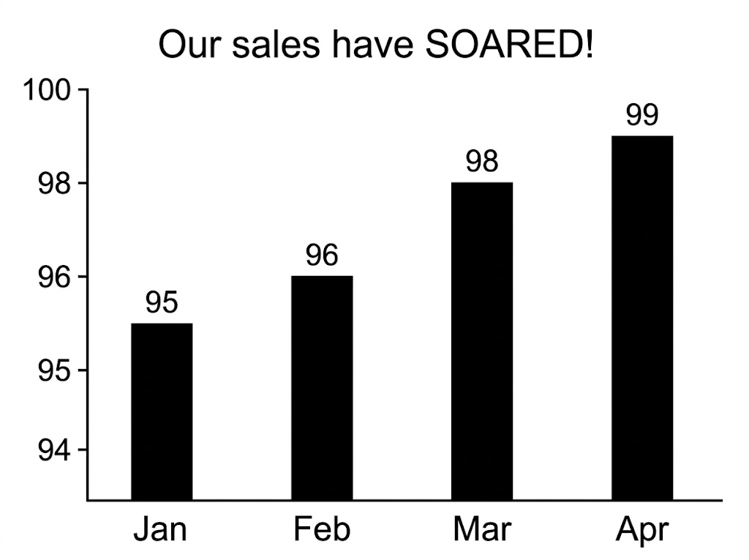
EDEXCEL GCSE MATHS · FOUNDATION & HIGHER
Question 4 · 2 marks · Non-calculator
A company used this graph in an advert to show that its sales had "soared". Give two reasons why the graph is misleading. (2 marks)
Interpreting and representing data
openrevise.com
Lesson 6 of 6

Slide 28
EDEXCEL GCSE MATHS · FOUNDATION & HIGHER
Question 4 · mark scheme
2 marks available. Award a mark for each point made.
One valid reason, e.g. the axis does not start at 0
C1
A second valid reason, e.g. no axis label, or an uneven scale
C1
Interpreting and representing data
openrevise.com
Lesson 6 of 6

Slide 29
EDEXCEL GCSE MATHS · FOUNDATION & HIGHER
Question 5 · 2 marks · Non-calculator
“
The table shows the heights, h cm, of 25 plants. 0 < h ≤ 10: 3 plants. 10 < h ≤ 20: 8 plants. 20 < h ≤ 30: 10 plants. 30 < h ≤ 40: 4 plants. Write down the coordinates of the points you would plot to draw a frequency polygon.
HOW TO ANSWER IT
Command word: Non-calculator. Worth 2 marks, so plan before writing.
Interpreting and representing data
openrevise.com
Lesson 6 of 6

Slide 30
EDEXCEL GCSE MATHS · FOUNDATION & HIGHER
Question 5 · mark scheme
2 marks available. Award a mark for each point made.
All four points correct
B2
Midpoints correct, or at least two points correct
B1
Interpreting and representing data
openrevise.com
Lesson 6 of 6

